Slide 1

A Conformal Decomposition
Finite Element Method with
Guaranteed Quality Dynamic Discretization
Richard M. J. Kramer and David R. Noble
Sandia National Laboratories
Albuquerque, New Mexico, USA
MultiMat 2015, September 2015

Slide 2
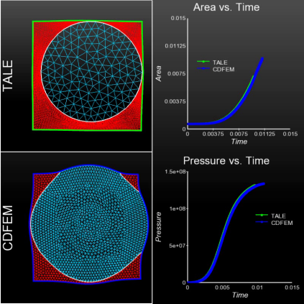
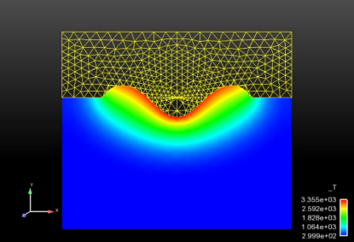
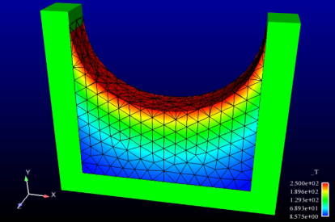
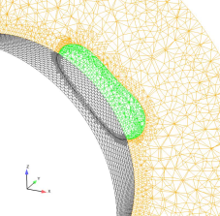
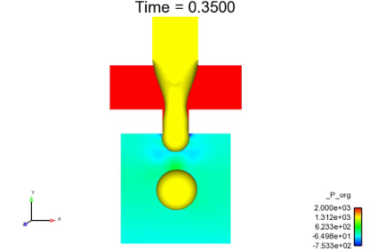
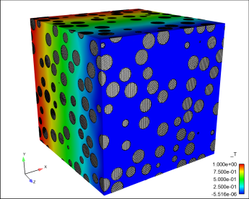
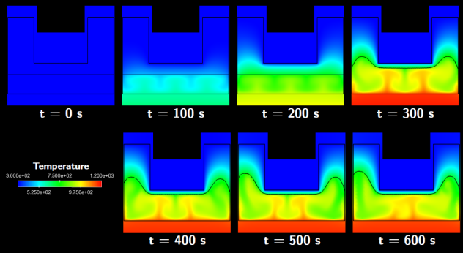
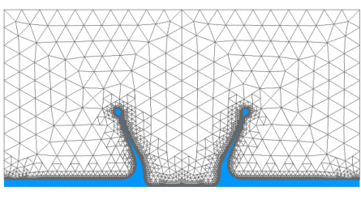
Motivation
Many problems of interest
have moving or topologically
complex interfaces with
discontinuous physics
and fields
Laser welding
Conductive burn
of energetic materials
Material death
Transport in topologically complex
domains including composite
energetic materials and batteries
Organic Material Decomposition (OMD)
with coupled porous and low Mach flow
Capillary Hydrodynamics

Slide 3
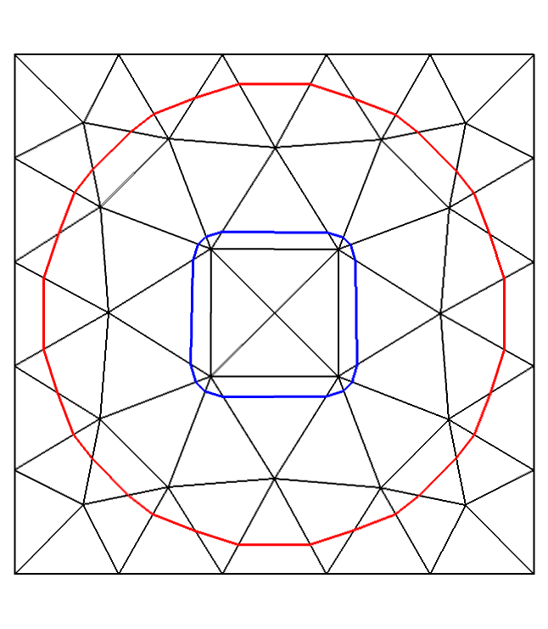
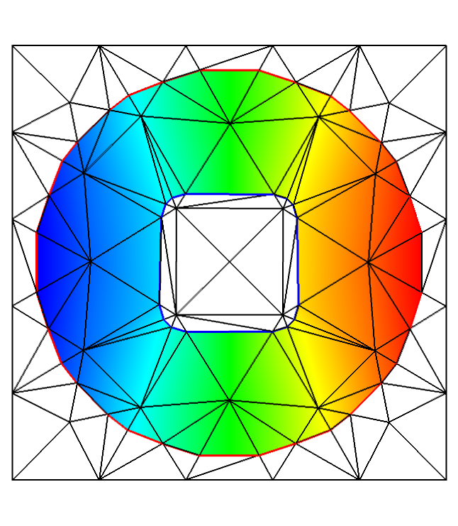
Conformal Decomposition FEM
An adaptive enrichment/refinement idea:
  Use level set(s) to define interfaces on a background
  non-conforming mesh
  Dynamically decompose non-conformal elements
  into conforming sub-elements
  Solve the problem on the conforming elements
Features:
  Designed for triangular and tetrahedral meshes
  Reuse standard FEM data structures, assembly,
  interpolation & quadrature
  Supports variety of interfacial conditions
  Supports general topological evolution
See Noble, et al. IJNMF (2010)

Slide 4
CDFEM vs. XFEM
XFEM Approximation
CDFEM Approximation
CDFEM contains the XFEM space:
  CDFEM can be constrained to be identical to the std. XFEM space
  Appropriately enriched and constrained XFEM can be mapped to CDFEM by linear transformation
  Convergence and accuracy follow from FEM theory
Notes:
Because XFEM is better known that CDFEM, it is useful to compare the discretizations. In XFEM, all unknowns are associated with the existing nodes of the input element. When an interface passes through an element, additional unknowns are added to the existing nodes in order to describe all of the materials present in the element. In contrast, CDFEM enriches the element by adding nodes on the interface between the materials.
These two discretizations can be made equivalent by constraining the CDFEM nodes to agree with values interpolated from the XFEM discretization. In this way, the discrete space of CDFEM contains the discrete space of XFEM. This has consequences for accuracy and boundary conditions. CDFEM is at least as accurate as XFEM with Heaviside enrichment. Dirichlet and flux boundary conditions are both readily applied in CDFEM, but can be challenging in XFEM.

Slide 5
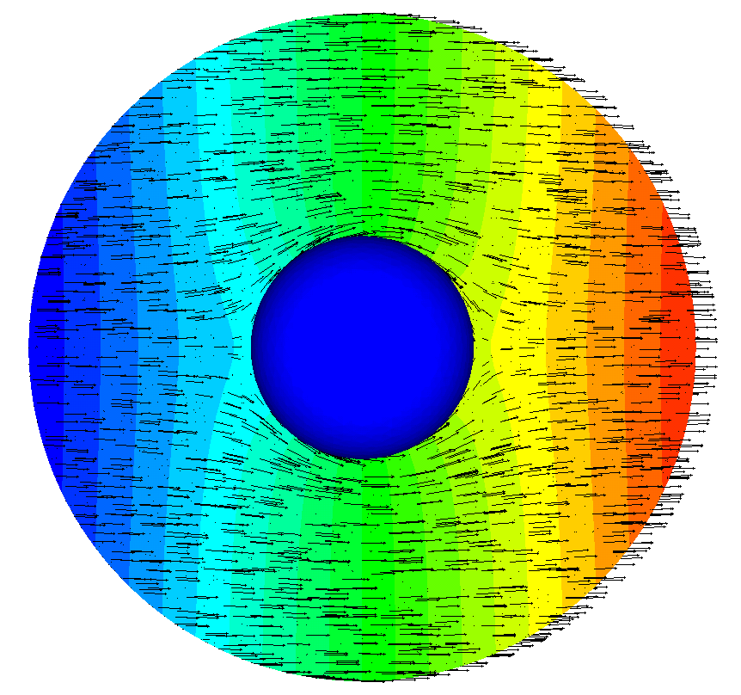
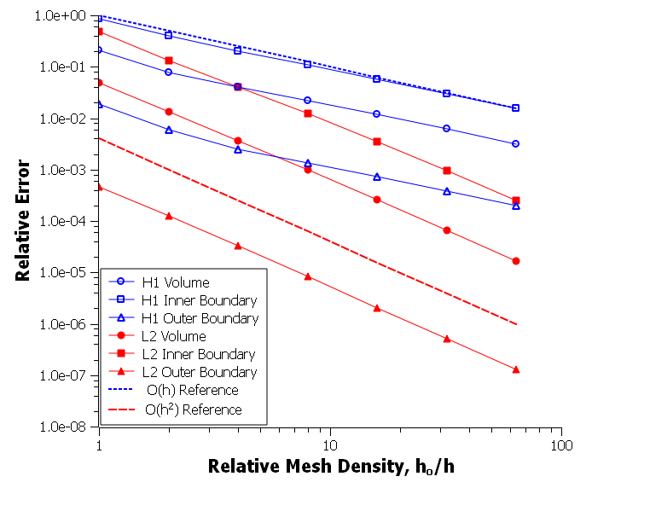
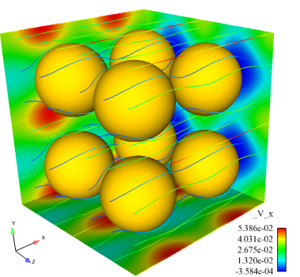
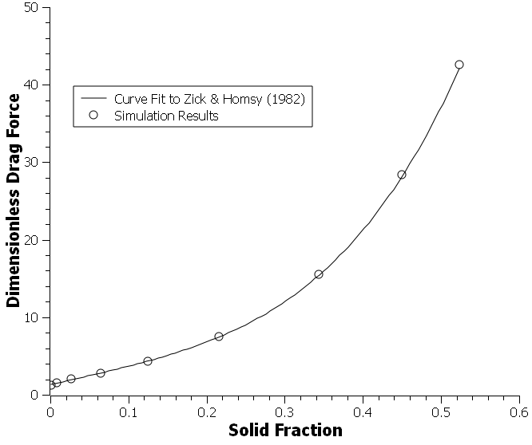
Static CDFEM verification
Steady potential flow about a sphere
Steady viscous flow about a periodic array of spheres
Embedded curved boundaries
Optimal convergence rates obtained on volume
and boundaries
  Multiple embedded curved boundaries
  Accurate close to packing limit
  Sum of nodal residuals accurately measure drag force

Slide 6
Dynamic interfaces
Consider a scalar advection-diffusion problem:
  Level set evolution:
  Arbitrary discontinuity permitted across the interface (φ = 0)
Moving interfaces bring challenges:
  How do we preserve discontinuities?
  What happens when nodes change material?

Slide 7
ALE-type mesh motion
Use a local mesh velocity defined from interface motion to derive time derivatives at desired locations in space:
  Mesh velocity definition
Tilde quantities are projected
from point nearest x on the last
interface (and on the same side)
  Avoids projecting gradients
Extends to 2nd-order BDF2
time integration

Slide 8
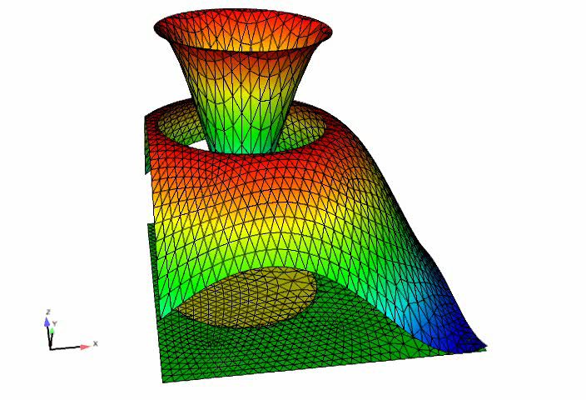
Advection-diffusion demonstration
2-D manufactured test problem:
  Strong discontinuity, fixed jump interface condition
  Piecewise diffusion coefficient
Converges at second-order in space and time using the BDF2 time integrator

Slide 9
What about low quality elements?
Conformal cutting procedure permits
arbitrarily bad elements:
  Infinitesimal edge lengths
  Arbitrary aspect ratios (small angles)
  Introduces large angles, potentially up to 180°
Consequences:
  Explicit problems – small time step
  Implicit problems – poor matrix conditioning
  Large interpolation and approximation errors
Questions:
  How serious are these issues?
  What can be done to mitigate them?
Good secondary cut
(cuts largest angle)
Bad secondary cut
(sliver element)

Slide 10
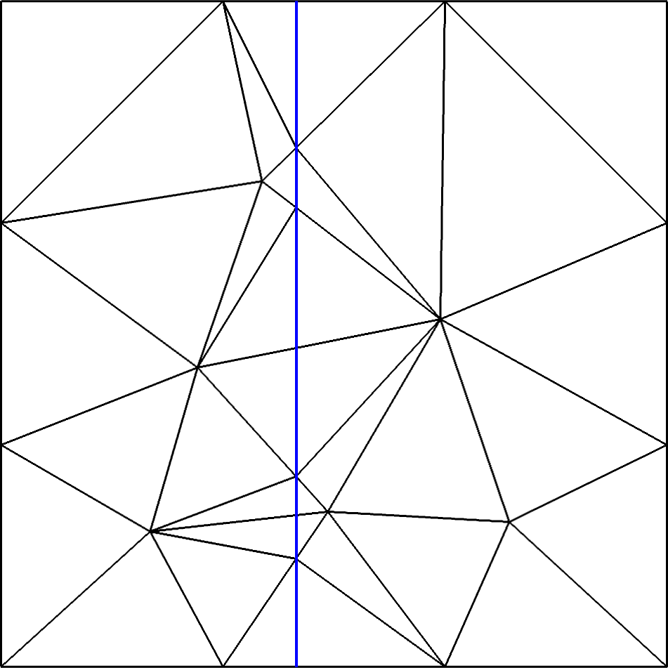
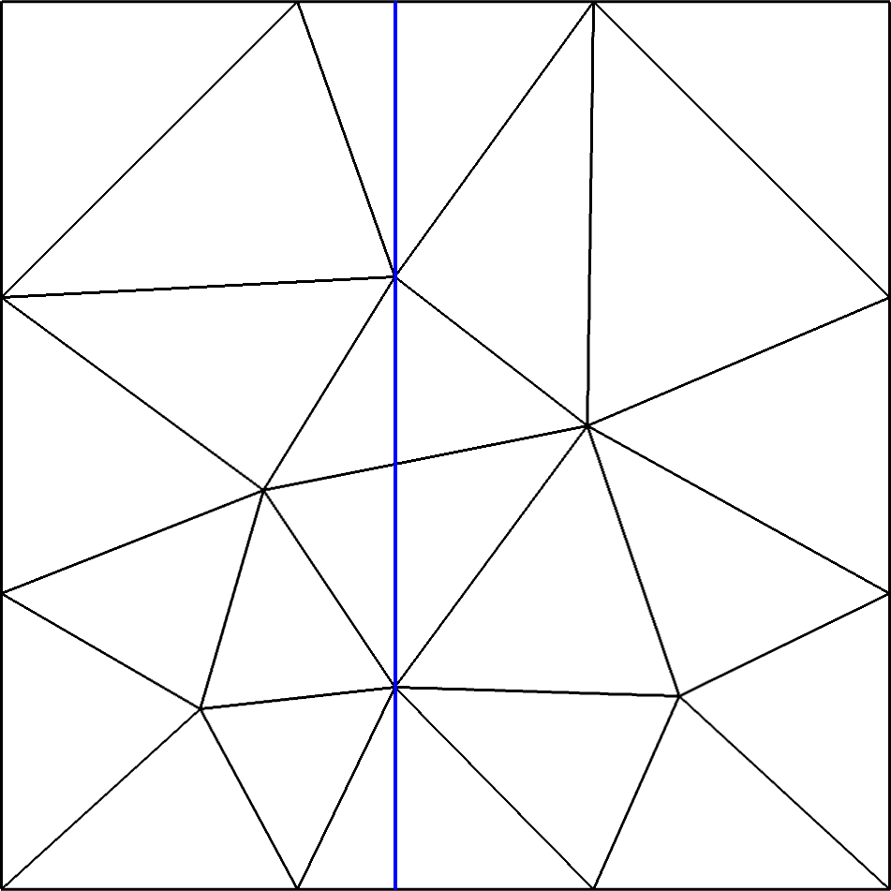
Snapping to the interface
A simple fix:
  Determine edge cut locations by intersecting
  parent mesh edges with the level set
  When any edges of a node are cut below a
  specified ratio, move that node to the closest
  edge cut location, so snapping the background
  mesh node to the interface (•→•)
Related work:
  Moës et al. (2002) – Snapping interface to nodes
  with XFEM
  Labelle & Shewchuk (2007) – Isosurface stuffing
  to guarantee quality surface-conforming meshes
  Rangarajan & Lew (2012) – Universal meshes for
  guaranteed quality conforming triangulations

Slide 11
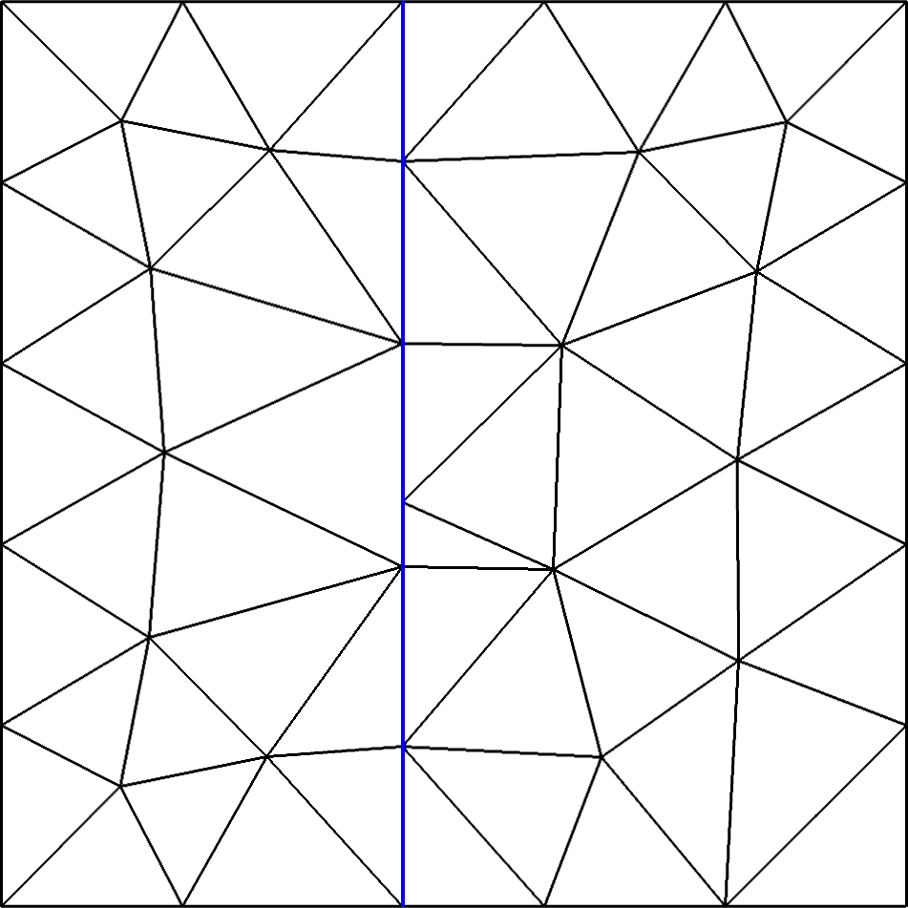
Choosing the Edge Snap Tolerance
Limits on the snapping tolerance:
  Avoid degenerate elements
  If tolerance is too high, all nodes of an element
  could snap to the interface
Geometric analysis:
  Tolerance α, in terms of max. nodal edge length ratio, r
C
C
F
D
E
B
A
A
E
B
H
G
F
D

Slide 12
Quality Measures
Quantifying the mesh quality improvement from snapping
  Normalized inverse minimum edge length:
  Element quality (Berzins, 1998):
Expectations:
  Triangular mesh
  Tetrahedral mesh
Triangles:
Tets:

Slide 13
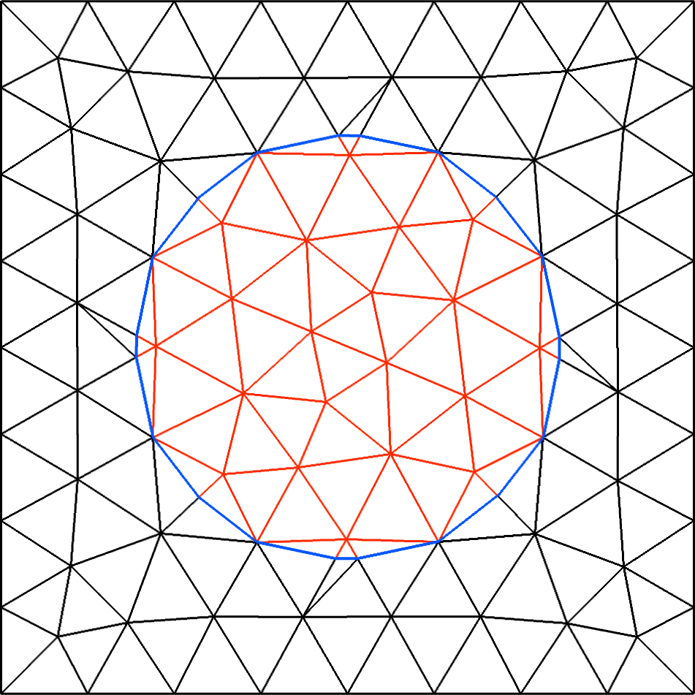
Effect on matrix conditioning (2D)
Test:
  Examine 500 decompositions for circular interface of random radius
  Evaluate minimum edge length and condition number of Laplacian matrix
Results:
  Condition number strongly correlates with minimum edge length
  Snapping keeps condition number of enriched system to small factor of base matrix – without snapping, condition number can be 100,000x larger

Slide 14
Effect on interpolation error (2D)
Test:
  Examine 500 decompositions for circular interface of random radius
  Evaluate mesh quality Q_{w} and interpolation error for
Results:
  Interpolation errors hardly vary with mesh quality in either norm
  Snapping dramatically improves element quality; slight increase in error due to slightly larger element sizes

Slide 15
Conformal decomposition in 3D
Optimally decomposing triangles is easy: cut largest angle
Cut tetrahedra in 3D have multiple quad faces
To cut the wedge(s) into tetrahedra:
  Choose diagonals to cut largest angles (like 2D)
    Can generate a Schönhardt polyhedron
    Requires floating point comparisons
  Choose diagonals based on global vertex ID’s
    Very robust: only integer comparisons
    No guarantee of angle optimality
1 tet + 1 wedge
3 quad faces
2 wedges
5 quad faces
Valid wedge face cuts
Schönhardt polyhedron:
Not tetrahedralizable

Slide 16
Effect on matrix conditioning (3D)
Test:
  Examine 50-100 decompositions for spherical interface of random radius
  Evaluate minimum edge length and condition number of Laplacian matrix
Results:
  As in 2D: condition number strongly correlates with minimum edge length
  Snapping has far greater effect than cutting strategy: can use easier cutting method without significant cost to matrix conditioning

Slide 17
Effect on interpolation error (3D)
Test:
  Examine 100 decompositions for spherical interface of random radius
  Evaluate mesh quality Q_{w} and interpolation error for
Results:
  Face angle cutting modestly reduces H₁ error, little effect on mesh quality
  Snapping has far greater effect than cutting strategy

Slide 18
Other error questions…
Convergence
Gradient L∞ error
Error reduction due to mesh refinement overwhelms all other effects (in L₂ or H₁)
Supported by verification studies
  Potentially unbounded as smallest angle goes to zero
  Cutting method and snapping have a significant effect

Slide 19
Summary
Conformal Decomposition Finite Element Method (CDFEM)
  Effective approach for enriching dynamic interface problems
  Simplicial decomposition encapsulates enrichment from physics
Captures dynamic interface motion
  Using ideas from ALE to define mesh motion when interface moves
  Preserves discontinuities and converges at expected rates
Guarantee quality by snapping nodes to interface
  Impact on mesh quality and matrix conditioning is dramatic
  Minimal effect on interpolation errors
Examined cutting strategies in 3D
  Snapping to interface allows simpler ID-based strategy to be used

