Slide 1
A UQ Enabled Aluminum Tabular Multiphase Equation-of-State Model
Allen C. Robinson, John H. Carpenter, Bert Debusschere
Sandia National Laboratories
MultiMat 2015
Sept 7-11, 2015, Würzburg, Germany

Slide 2
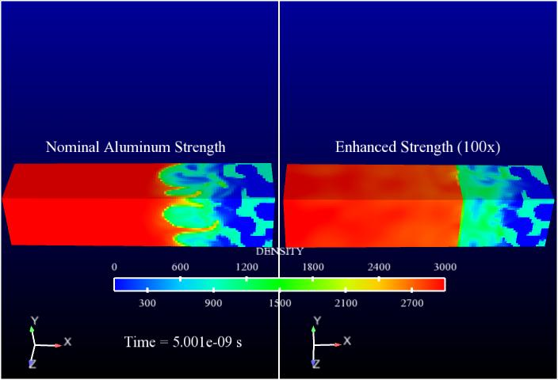
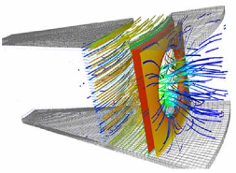
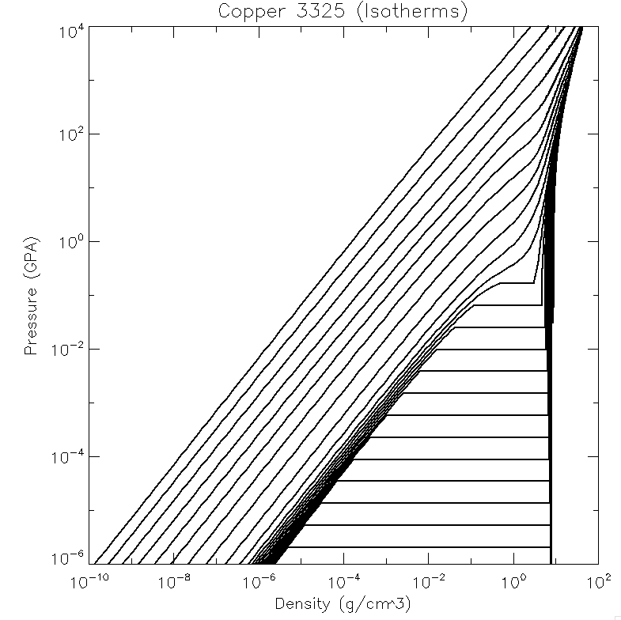
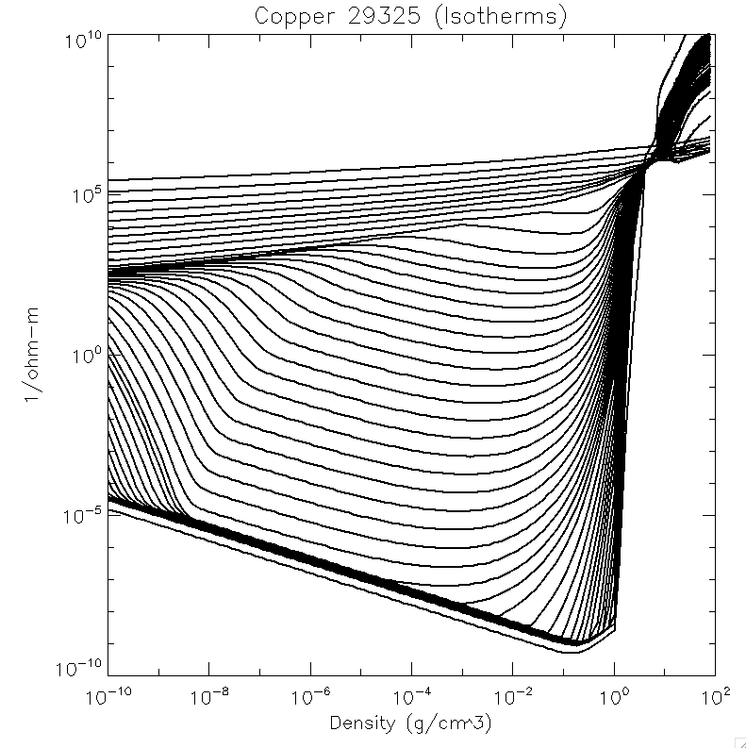
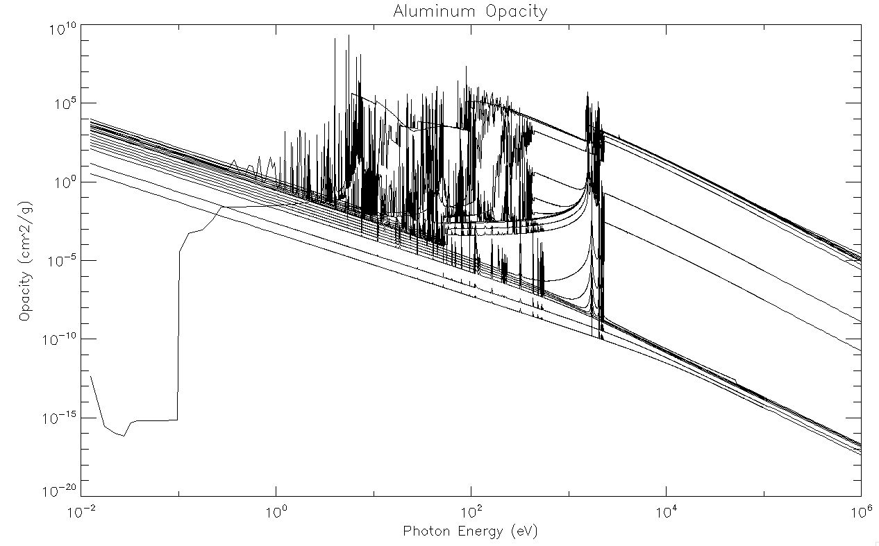
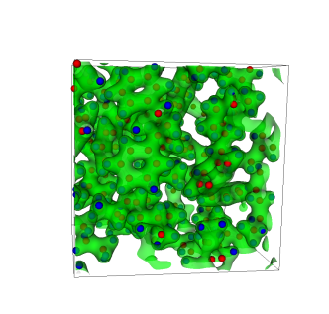
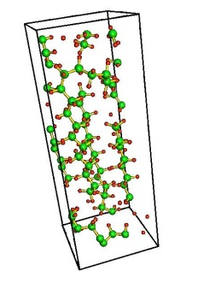
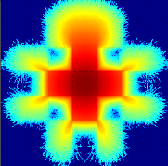
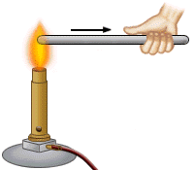
Material models determine the outcome of radiation- magneto-hydrodynamic simulations
Hydrodynamics
The hydrodynamics moves material based on the material properties.
Magnetics
Equation of State
Conductivity
Chris Garasi, SNL
Tom Haill, SNL
Conductivity determines magnetic
field diffusion.
Most simulation codes will tally the total energy in each cell and, based on that energy and the density, compute a new pressure and temperature in preparation for the next hydrodynamic step.
Radiation
Conduction
Opacity
Radiation is an important energy transfer mechanism for hot systems
Nuclear Mathematical and Computational Sciences: A Century in Review, A Century anew
Thermal conduction is used to augment the movement of energy in a simulation.
Tom Brunner, LLNL
Notes:
This slide illustrates the multi-physics aspect of many of our simulations.
The different material models determine the outcome of all simulations, it is so obvious that it is often taken for granted that they work.
Simulations of high fidelity require very high quality material models – there is no way around it.
The goal of high-quality simulations is a relay between material models, algorithms, meshing, and computational resources.
Having a validated, high-fidelity material model makes is possible to look for improvements elsewhere.
And the opposite is true too, using material models from 30 to 100 years ago (early sesame and Mie-Gruneisen, respectively) on today’s peta flop computers is not the way to do it.

Slide 3
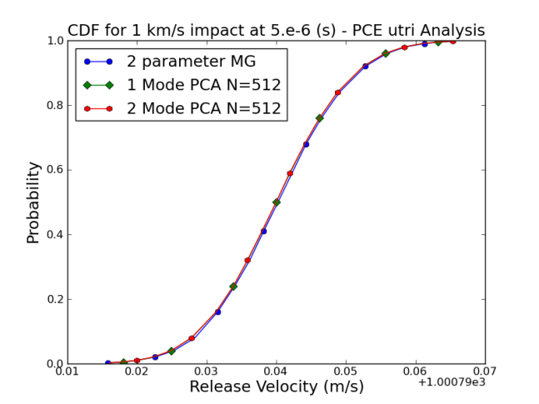
During modeling process, information on closure property uncertainty must be captured and propagated.
Goal: The analyst running the continuum code should easily get distributionally based information on any chosen Quantity of Interest (QOI).
Goal: All pathways should be connected in a unified engineering process and iteratively improved. Upscaling bridges must be built with embedded UQ information.
We wish to propagate uncertainty due to statistically equivalent possible EOS fits to the same data, to the analyst.
Notes:
This particular problem is an aluminum plate at 1 km/s hitting an aluminum target and the quantity plotted is the cumulative distribution function (CDF) of the free surface velocity. There is a 50% chance that the release velocity is less than 0.04 +1.000079e3 m/s. And about 90% chance it is below 0.055 + 1.00079e3 m/s.

Slide 4
Our approach to solving this problem
Robinson, Berry, Carpenter, Debusschere, Drake, Mattsson, Rider, “Fundamental issues in the representation and propagation of uncertain equation of state information in shock hydrodynamics”, Computers and Fluids, 83, (2013) p. 187–193.
Software Package | Output
EOS model library and data | Proposal Model (XML input deck)
Bayesian Inference using Markov Chain Monte Carlo | Extensive sampling of the posterior distribution function (PDF)
EOS Table Building | Topologically equivalent tables for each sample
PCA Analysis | Mean EOS table + most significant perturbations
Hydrocode + Dakota | Cumulative Distribution Function (CDF) for quantities of interest
History and Context: This work has been supported at Sandia since FY11 and the basic ideas have not changed much from the beginning but working out the operational , production quality details for multiphase EOS has been very challenging.

Slide 5
Multiphase EOS model for Aluminum
Key Requirement:
  All expert knowledge of EOS construction and proper behavior must be encoded into the xml input file and associated software. (Reproducible!)
  This enables later steps to complete since these assume correct EOS behavior
Wide range AL EOS is built from semi-empirical models, with solid and liquid phases including melt/vaporization/sublimation.
37 total parameters, 25 constrained well enough by data for inferring UQ information.
16 Data Sources from:
  Hugoniot experiments and calculations
  Isobaric and thermophysical expansion data
  DFT-MD isotherms near critical point
  Diamond Anvil Cell compression data
  DFT cold curve
  Melt and vaporization experiments and calculations
Constraints on physicality: smoothness and convexity change limitations along phase boundaries; thermodynamic stability checks across range of interest
5

Slide 6
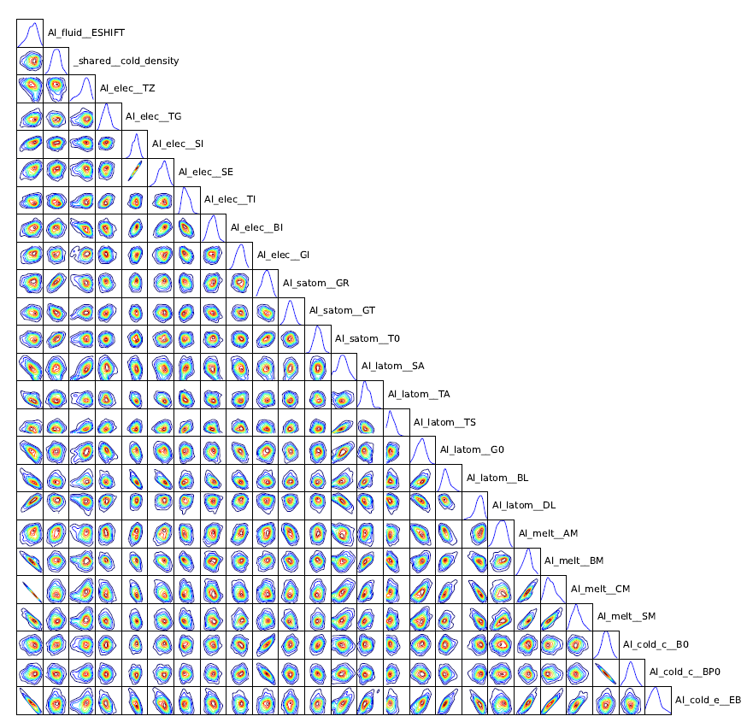
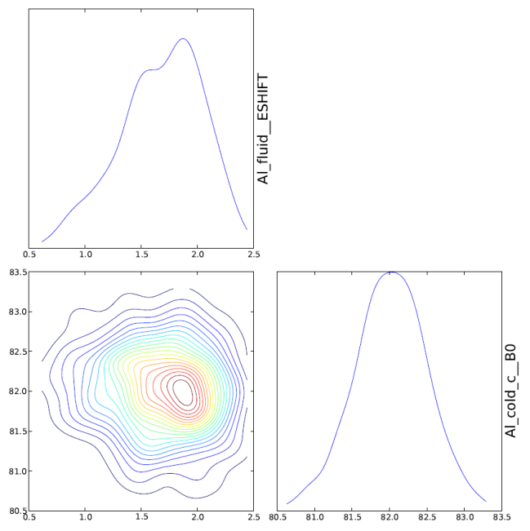
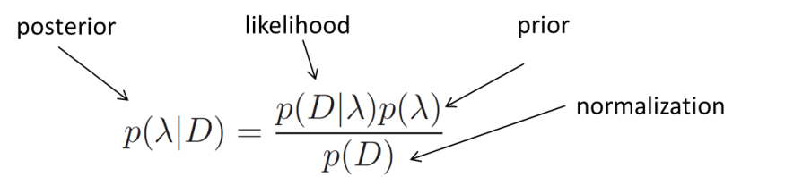
Al EOS Model Parameter Bayesian Inference for Posterior
A marginal distribution
Data sources appear in likelihood with a noise model.
Use adaptive Markov Chain Monte Carlo (MCMC) scheme to reduce the number of steps
Use optimization to find Maximum A Posteriori (MAP) parameters from which to start chain
Each posterior evaluation is roughly equivalent to generating an entire EOS table and having an expert check it for correct behavior!
PDF evaluations may be parallelized to enable long chains (~4.5M steps for this EOS, one serial evaluation is approximately 2 sec.)
Bottom Line: The inference process is costly.
6
Notes:
Bayes’ rule terms:
Prior – encodes prior information and expert opinion and is often “discovered” along the way
Likelihood – how likely is data for given parameter values (encodes the uncertainty information of the data)
Posterior – the probability of parameter values after updating with the data
MCMC is a serial process, but prior and likelihood evaluation can be parallelized to some degree
Al model includes stability and smoothness conditions across the range of
interest in the prior, as well as 16 sets of data in the likelihood

Slide 7
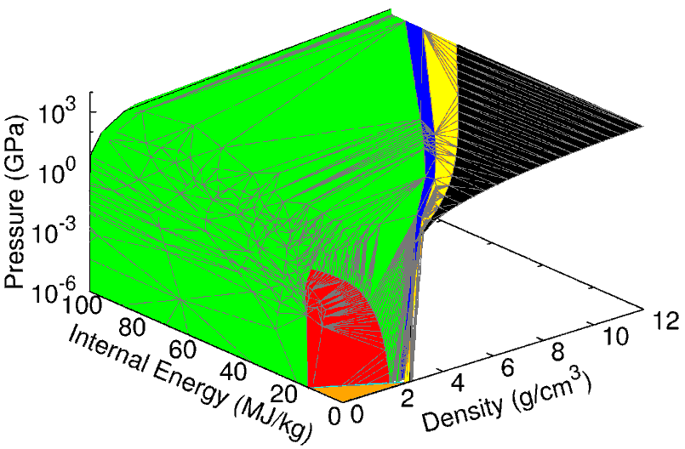
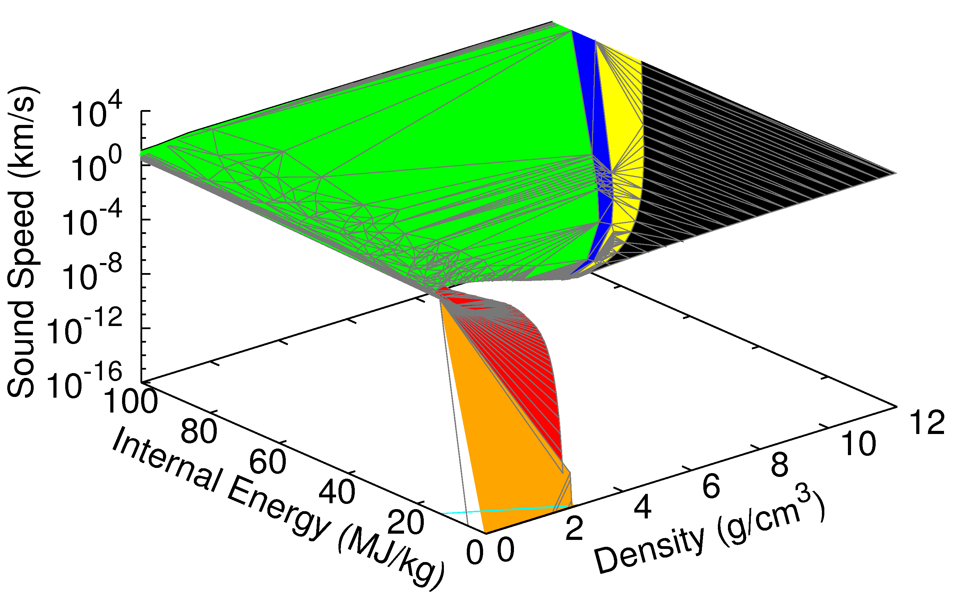
UTri EOS tables accurately match the model
UTRI tabular format
Triangular mesh e.g. (density, energy) with all other thermodynamic quantities and their derivatives tabulated at the mesh nodes.
Mesh nodes added to reduce error below tolerance with respect to model.
Accurate EOS tables correctly represent the thermodynamic sound speed as being very small in certain mixed phase regions with precise phase jumps.
Phases:
off table
solid
fluid
melt vaporization
sublimation
Notes:
Sound speed relation: c_s^2 = dP/drho|S = dP/drho|T + T/rho^2 (dP/dT|rho)^2/c_v
In the mixed phase regions the first dp/drho derivative is zero. In the vapor dome, the other terms are order one compared to dP/dT|rho which is on order of the pressure (which becomes very small, hence the sound speed also).

Slide 8
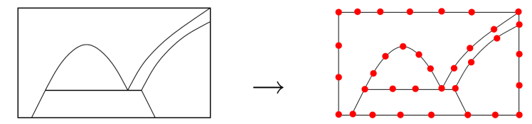
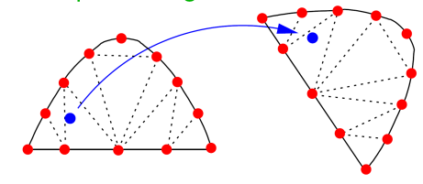
UTri Tabular EOS generation
Must build N UTri tables which are topologically equivalent and of similar accuracy:
  Adaptively mesh boundaries:
  Adaptively mesh phase regions:
Complexities:
  Constrained Delaunay triangulation used as transfer function
  Extreme non-convexity in individual phase regions
  Computational chain must be parallelized for large numbers of tables
Lesson Learned: Great care must be taken with non-convexity issues associated with phase regions.

Slide 9
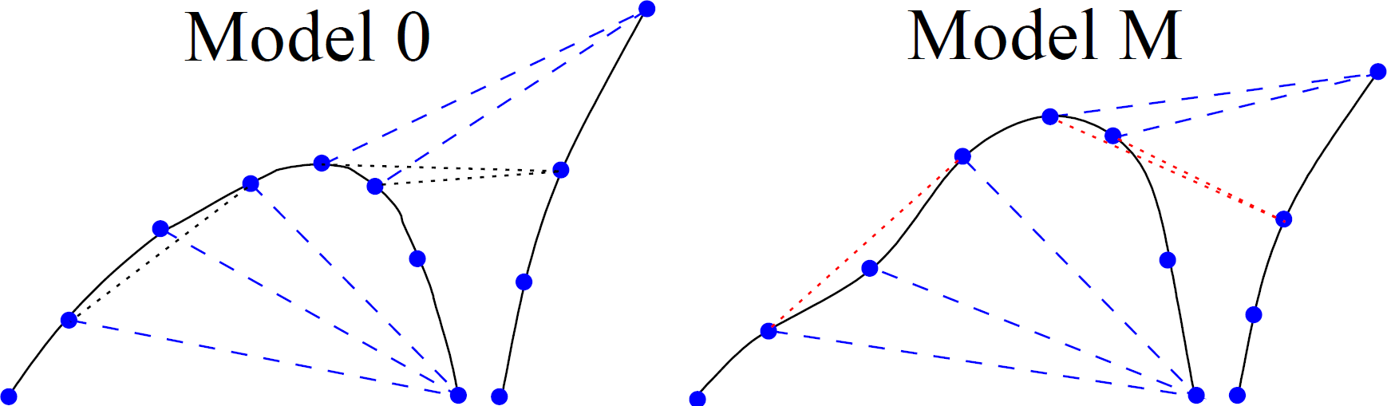
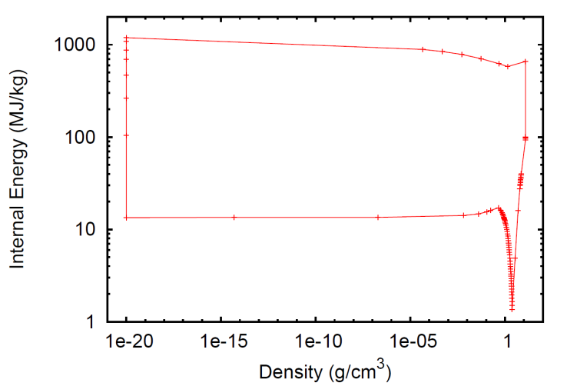
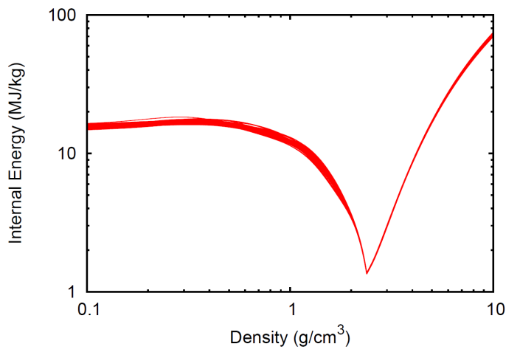
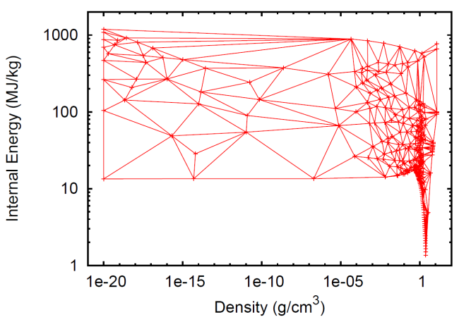
Convexity Complexity
Non-convexity of boundaries complicates the mapping:
Reality is messy:
Must iteratively “fix” the bad triangles
Mesh 0 boundary (1.0 tolerance)
70 other phase boundaries
Mesh 0 grid

Slide 10
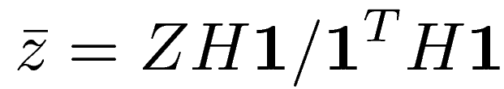
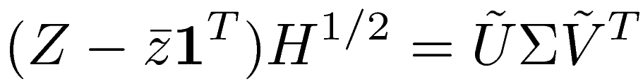

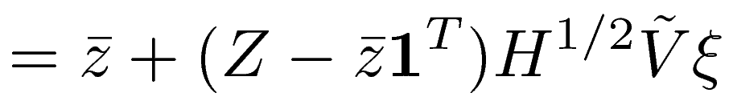
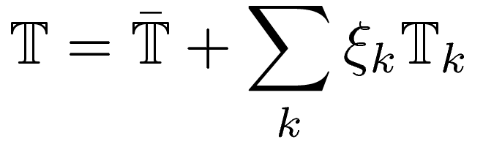
Tabular EOS UQ representation
Principal Component Analysis (PCA) is used to look for a tabular representation with reduced dimensionality:
N tables from previous meshing step are starting point
Export a truncated set of mode tables that capture most of the details (i.e. eigenspectrum energy)
Multi-precision floating point is necessary due to dynamic range of multi-phase tables.
Log density and log energy used in PCA analysis (also ensures positivity)
Parallel processing of SVD matrix creation is important.
Random variables ξ are uncorrelated, with zero mean and unit standard deviation, but not necessarily independent
PCA solver currently scales as MN² so this limits the practical number of samples.
10
Notes:
1024 bits of precision were used in the PCA for calculations on the aluminum model.
Both the tabulation and the PCA analysis are very costly in terms of time and memory.

Slide 11
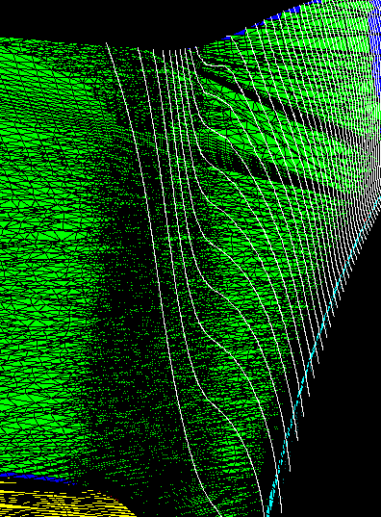
Multiphase Tabular Generation and Representation: AL UQ enabled table
Current wide range UQ AL EOS with 6 phase regions in the density-energy table.
With the current multi-phase model there are 37 free parameters. 12 parameters were fixed due to insufficient constraining data. The MCMC inference samples 25 parameters.
We took 442 samples from the chain. There were 7 modes at 1e-3 cutoff in the PCA analysis.
Accuracy of the tables is set at a relative tolerance of 0.01.
Isobars of mean table in density-energy plane

Slide 12

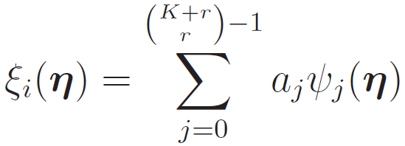
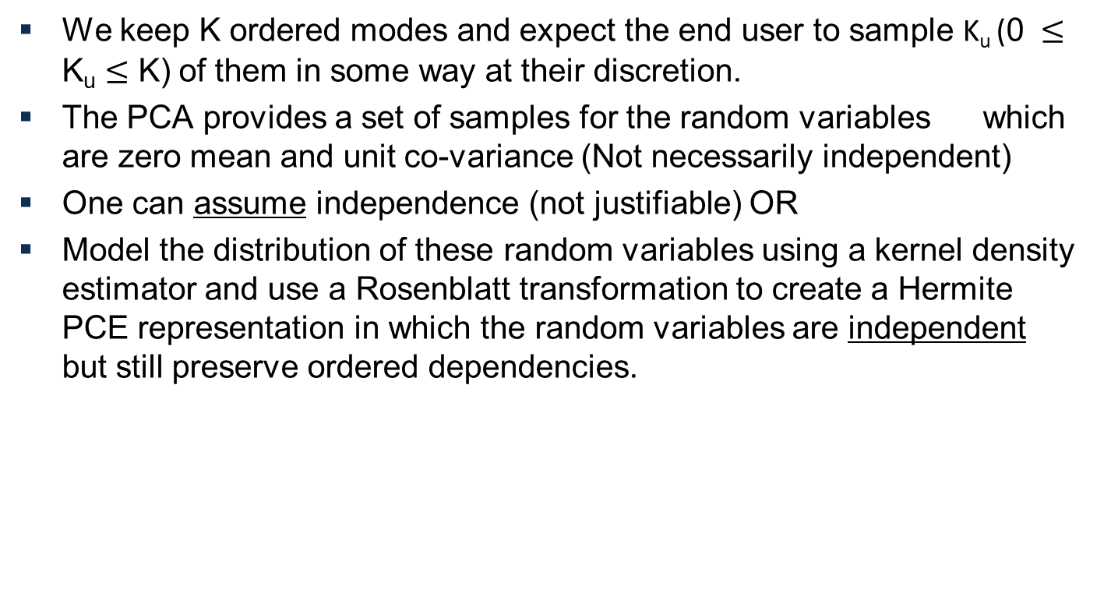
Develop surrogate random variable distributions
We keep K ordered modes and expect the end user to sample K_{u} (0 $≤$ K_{u} $≤$ K) of them in some way at their discretion.
The PCA provides a set of samples for the random variables which are zero mean and unit co-variance (Not necessarily independent)
One can assume independence (not justifiable) OR
Model the distribution of these random variables using a kernel density estimator and use a Rosenblatt transformation to create a Hermite PCE representation in which the random variables are independent but still preserve ordered dependencies.

Slide 13
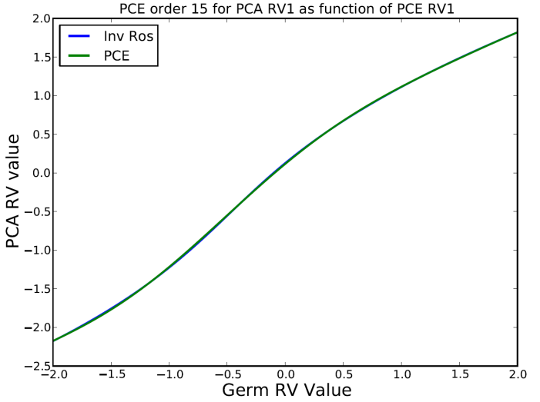
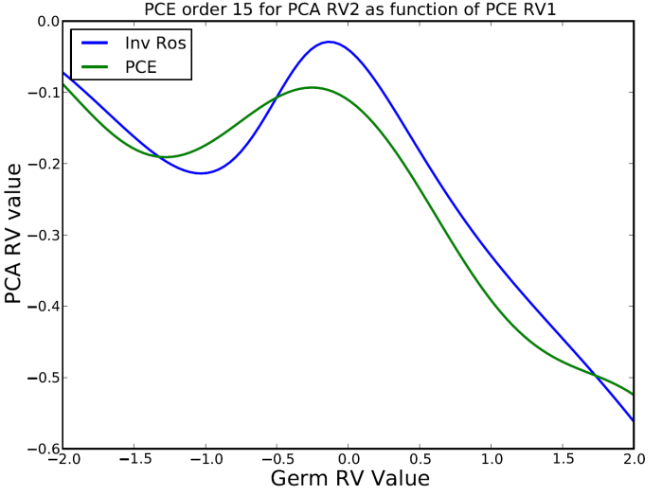
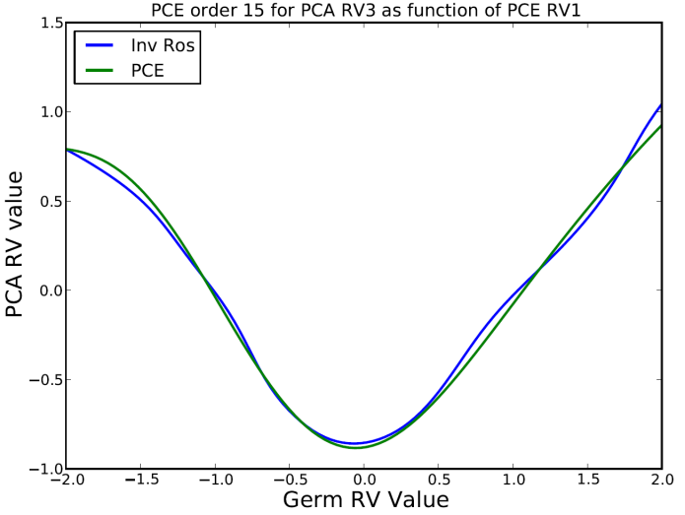
Rosenblatt transformation needs more samples
The Rosenblatt transformation seems to do quite well in the main components. I.e. relating the first mode to the first PCE dimension.
However, the coupling terms between the different modes are much more nonlinear, and seem a bit noisy. Even 15th order PCE does not seem to be sufficient.
We need more samples, and higher order PCEs (or another mapping approach).
We are now going for 10,000 sample tables! With this many tables we are now hitting conditions where the meshing near the critical point is failing. This has to do with the constraints on the model and possibly some small inconsistencies in how the critical point is computed. This is the next major item to be fixed in the automatic table generation process.

Slide 14

Meta-analysis approach for enabling users
DAKOTA is embedded in
ALEGRA Executable
DAKOTA
optimization, calibration,
sensitivity analysis,
uncertainty quantification
DAKOTA
loose coupling:
file system interface with separate executables
Internal API integrated with physics input and response functions; single input file
parameters
file
responses
file
parameters
responses
ALEGRA
ALEGRA
It helps users to have a unified, user-friendly and regularly tested capability

Slide 15
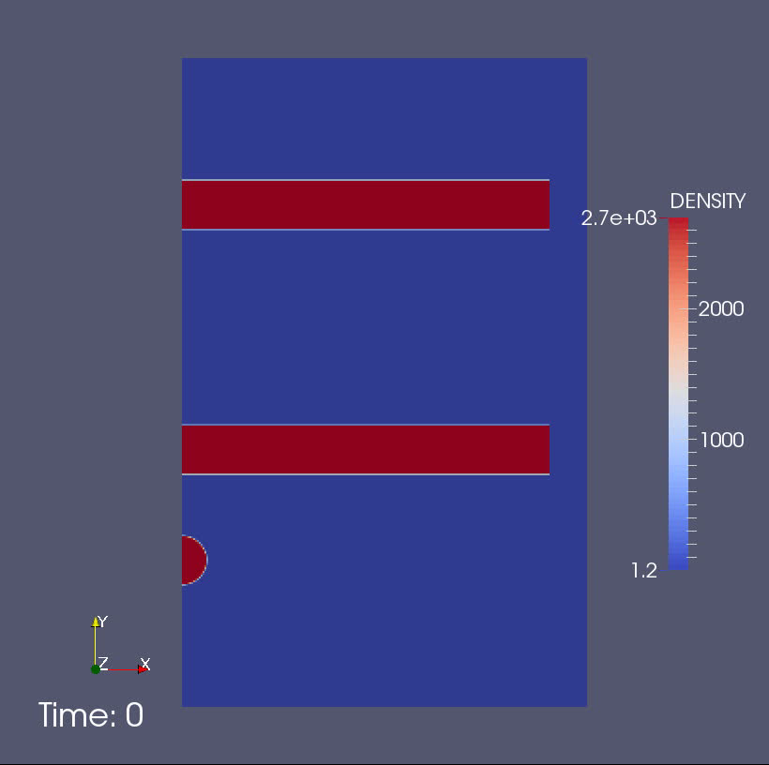
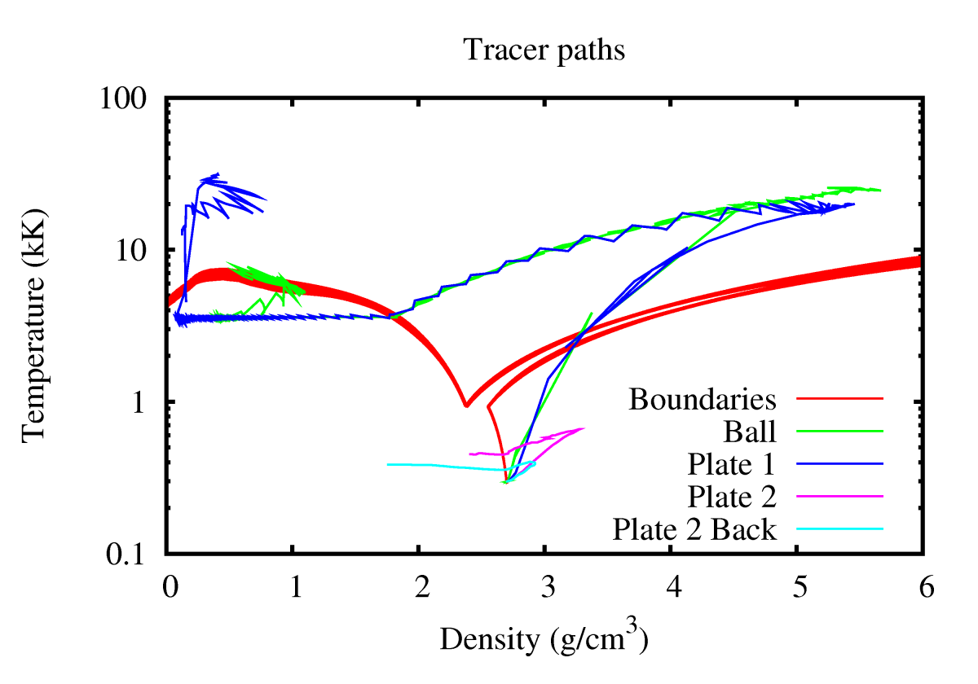
2mm diameter Al ball impacting spaced Al plates at 20 km/s in air background. Termination at 1.5 microsec
Phase boundary lines of PCA source EOS files are shown along with phase space trajectory of tracers (mean table, csmin=0, mfac=4).
(The results on this slide are from the Aluminum EOS as of Fall 2014 )

Slide 16
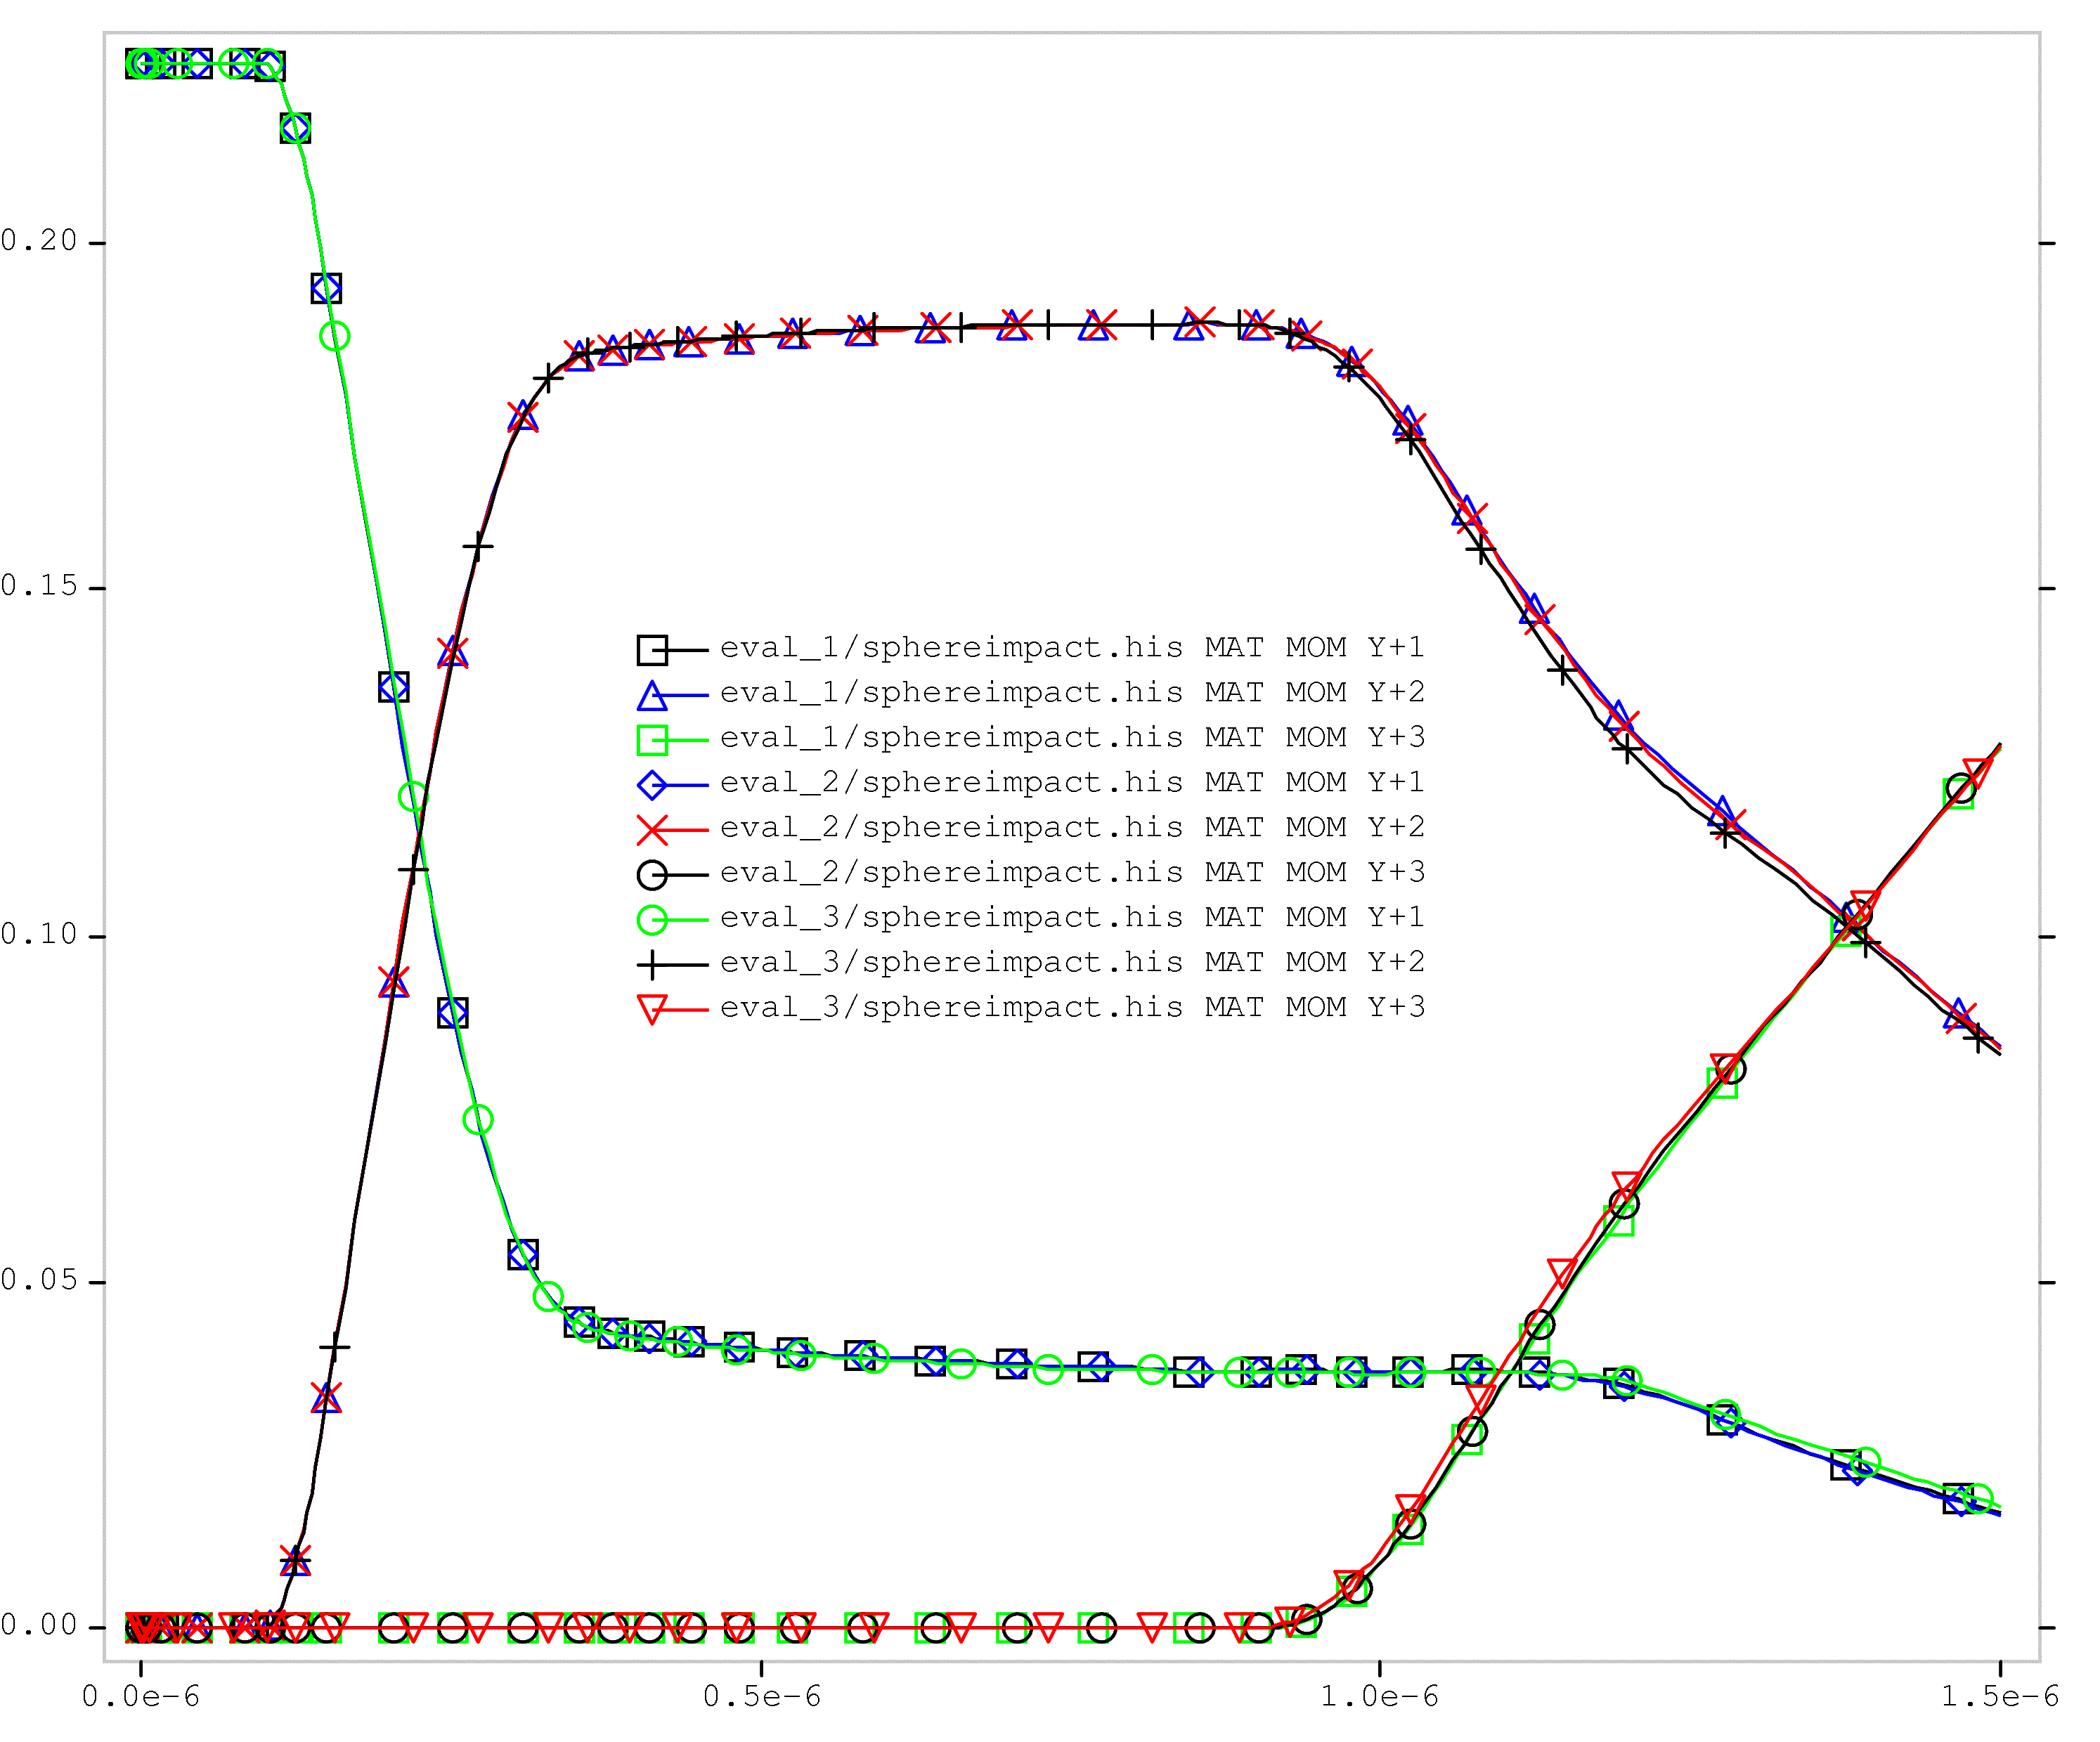
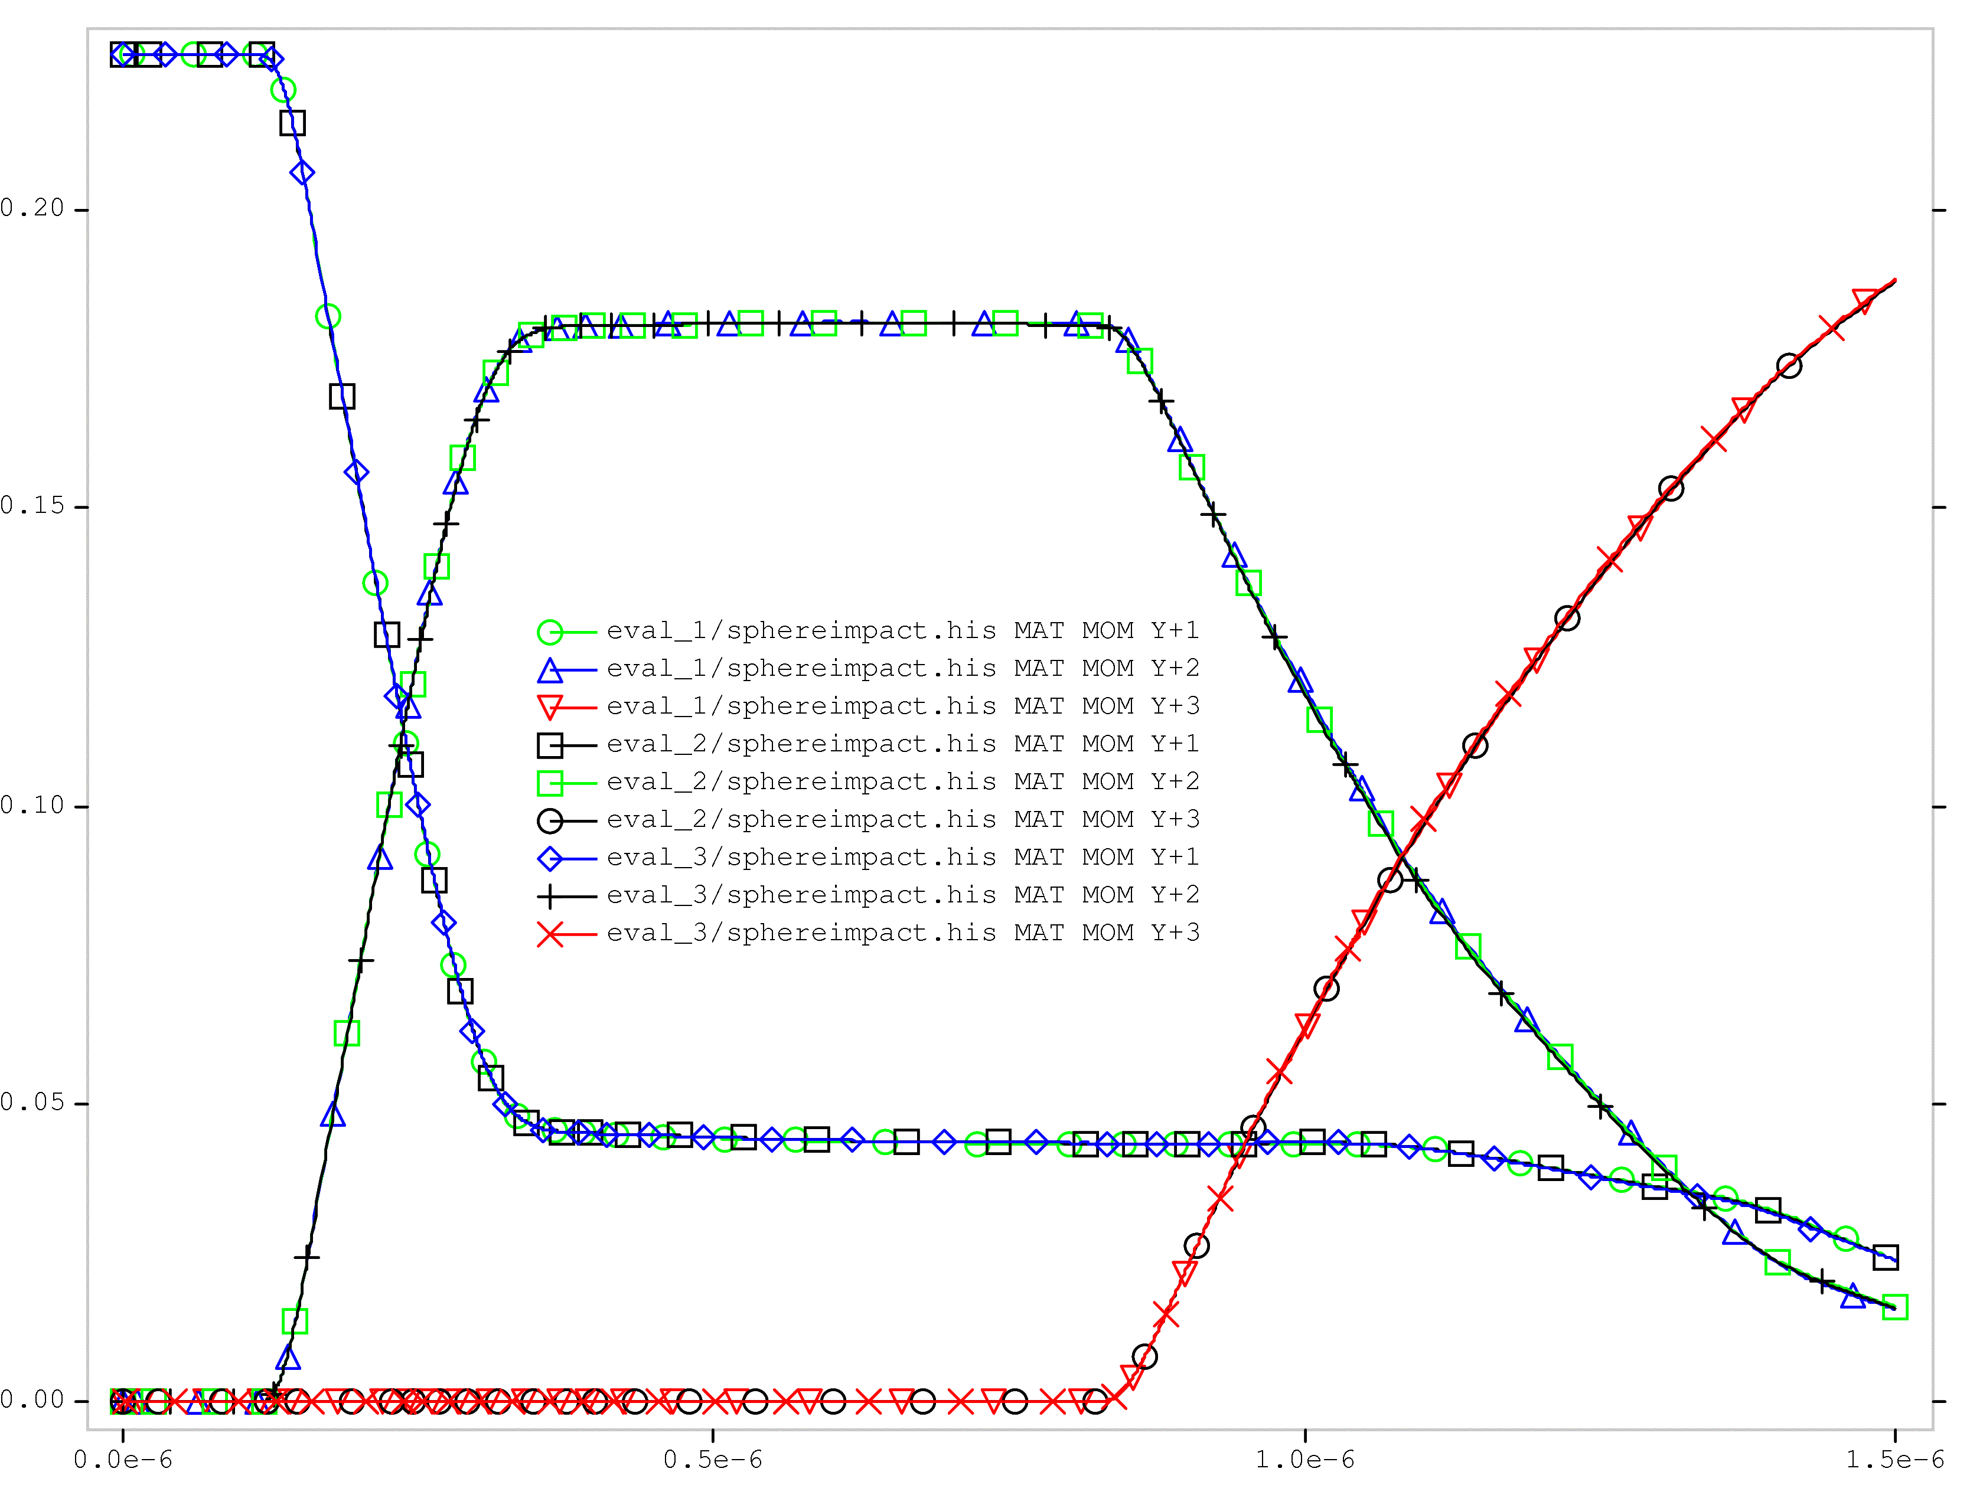
Looking at UQ Results via ALEGRA-DAKOTA
3 PCE (polynomial chaos expansion) quadrature points and 1 tabular mode with K=3 and r=6 Rosenblatt transformation. (eval_2 centered quadrature point)
Showing here material momentums plots at factor of 1 and 4 times resolution.
Sample output time histories are a good way to gain perspective on what might be important.
Low resolution
4 times resolution

Slide 17
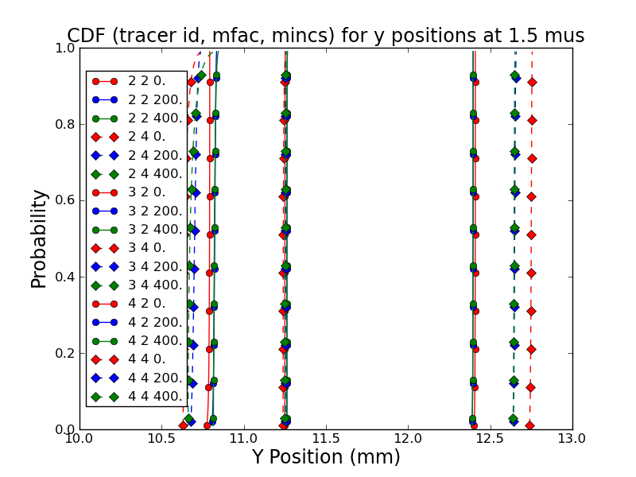
Uncertainty analysis using UQ enabled AL EOS
3 PCE (polynomial chaos expansion) quadrature points and 1 tabular mode with 3 mode (K=3,r=6) Rosenblatt transformation.
Higher resolution (diamonds)
mincs = 0 (red)
Lower resolution (circles)
2
3
4
Tracer Id
Effects of EOS uncertainty can be comparable or smaller than other model uncertainty (e.g. mesh resolution (mfac), numerical or modeling constants (mincs))
Conclusions will depends on where you look! QOI is fundamental.
Availability of the formal UQ material model approach encourages a UQ viewpoint on the whole modeling process.
UQ enabled table capability tends to drive useful verification and numerical work
Notes:
Tracer 2 is in the center of the first plate
Tracer 3 is at the center of the second plate
Tracer 4 is at the back of the second plate
All are at the center (0.) x location.

Slide 18
Conclusion
A multiphase EOS table approach with embedded UQ provides the following value:
  More precise EOS surface representation including phase boundaries
  Embedded UQ information in EOS
  Usable EOS representation for UQ enabled continuum analysis
  Quantitatively improves clarity for the end user on issues of model and model data uncertainty relative to other V&V issues.
What is next:
  Build a representation based on 10,000 sample tables to provide a satisfactory usable representation.
  Implement other closure models (i.e. conductivity) into the same consistent framework.
  Eventually, work toward providing UQ enabled strength modeling.

