Slide 1
On the Extension of Monotonicity to
Multi-Dimensional Flows
7th International Conference on Numerical Methods for Multi-Material Fluid Flow (MULTIMAT 2015), Würzburg, Germany, 7-11 Sept.2015
Gabi Luttwak¹
¹Dynamic-123D consulting, Haifa 3475859, Israel; gabi@dy123d.com

Slide 2
Schemes for Compressible Flows
  Schemes can be formulated as either FD,FV,FE
  Conservation laws integrated over a computational zone
  First Order schemes => variables assumed constant over each computational zone
  High Order schemes => variable profile in a zone determined by zone centered gradients e.g. by a Taylor expansion
    These profiles used to find face-centered values.
    In Godunov schemes these serve as data for the RP.
    The RP solution => fluxes through the zone faces

Slide 3
High order schemes & Discontinuities
Gradients undefined at discontinuities
Using them causes fluctuations in the solution
S. Godunov barrier theorem: (1954,1959)
    “If an advection scheme is monotonicity preserving it cannot be better than first order accurate”
To preserve a monotonic profile it is necessary to limit either the gradients or the resulting fluxes:
  J. P. Boris – Flux corrected Transport FCT (1973)
  Bram van Leer – Slope limiters & 2nd Order Godunov schemes (1976,1979)
1970’s

Slide 4
Monotonicity in 1D well understood
A density is monotonic between L,R if:
High Order schemes should not cause Minima and Maxima to grow
A. Harten (1983) : TVD property –
Total Variation Diminishing
B. van Leer defined a range of slope limiters e.g.:
  Minmod
  Double Minmod =>
  Superbee

Slide 5
Monotonicity in 2D,3D
How to define monotonicity in multidimensional flow?
Variables can be
  Scalars (2011-2013)
  Vectors ( Pavia 2009-2014)
  Tensors (2013-2014)
For inviscid hydrodynamic flow – the velocity and momentum are vectors
For elastic-plastic flow – the stress is a symmetric tensor

Slide 6
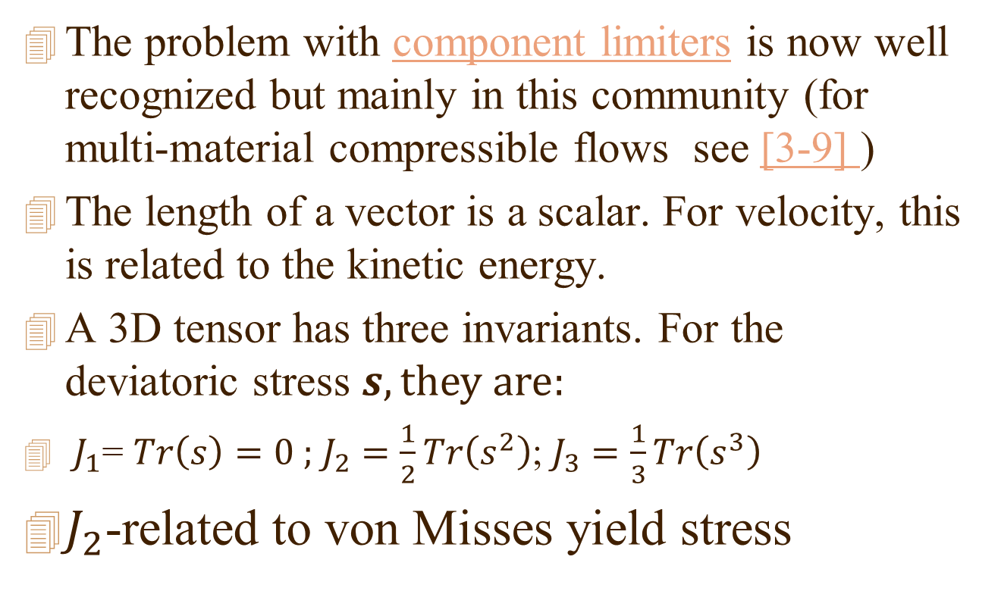
Montonicity of vectors and tensors
The problem with component limiters is now well recognized but mainly in this community (for multi-material compressible flows see [3-9] )
The length of a vector is a scalar. For velocity, this is related to the kinetic energy.
A 3D tensor has three invariants. For the deviatoric stress $s, they are:$
${ J}_{1}\text{= }Tr\left(s\right)=0 ;$ $J_{2}$ $=\frac{1}{2}Tr\left(s^{2}\right)$; $J_{3}$ $=\frac{1}{3}Tr\left(s^{3}\right)$
$J_{2}$-related to von Misses yield stress

Slide 7
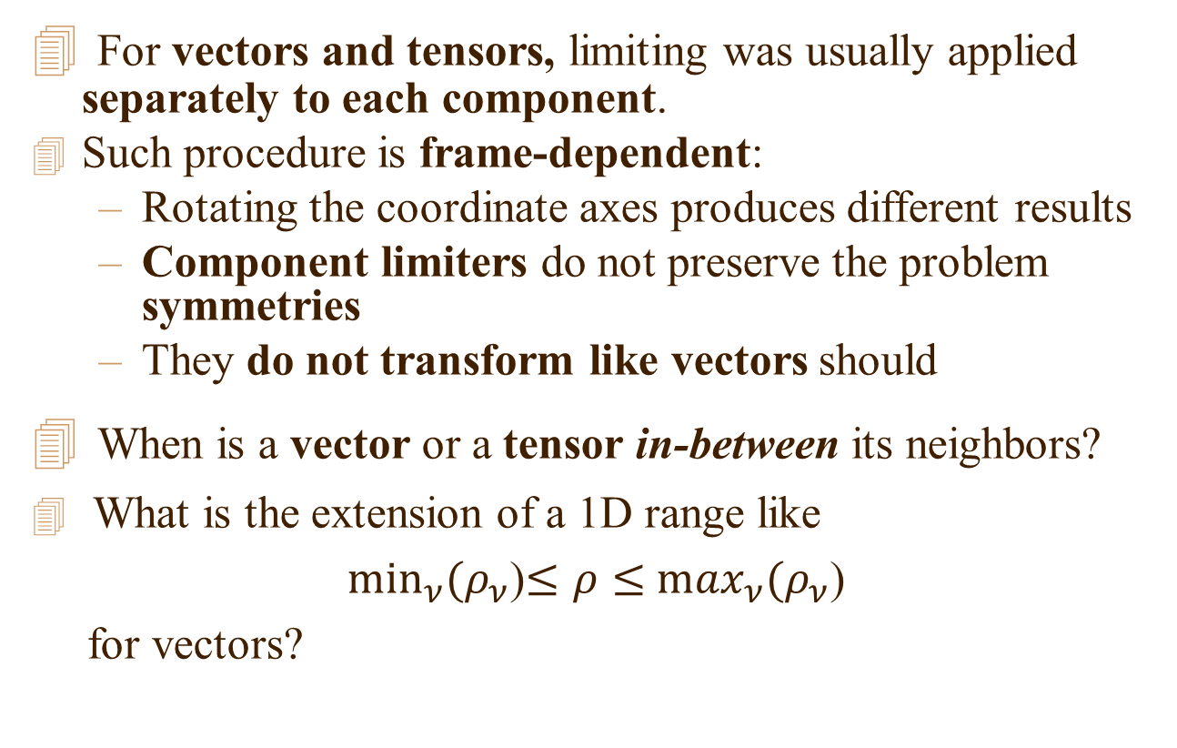
Monotonicity for Vectors
For vectors and tensors, limiting was usually applied separately to each component.
Such procedure is frame-dependent:
  Rotating the coordinate axes produces different results
  Component limiters do not preserve the problem symmetries
  They do not transform like vectors should
When is a vector or a tensor in-between its neighbors?
What is the extension of a 1D range like
$\min_{ν}⁡(ρ_{ν}$)$≤ρ≤$ $\max_{ν}(ρ_{ν}$)
for vectors?

Slide 8
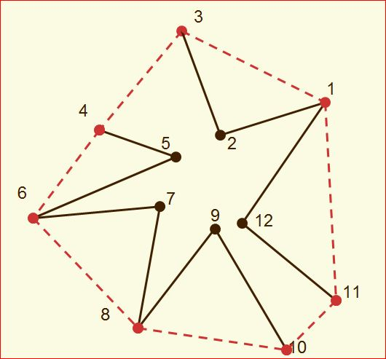
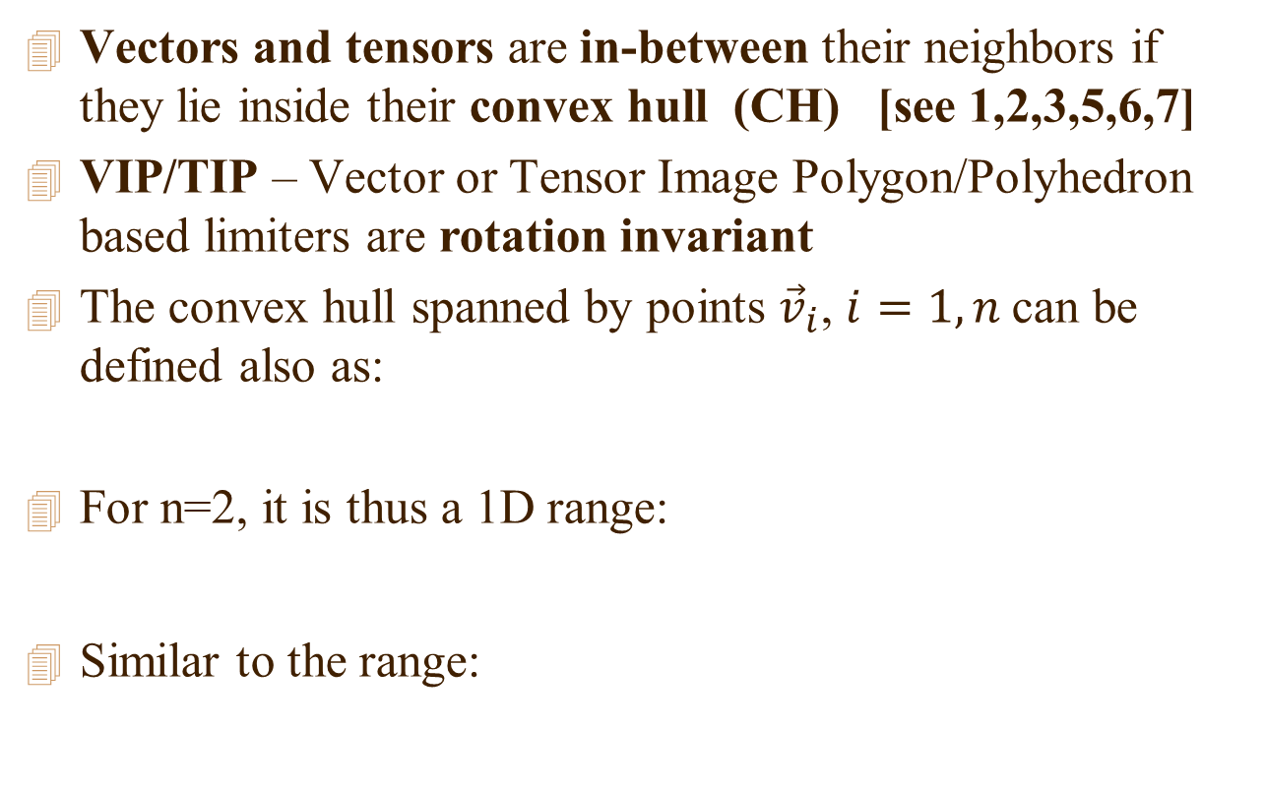
Convex hull (CH) based VIP limiter
Vectors and tensors are in-between their neighbors if they lie inside their convex hull (CH) [see 1,2,3,5,6,7]
VIP/TIP – Vector or Tensor Image Polygon/Polyhedron based limiters are rotation invariant
The convex hull spanned by points ${\vec{v}}_{i}$, $i=1,n$can be defined also as:
For n=2, it is thus a 1D range:
Similar to the range:

Slide 9
A Convex Hull based limiter
The “natural” extension of the concept of monotonicity to multi-dimensional flow
Robust and rotation invariant leading to good preservation of the symmetries present
Applying the VIP limiter to the gradient of scalar variables resulted in improved advection
But, slower and more complex algorithm
A VIP limiter for stress => CH in 5D space
Directly limiting the gradient of vectors => 6D

Slide 10
Alternative Limiter for Vectors
P.H. Maire [4]: proposed another invariant limiter for vectors:
  Prevent symmetry breaking by doing component limiting along local flow related orthogonal physical directions
  It might be quicker and simpler to code than VIP
  Results depend on the choice of the “physical directions”
  Some apparently physical directions, like the flow velocity are not Galilei invariant.
  Component limiters, define a box in the space
  If this box is aligned with the mesh it breaks symmetry
  If defined in physical directions it preserves symmetry
Notes:
10

Slide 11
Let search for a quicker scheme based on the CH
Could we approximate the CH and still retain its good properties?
A bounding box (BB) should be the simplest such approximation
Especially when the limiter is based on a small number of neighbors
The box orientation should be mesh independent
Could we build the BB without building the CH first? (the rotating calipers method [12] first builds the CH to get the minimal BB)

Slide 12
A Bounding Box approximation for a convex hull
Like the convex hull the bounding box defined in vector or tensor space
We do not have to explicitly build the convex hull
Find the box direction, by approximately aligning it with the longest size of the CH

Slide 13
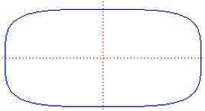
The Bounding Box
The bounding box encloses the convex hull
Thus an ellipsoid or super-ellipsoid (a Lame curve in 2D) may be even better as it is continuous:
e.g. for n=4 in 2D x-y

Slide 14
The normals to the box faces
Find the center of all neighbors and search for the neighbor point most off center:
Take the vector pointing to it as the first normal and remove components of along it.
Proceed in a similar way to find the next normal

Slide 15
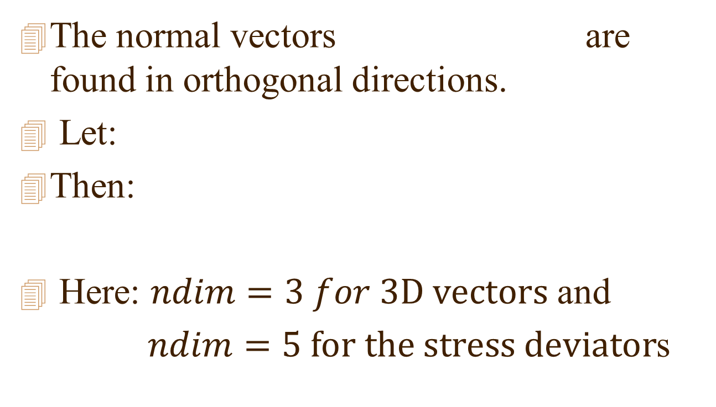
Finding the min/max values
The normal vectors are found in orthogonal directions.
Let:
Then:
Here: $ndim=3 for 3D vectors$ and
$ndim=5 for the stress deviator$s

Slide 16
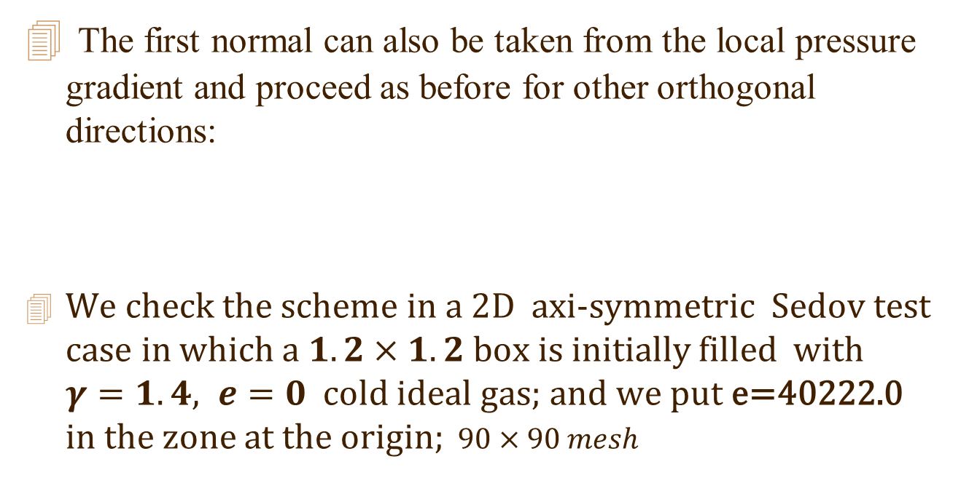
Ways to improve the BB alignment
The first normal can also be taken from the local pressure gradient and proceed as before for other orthogonal directions:
We check the scheme in a 2D axi-symmetric Sedov test case in which a $1.2×1.2$box is initially filled with $γ=1.4, e=0$ cold ideal gas; and we put e=40222.0 in the zone at the origin; $90×90 mesh$

Slide 17
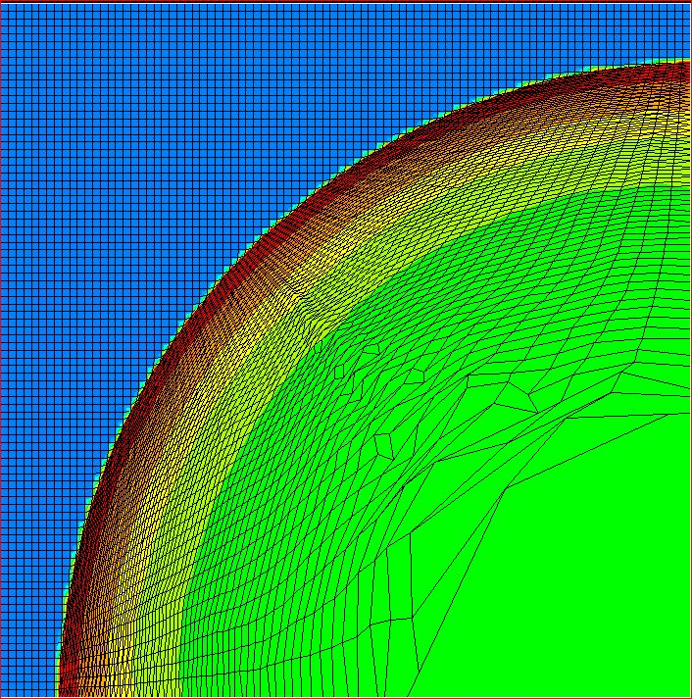
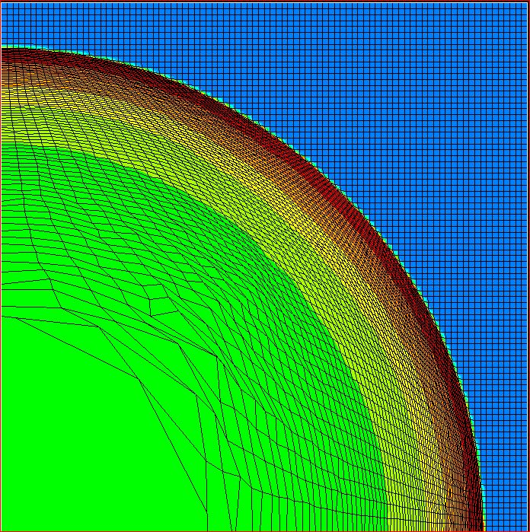
Cylindrical 2D Sedov test; at T=0.24
On the right box first direction taken from local pressure gradient

Slide 18
Using the local pressure gradient has slightly better symmetry.
Most of the differences occur at the start of the calculation near the origin
Let us next compare with the original CH calculation:

Slide 19
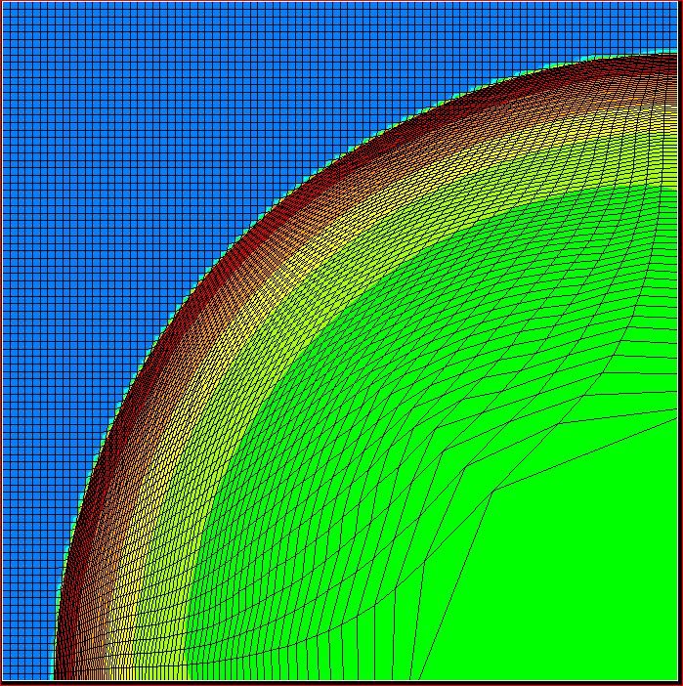


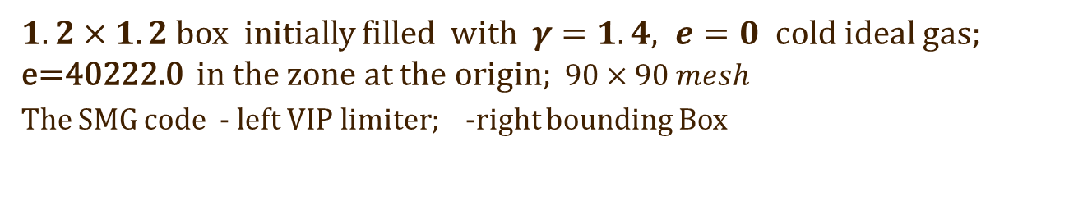
Cylindrical 2D Sedov test; at T=0.24
$1.2×1.2$box initially filled with $γ=1.4, e=0$ cold ideal gas; e=40222.0 in the zone at the origin; $90×90 mesh$
The SMG code - left VIP limiter; -right bounding Box

Slide 20
Discussion
Both calculations look symmetry preserving.
The CH limiter is still more robust and is better in preserving the symmetry.
There are almost no differences near the front, but they begin at the start of the calculation when the point explosion starts near the origin.

Slide 21
Limiters for stress
Sambasivan et al. [8] and Maire et al. [9] present schemes for elastic plastic flow which good test problems and results.
Here we want to show how a BB approximate CH limiter could be used instead.

Slide 22
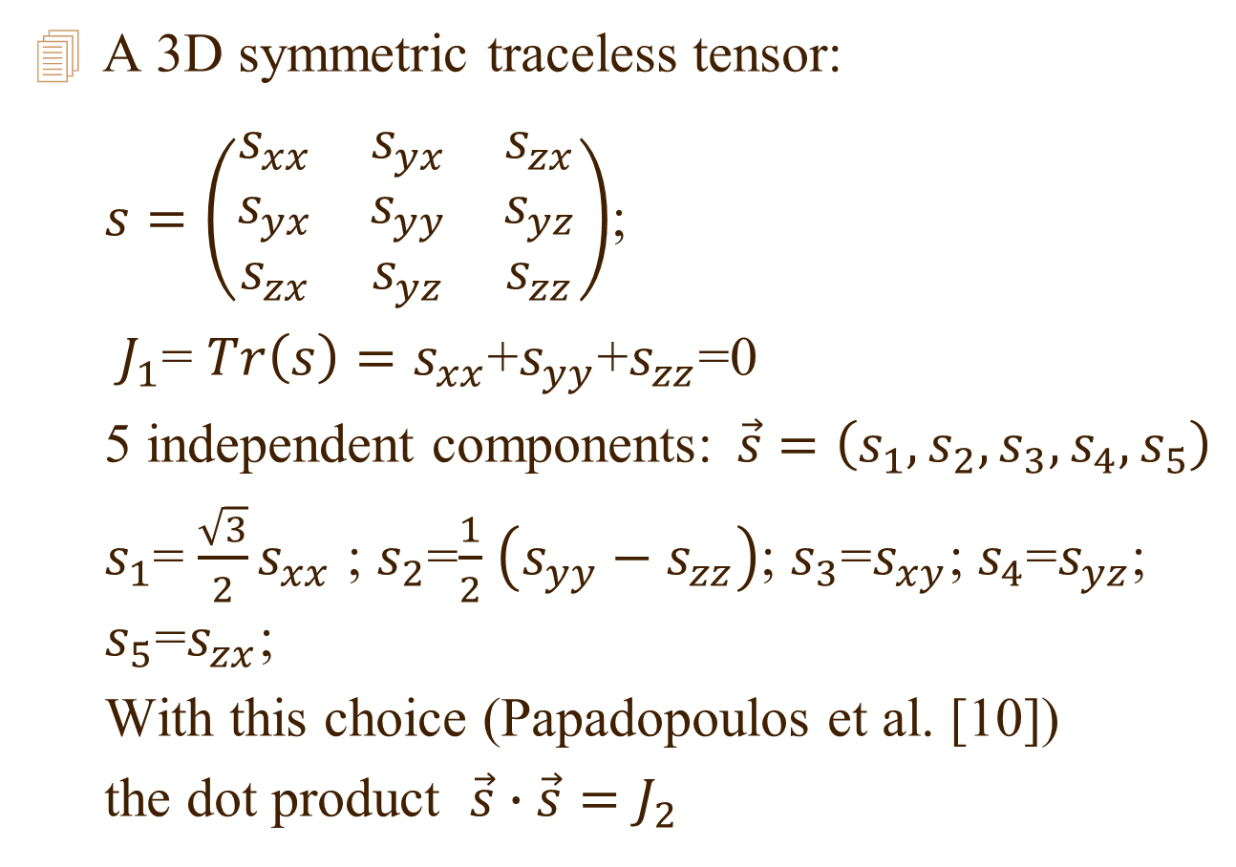
The Deviatoric Stress
A 3D symmetric traceless tensor:
  $s=\left(\begin{matrix}s_{xx} & s_{yx} & s_{zx} \\ s_{yx} & s_{yy} & s_{yz} \\ s_{zx} & s_{yz} & s_{zz}\end{matrix}\right)$;
  $J_{1}$= $Tr\left(s\right)=s_{xx}$+$s_{yy}$+$s_{zz}$=0
  5 independent components:$\vec{s}=\left(s_{1},s_{2},s_{3},s_{4},s_{5}\right)$
  $s_{1}$= $\frac{\sqrt{3}}{2}s_{xx}$ ; $s_{2}$=$\frac{1}{2}$ $\left(s_{yy}−s_{zz}\right)$; $s_{3}$=$s_{xy}$; $s_{4}$=$s_{yz}$; $s_{5}$=$s_{zx}$;
  With this choice (Papadopoulos et al. [10])
  the dot product $\vec{s}∙\vec{s}=J_{2}$

Slide 23
BB limiter for stress
This way we implemented a BB limiter for stress and it seems to work reasonable.
In the SMG code for now the stress gradients are used only in the ALE phase.
This will change as the Riemann Problem solution should take into account the jump in the stress too.
The present elastic plastic flow scheme does not exactly preserve symmetry even for Lagrange and worse in ALE.
We still bring some preliminary results, to show that the BB limiter works and is relatively robust.

Slide 24
Square Rod Impact on Wall
Luttwak et al.[10]: 1020 steel rods normal impact wall at 243 m/s.
Initial squared profile rods:
  40x6.3x6.3mm
Final size of recovered rods in the experiments:
  33.4x10.9x10.9 mm

Slide 25
Preliminary results with the BB based slope limiter for stress.
The BB based slope limiter for stress have been implemented in the code.
In the SMG code the stress gradients are now used only in the ALE phase. (The Riemann Problem solution takes into account only the jump in the pressure at the faces).
The elastic-plastic part of the SMG code used in these simulations require further work to better preserve symmetry, apart from the limiter, even in Lagrange, but especially in the ALE mode.
Because of symmetry we mesh only a quart of the rod. We use 6x6x80 zones.

Slide 26
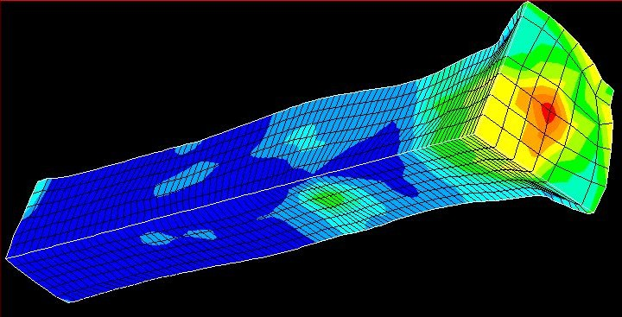
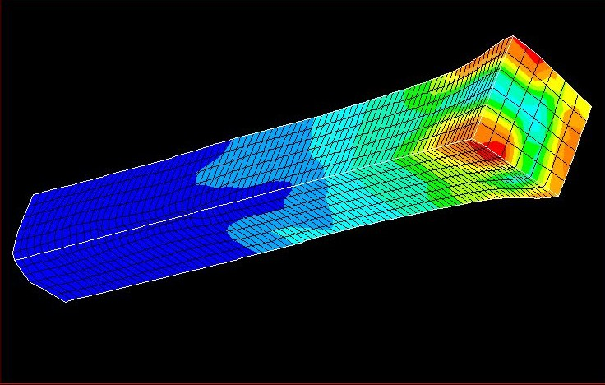
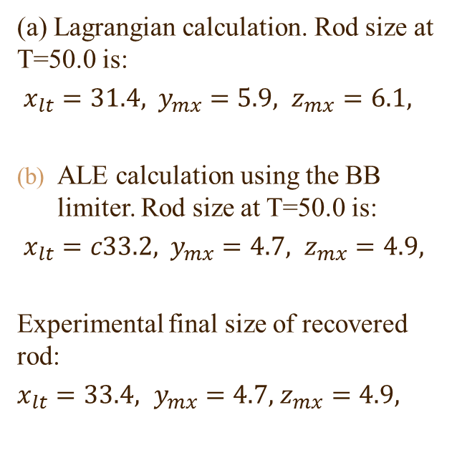
T=45 Square rod impact on wall
Shown on mesh are contours of equivalent plastic strain.
(a)
(a) Lagrangian calculation. Rod size at T=50.0 is:
$x_{lt}=31.4\text{,}{ y}_{mx}=5.9,$ $z_{mx}=6.1,$
ALE calculation using the BB limiter. Rod size at T=50.0 is:
$x_{lt}=c33.2\text{,} { y}_{mx}=4.7,$ $z_{mx}=4.9,$
Experimental final size of recovered rod:
${x_{lt}=33.4\text{,} y}_{mx}=4.7,$ $z_{mx}=4.9,$
(b)

Slide 27
Conclusions
In order to use CH limiters for the stress tensor and the direct limiting of the gradients we look for simpler and efficient approximations of CH’s.
We checked the performance of a Bounding Box (BB) limiter in a 2D axi-symmetric Sedov test case.
  The BB limiter preserved well the symmetry at the front.
  The original CH limiter is still more robust and has better overall symmetry preservation.
  The difference occur mainly at the start of the calculation and improving the box alignment with the hull may help

Slide 28
References
[1] G. Luttwak and J. Falcovitz, Int. J. Num. Meth. in Fluids, 65 , 1365:1375, (2011).
[2] G. Luttwak and J. Falcovitz, Eur. Physics J. - EPJ Web of Conferences, 10, 00020, 2010.
[3] G. Luttwak, J. Falcovitz, Computers and Fluids, 83, 90:97, 2013.
[4] P. H. Maire, J. Comp. Phys.,228(7), 2391:2425, 2009.
[5] “Godunov Techniques and Slope Limiters in Lagrangian and Ale Hydrodynamics”, Mini-symposium , at the joint WCCM XI ECCM VECFD VI congress, Barcelona, Spain, 2014.

Slide 29
More References
[6] J Velechovský , M Kucharik , R Liska , M Shashkov, J. Phys.: Conf. Ser. 454 01200
[7] P. Hoch, E. Labourasse, Int. J. Num. Meth. Fluids,
76(12), 1043:1063,
[8] S. K. Sambasivan, M. J. Shashkov, D. E. Burton, Computers and Fluids, 83, 98:118, 2013.
[9] P.H. Maire, R. Abgrall, J. Breil, R. Loubère, B. Rebourcet
J. Comp. Phys. 235, 626:665,2013 <==
<==

Slide 30
More References
[10] Papadopoulos, I.V., Davoli, P., Gorla, C., Filippini, M., Bernasconi, A., Int. Journal of Fatigue 19, 219:235, 1997.
[11] G. Luttwak, Z. Rosenberg, J. Falcovitz, ”Experimental and computational study of Taylor impact with square rods”,
15th Int. Symp. on Ballistics, Jerusalem,1995
[12] H. Freeman, R. Shapira, ”Determining the minimum-area encasing rectangle for an arbitrary closed curve”. Comm. ACM, 18(7), 409:413, 1975

Slide 31
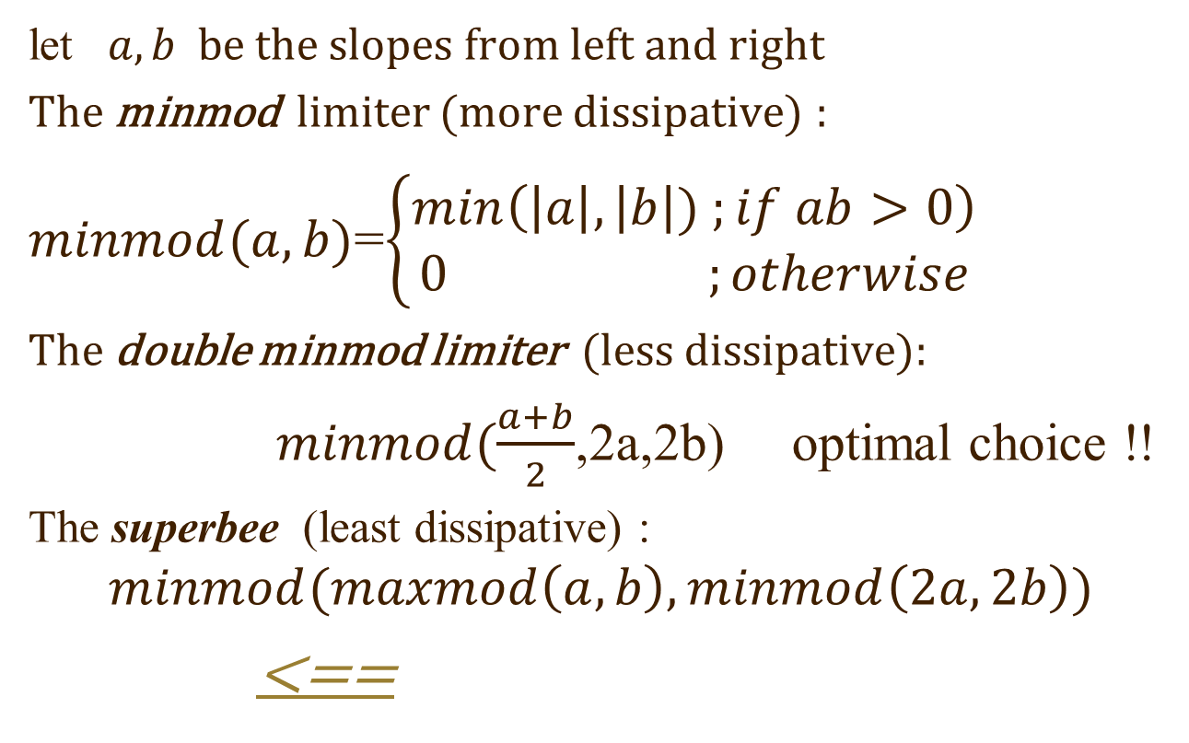
Example of some 1D limiters
(see van Leer)
let $a,b$ be the slopes from left and right
The minmod limiter (more dissipative) :
$minmod(a,b)$=$\left\{\begin{aligned}min\left(\left|a\right|,\left|b\right|) ;if ab>0\right) \\ 0 ;otherwise\end{aligned}\right.$
The double minmod limiter (less dissipative):
  $minmod(\frac{a+b}{2}$,2a,2b) optimal choice !!
  The superbee (least dissipative) :
  $$minmod(maxmod\left(a,b\right),minmod\left(2a,2b\right))$$
<==

Slide 32
Background on Monotonicity in 2D,3D
  High Order schemes ( e.g. vanLeer's MUSCLE) were first applied to multi-dimensional flows for Cartesian mesh, through X-Y-Z operator splitting.
  1D Limiters & Monotonicity taken in each direction.
  For Vector or Tensor variables limiting was carried out separately for each Cartesian component
  Results seemed satisfactory, especially if flow was mostly along X,Y,Z
  <==

Slide 33
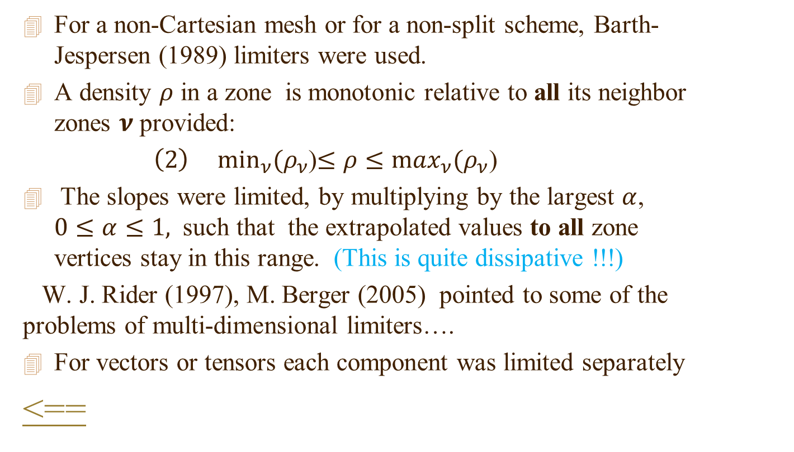
Monotonicity in 2D,3D
For a non-Cartesian mesh or for a non-split scheme, Barth-Jespersen (1989) limiters were used.
A density $ρ$ in a zone is monotonic relative to all its neighbor zones $ν$ provided:
$\left(2\right) \min_{ν}⁡(ρ_{ν}$)$≤ρ≤$ $\max_{ν}(ρ_{ν}$)
The slopes were limited, by multiplying by the largest $α$, $0≤α≤1,$ such that the extrapolated values to all zone vertices stay in this range. (This is quite dissipative !!!)
W. J. Rider (1997), M. Berger (2005) pointed to some of the problems of multi-dimensional limiters….
For vectors or tensors each component was limited separately
<==

Slide 34
High resolution codes in 2D,3D
But high resolution codes in 2D,3D work now for about 40 years !!!! Is this really a serious problem????
Quoting R.Loubere [2005] who did a large set of test problems:
  “It has been demonstrated the effectiveness of a limiter on perfectly quadrangular grids aligned with the flow, however if the mesh is not aligned with the flow or if it is simply unstructured, then, not only the limiter is not effective anymore but it generates instabilities leading to lack of symmetry.”
<==

