Slide 1



(U) Advances in Dendritic Mesh Generation
LA-UR-15-26863
Tristan Coulange - Kitware SAS, Lyon - France
Tristan Delaney - Stony Brook University, Stony Brook, NY
Mack Kenamond - X-Computational Physics, LANL
Multimat 2015
International Conference on Numerical Methods for Multi-Material Fluid Flows
Wurzburg, Germany, September 7-11, 2015
Acknowledgements: Misha Shashkov, Guy McNamara, Davis Herring, Brian Jean, Brandon Smith

Slide 2
Outline
Introduction: What is a dendritic mesh?
Motivation: Why do you care?
Dendritic paving
  Method
  Results
Feathering
  Method
  Results
Future work

Slide 3
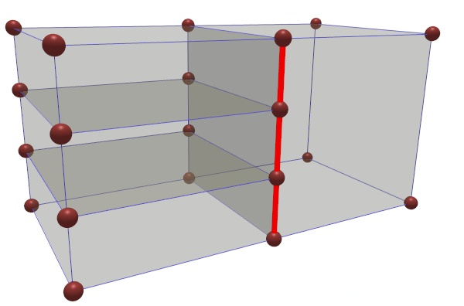
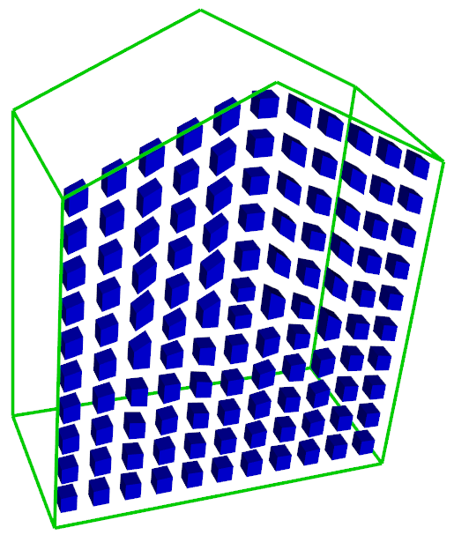
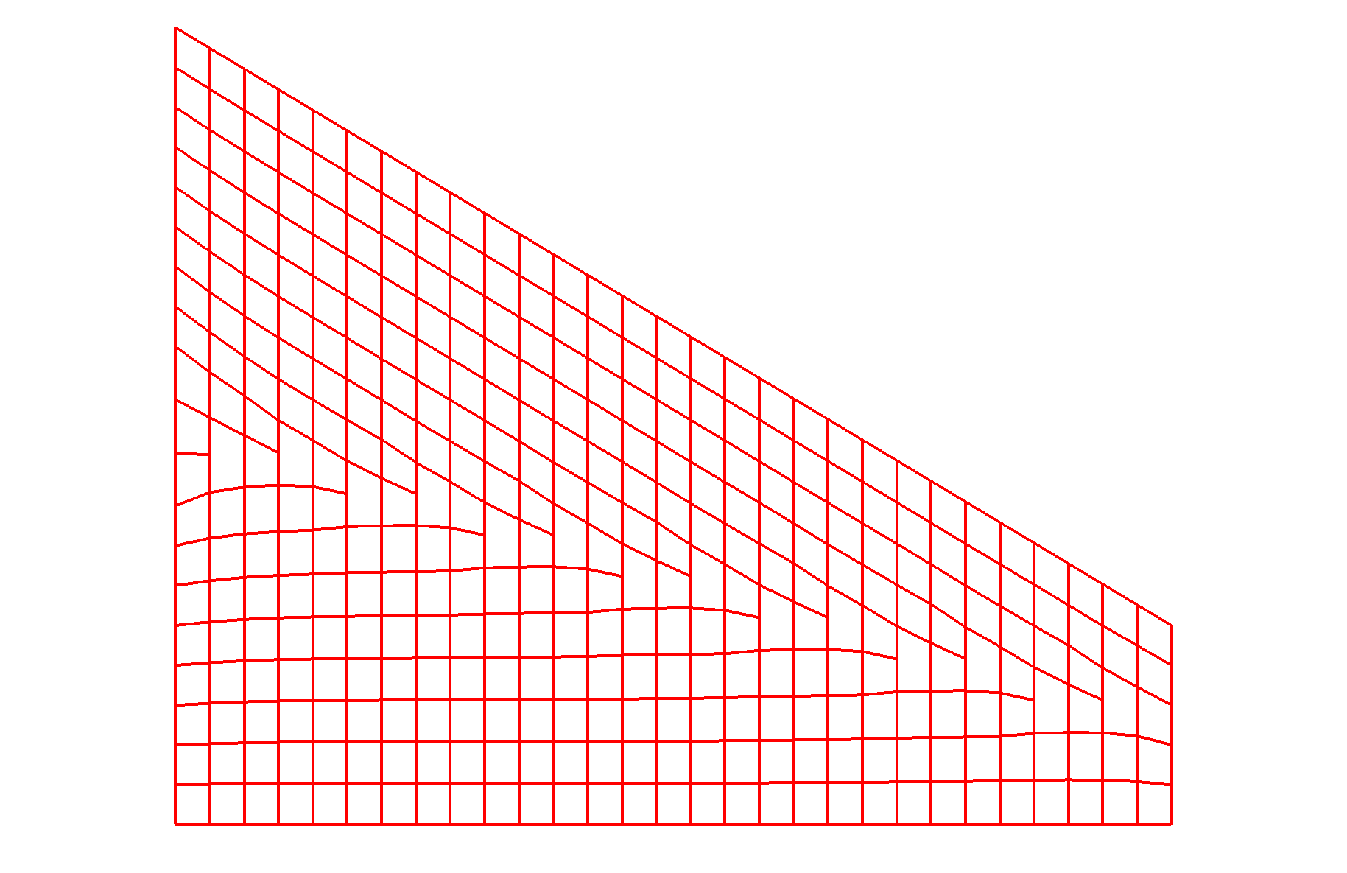
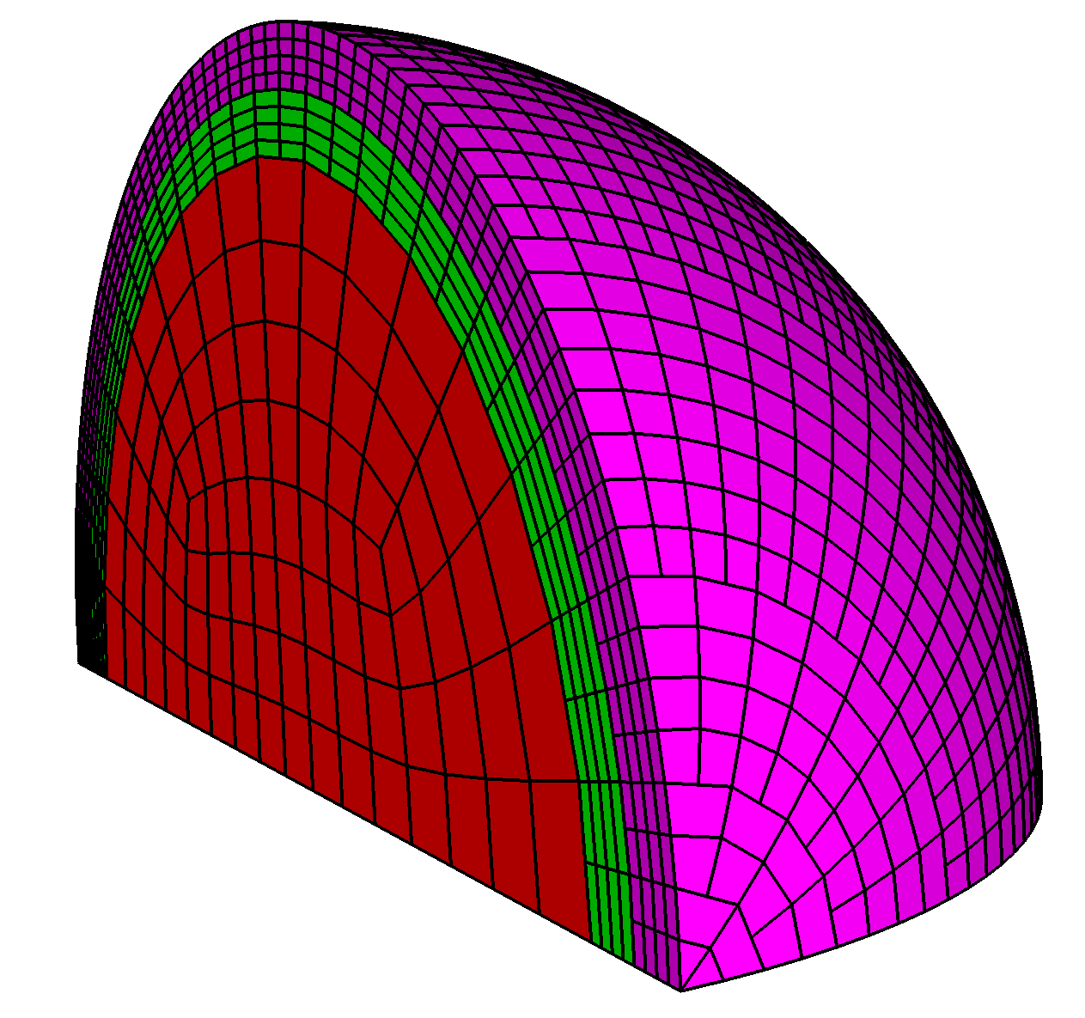
Introduction: What is a dendritic mesh?
Dendritic mesh = mesh containing dendrites
Well, what is a dendrite?
  Mesh resolution transition
  Multi-point constraint
“Dendrite”
“Masters”
“Slave”

Slide 4
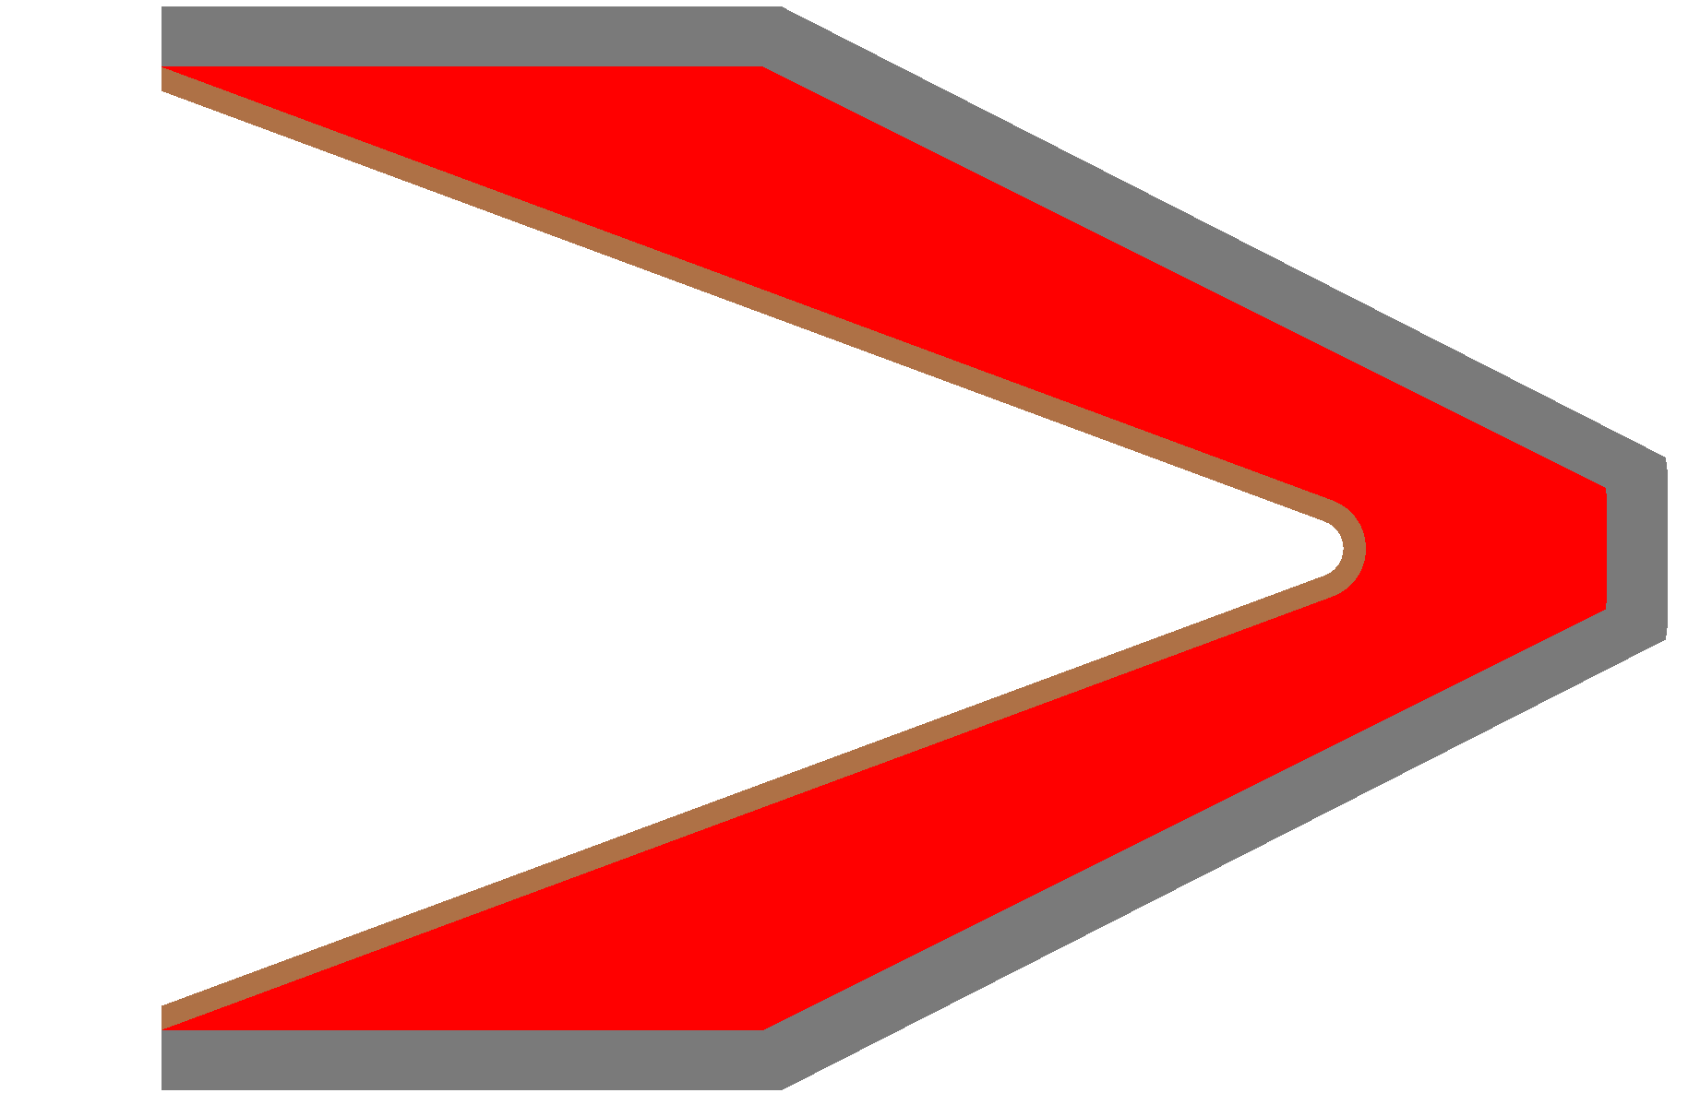
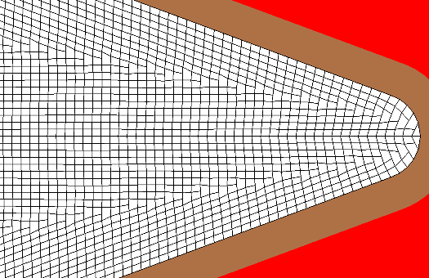
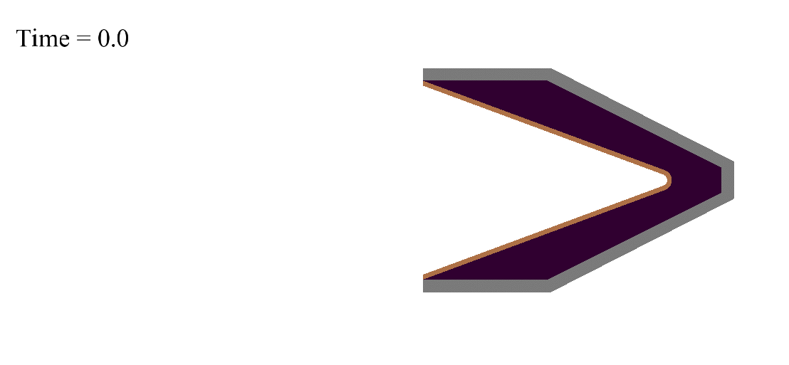
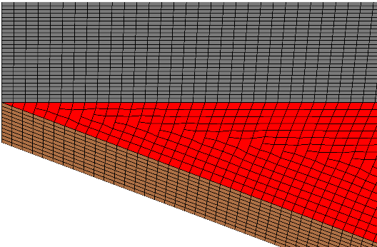
Motivation: Why do you care?
Lagrange hydrocodes benefit from certain mesh qualities
  Uniform cell size and orientation in a homogenous domain
    Correct shock propagation
  Cell quality
    Reduce discretization errors
  Conformal meshes
    Cells at interfaces are pure, no sub-scale model errors
  Impedance/mass matched interfaces
    Improves shock transmission/reflection at material interfaces
Difficult to satisfy all of these mesh constraints
Dendritic meshes make this possible
Shaped
Charge
Steel
Explosive
Copper
Detonator

Slide 5
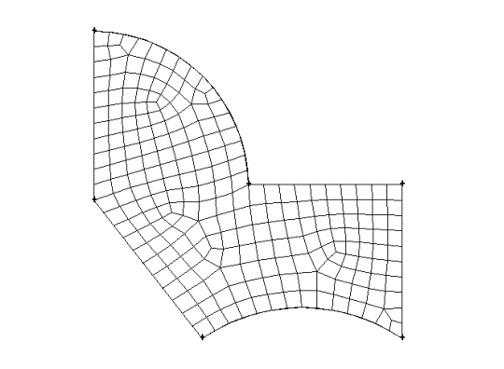
Dendritic paving
Blacker and Stephenson introduced the “paving” method in 1991 [1]
Can automatically mesh complex geometry with quad elements
Mesh a domain from the boundary inward row by row or element by element
Tucks, wedges, seaming, loop closure and repair are operations required to generate paved meshes
For years, I’ve wondered, “What would paving look like with the addition of dendrites?”
Quad paving
Dendritic paving
Hand-drawn, ~2006

Slide 6
Traditional paving processes (notional)
Given a “loop” of connected nodes and edges, categorize nodes along loop
  Row end, row side, corner, row reversal
  Based on node angle
Determine range of nodes to pave (paving row)
  Between two row end nodes
Pave row (add a row of new elements)
Evaluate added nodes
Apply “row adjustments”
  Wedges and tucks
  Adds or removes 2 loop edges
Stitch overlapping/intersecting rows
Seam acute loop corners
Smooth boundary and interior nodes
Loop closure
Wedge
Tuck

Slide 7
Dendritic paving processes
Overall, very similar to conventional paving
Differences are in wedge, tuck and seam operators
  Dendritic variants are used instead
Dendritic wedge and tuck only add/remove one edge
Dendritic seaming is simpler
All maintain tangential and normal orientation of source boundary
  Potentially useful for paving with prescribed anisotropic element size

Slide 8
Dendritic tuck and wedge
Dendritic tuck
  Merge two cells and “front edges”
  Add a dendrite
Dendritic wedge
  Split a “front edge”
  Add a dendrite
Normal/tangential orientation preserved
Simple!
Tuck
Wedge

Slide 9
Dendritic seaming
Required when row end node angles are small or negative
  As paving front geometry evolves
  When loops intersect or loop self-intersects
Two types
  Normal seam
  Disparate length seam
Tangential/normal orientation preserved
Both
Normal
Disparate Length

Slide 10
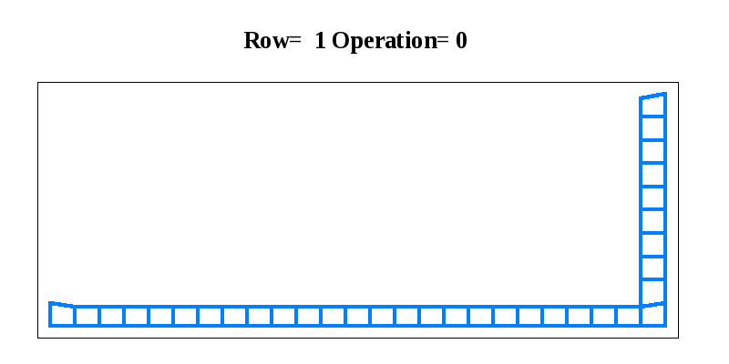
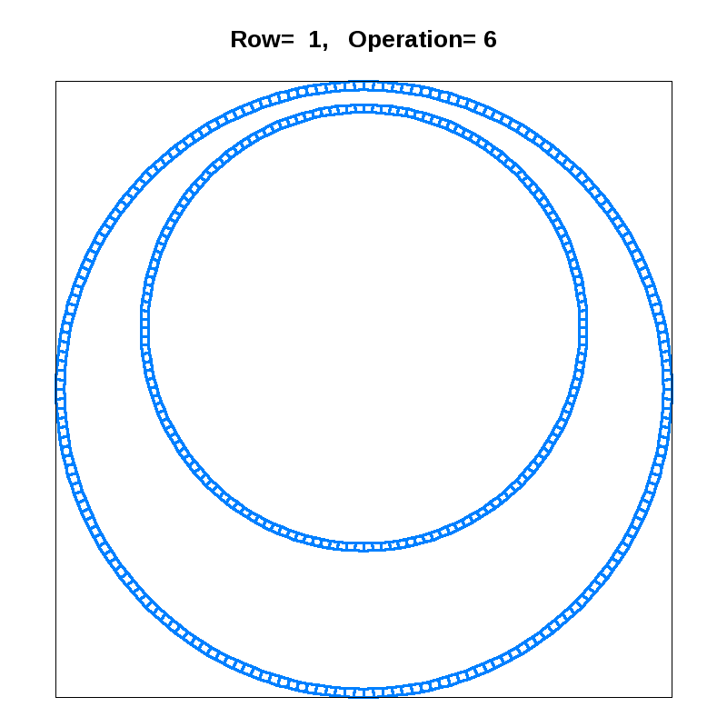
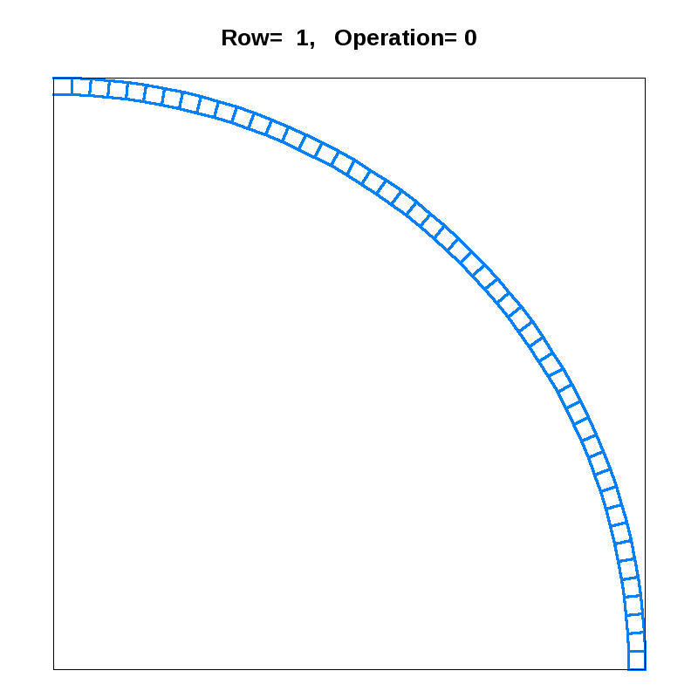
Dendritic paving results

Slide 11
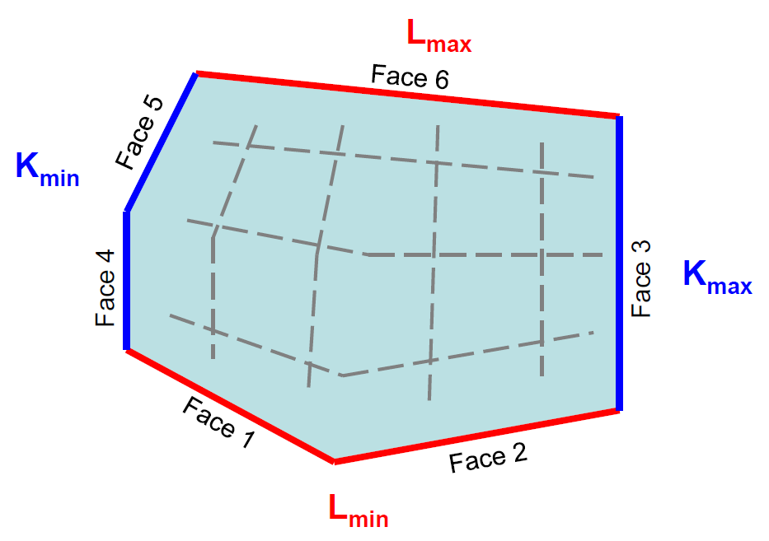
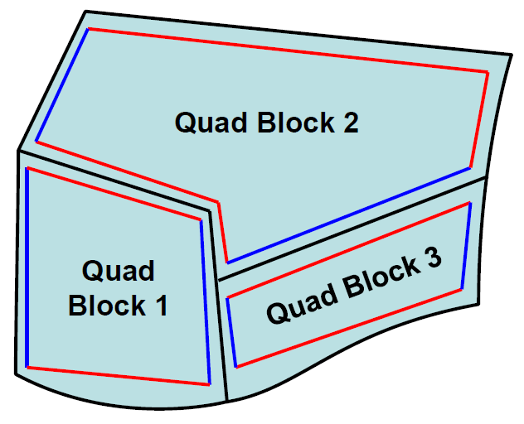
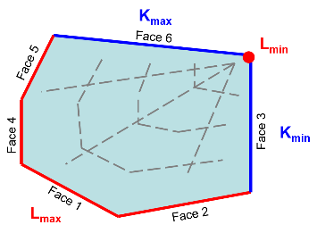
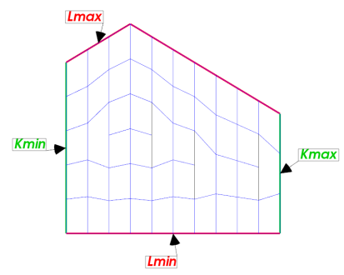
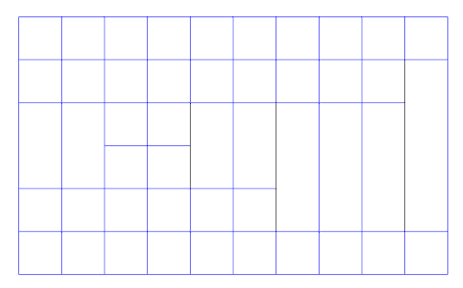
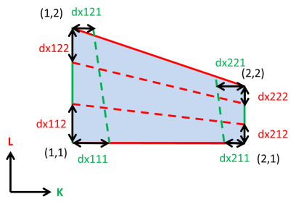
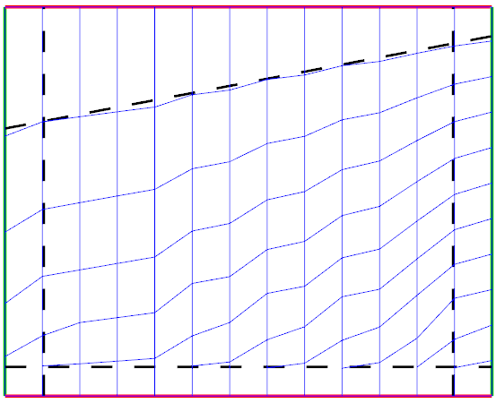
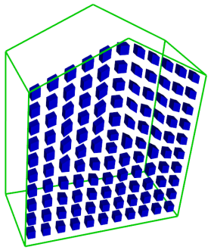
Feathering
Block-structured mesh generation technique [2,3]
Removes ranges of logical faces from a structured mesh block
Multi-directional feathering does this in multiple logical directions
Enables anisotropic element size control
Applicable to 2D and 3D
Requires dendrites

Slide 12
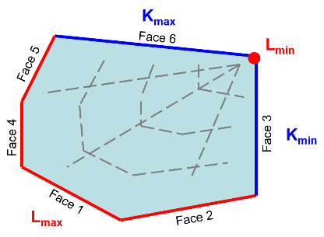
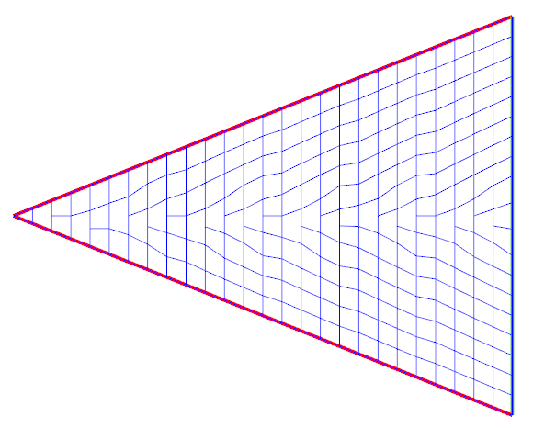
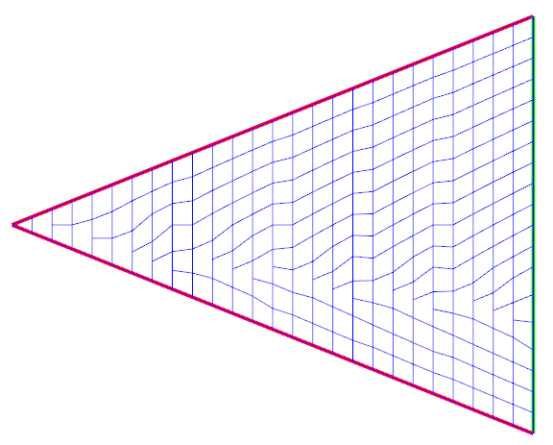
Feathering Method
Inputs:
  Block boundary (logical and geometry)
  Cell size boundary conditions (BC’s)
  Feathering pattern
Determine mesh resolution
  Calculate length of mesh lines (TFI)
  # edges from length and BC size data
  MAX sets logical block dimensions
Apply feathering pattern
  Concentrated, distributed
Interpolate points
  Account for feathering
  Distribute based on size BC’s
Build mesh

Slide 13
3D and Multi-directional Feathering
3D feathering:
  Same as 2D, mostly
  Repeated application of 2D feathering
    Each 3D slice treated as a 2D problem
  Requires coherence between slices
  Will not extend to tri-directional feathering
Multi-directional feathering:
  Difficult!
  Avoid invalid cells during feathering
    During K-feathering, set L-face removal locks
    Valid solution not always possible
  Repair invalid cells as post-processing
    Shift face removal locations
    Still, not always possible
  Interpolate point coordinates
    Also difficult
    Smoother probably required
3D Mesh Slice
Invalid Cells

Slide 14
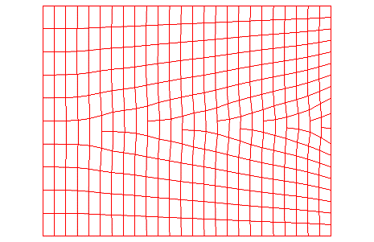
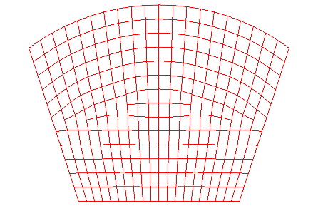
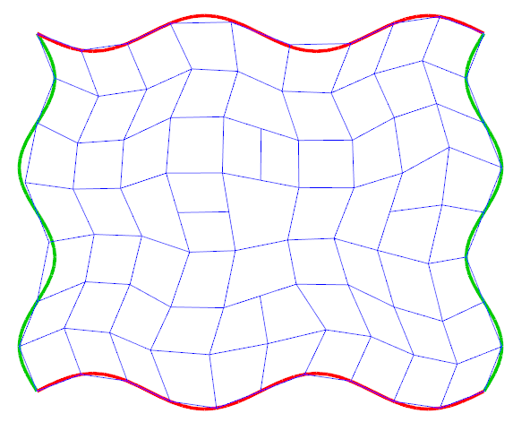
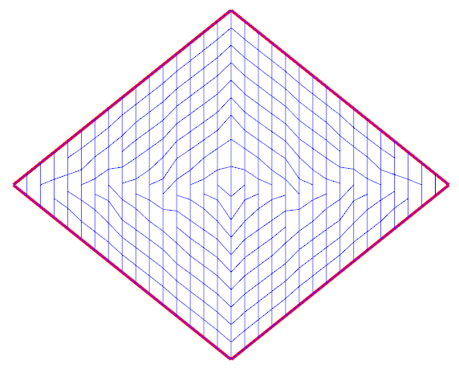

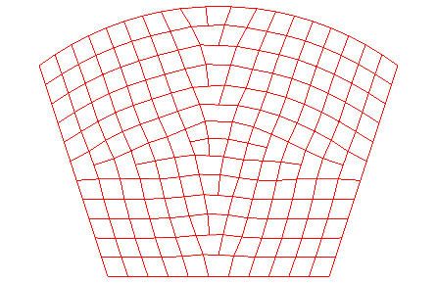
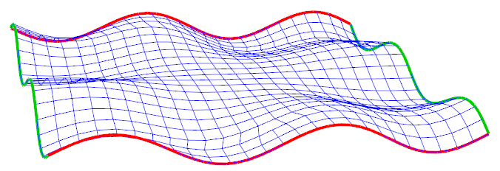
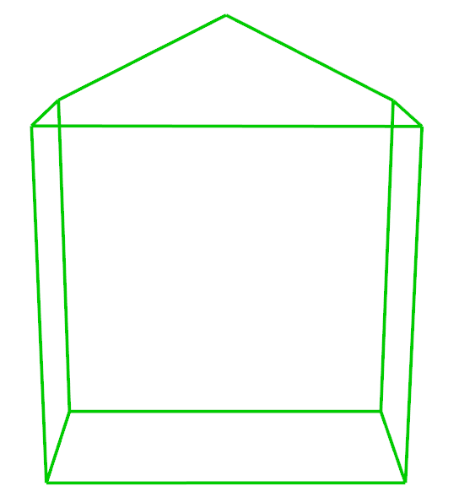
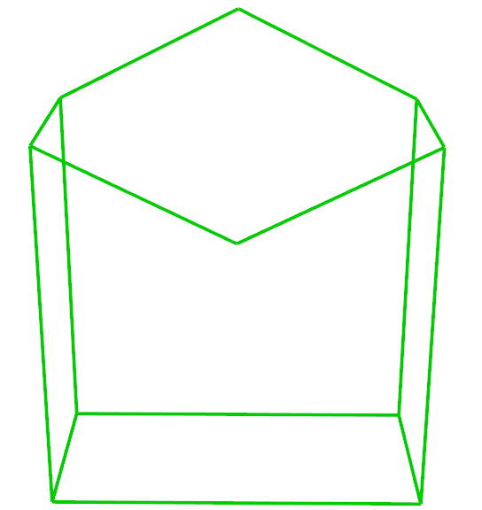
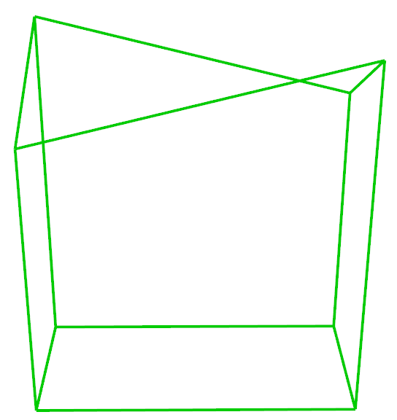
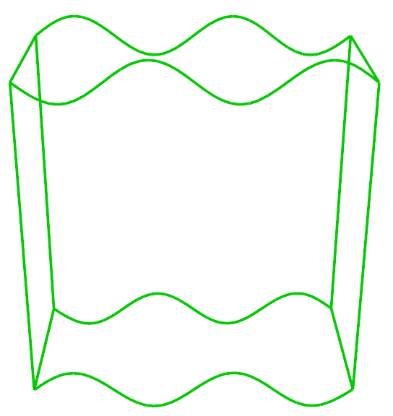
Feathering Results
Size control
Uni-directional
Curved boundaries
Curved surfaces
Bi-directional
Degenerate blocks
Multiple patterns
3D Uni-directional

Slide 15
Future Work
Dendritic paving:
  Explicit anisotropic size specification and propagation
    Row generation and adjustment
    Boundary and interior smoothing
  Loop closure and mesh repair
  Additional dendritic operators
  Structured feathered meshes in 2D/3D
Feathering:
  Improved conflict resolution
  Improved point placement
  3D bi- and tri-directional feathering
  General 3D geometry
  Coherent block-block connectivity
Validation

Slide 16
References
Blacker, T. D. and Stephenson, M. B. (1991), “Paving: A new approach to automated quadrilateral mesh generation.” Int. J. Numer. Meth. Engng., 32: 811–847.
Jean, B., Douglass, R., McNamara, G., Ortega, F., “Dendritic Meshing: LA-UR-11-04075.” 20th International Meshing Roundtable, Springer-Verlag, pp.619-636, October 23-26 2011.
Kenamond, M., “(U) Dendritic Zoner Idea.” LA-UR-14-23652, May 20, 2014

Slide 17
THE END

