Slide 1
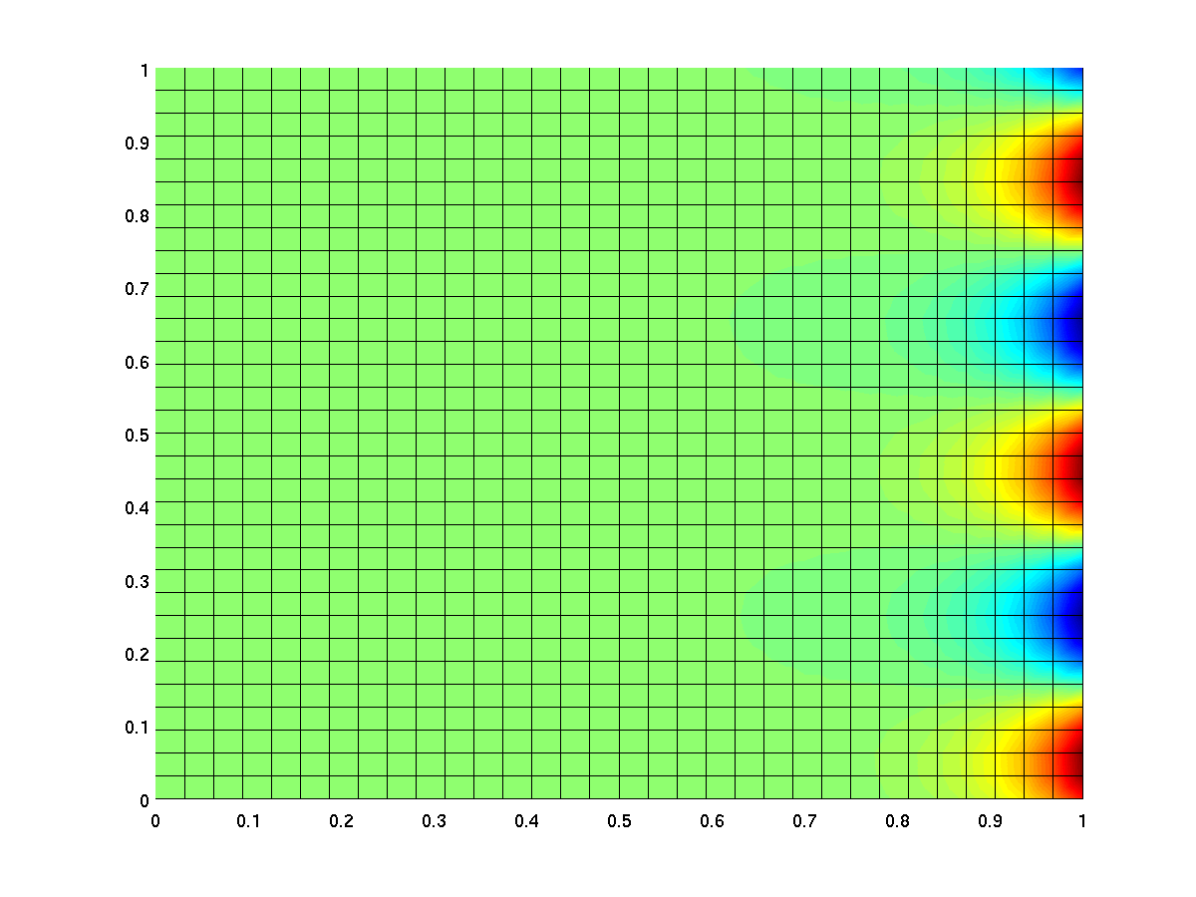
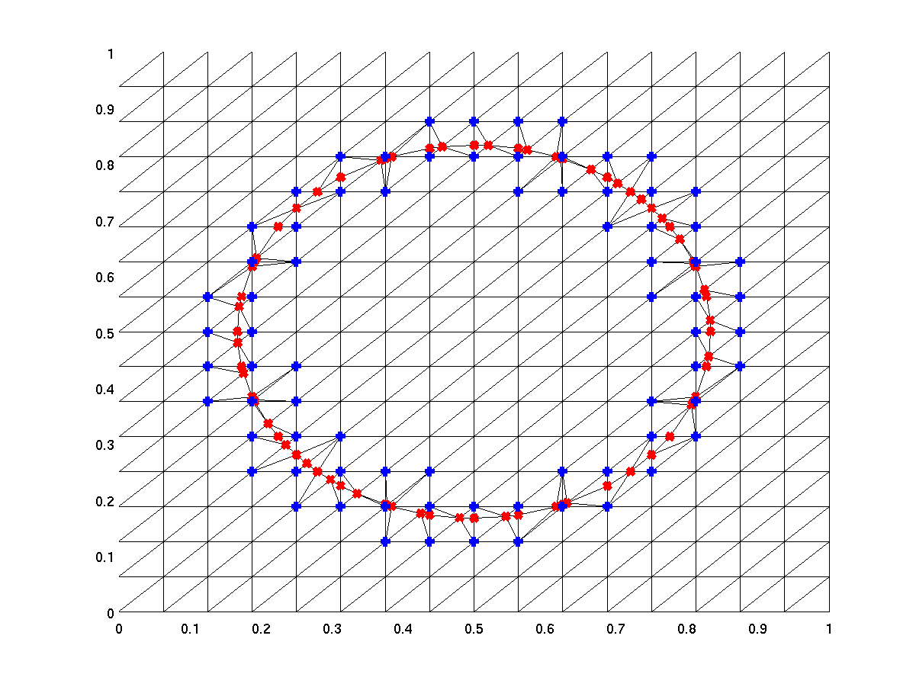
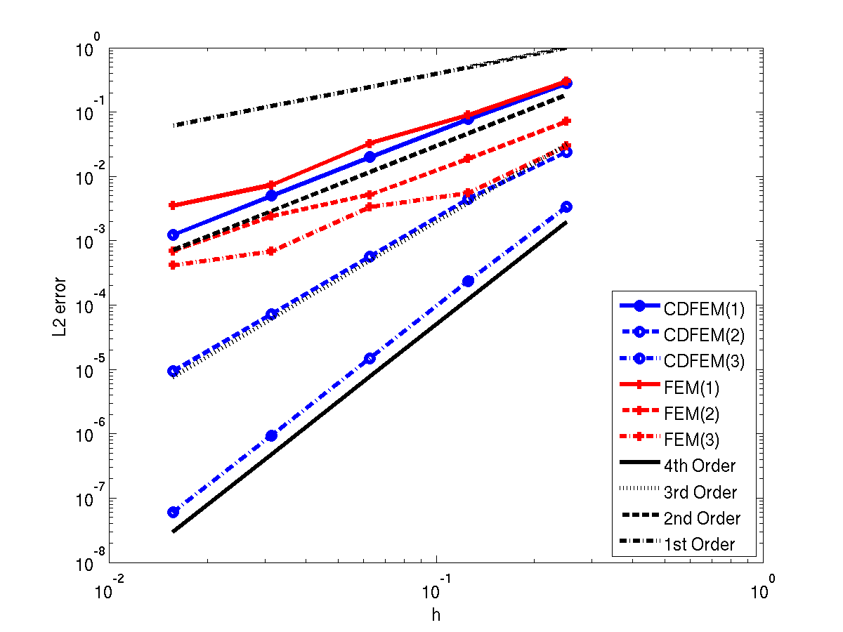
Implicit Solvers for Higher-Order Discretizations
Chris Siefert, Jonathan Hu, Travis Fisher and Stefan Domino
SAND2015-7204 C

Slide 2
Outline
Introduction
Coarsening: Making basis functions work for you!
Smoothing
Results
Conclusions
Special thanks to: Richard Kramer and Clark Dorhmann.

Slide 3
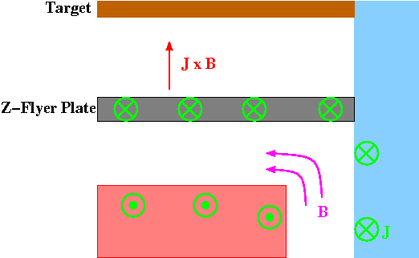
Introduction
EM applications form a non-trivial amount of SNL’s application space, e.g. flyer plates.
Given the near-singularity of the eddy current Maxwell’s equations, we must do this implicitly.

Slide 4



Introduction (with math)
We want to solve one (or more) of the following eqns…
Poisson (2D magnetics, 3D low magnetic Reynolds number)
Maxwell (3D eddy currents)
Grad-Div (3D thermal conduction)
For this talk I will focus on Poisson, though these techniques are broadly applicable…

Slide 5
Motivating Higher-Order
Higher-order methods have many desirable characteristics.
More accuracy with less mesh.
More efficient on advanced architectures (maybe).
Makes interface capturing more effective.
  Can conserve mass and have continuity (good for diffusion).
  More accurate interfaces can make a big difference.
Potentially opens more element options (tris/tets, anyone?).

Slide 6
Higher Order CDFEM Convergence

Slide 7
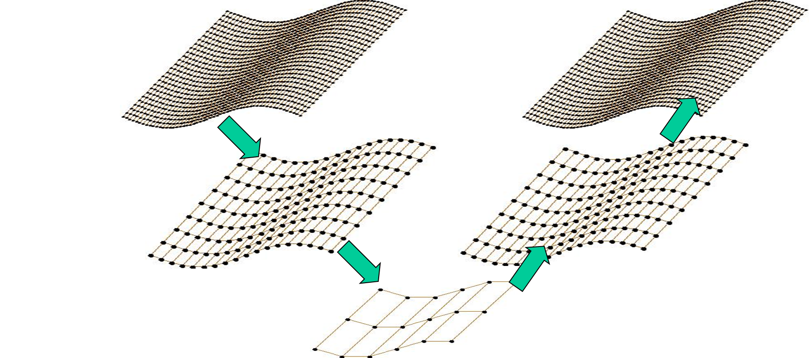
Basic Approach: Multigrid (MG)
Multigrid is very successful for (nearly) elliptic problems.
Works by “separating” the error into two parts
  Oscillatory – resolved by smoother.
  Smooth – resolved by coarse grid correction.
This can be done algebraically (AMG).
Smooth
Smooth
Smooth
Smooth
Solve

Slide 8
Why isn’t this enough?
Multigrid is designed for…
  p=1 FD & FE methods.
  Nice meshes.
  Elliptic operators.
Things that cause issues
  p>1 discretizations. Especially if they are adaptive.
  Local h-refinement, if it creates bad aspect ratios.
Other issues (not discussed today)
  Non-elliptic operators (e.g. convection).
  Alternative discretizations (e.g. DG).

Slide 9
From here on out…
First, we need to develop a method for coarsening to a problem we like.
  If we like p=1, let’s turn p>1 into p=1.
  If we like meshes w/o local refinement, let’s locally de-refine.
Second, we need to develop smoother(s) that can handle whatever we’re coarsening away.
  Standard methods (e.g. Gauss-Seidel, ILU often won’t cut it).
  More exotic methods (sometimes Schwarz-based) will be needed.

Slide 10
Outline
Introduction
Coarsening: Making basis functions work for you!
Smoothing
Results
Conclusions

Slide 11
Thinking About Matrices…
If we write out the stereotypical FEM stiffness matrix, we get
where F is the Jacobian and phi is the basis function.
Coarsening the matrix is like to changing to a different basis.
Note: In equation above, Jacobians are on the inside.
This means that change of basis matrices can be applied outside, i.e., to the assembled system.
This result is (a little) like a sub-parametric element.

Slide 12
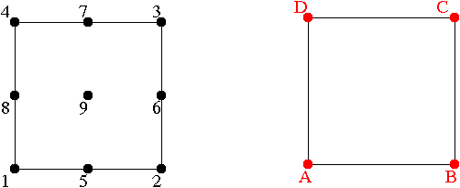
Example: p=2 Quad (HO-FEM)
Want to go from p=2 to p=1. Ask the basis functions:
“What would the lower-order interpolant be?”
p=2
p=1
 | 1 | 2 | 3 | 4 | 5 | 6 | 7 | 8 | 9
A | 1 |  |  |  | ½ |  |  | ½ | ¼
B |  | 1 |  |  | ½ | ½ |  |  | ¼
C |  |  | 1 |  |  | ½ | ½ |  | ¼
D |  |  |  | 1 |  |  | ½ | ½ | ¼
See: Siefert, Tuminaro, Gerstenberger, Scovazzi, and Collis. Computat. Geosci. 2014.

Slide 13
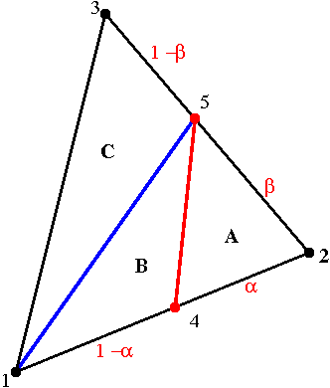
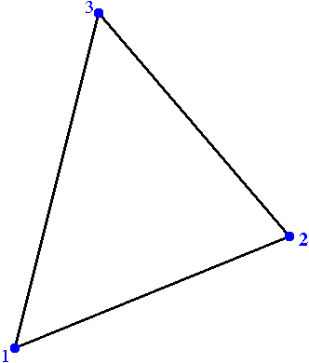
Example: h-Refined Tri (CDFEM)
Want to get rid of local h-refinement. Ask the basis functions:
“What would the lower-order interpolant be?”
h
H
 | 1 | 2 | 3 | 4 | 5
1 | 1 |  |  | α
2 |  | 1 |  | 1−α | 1−β
3 |  |  | 1 |  | β

Slide 14
About the approach…
This works for any element type and (almost) any basis.
Pseudo-code:
  HIcoord = get_reference_coords(HInodes)
  LObasis = evaluate_lo_basis(Hicoord)
  For each element i…
    J = list of HI unknowns for i
    K = list of LO unknowns for i
    P(J,K) = LObasis
The resulting “P” matrix coarsens the basis.
Note: “First touch” rules should be added for efficiency.

Slide 15
Outline
Introduction
Coarsening: Making basis functions work for you!
Smoothing
Results
Conclusions

Slide 16

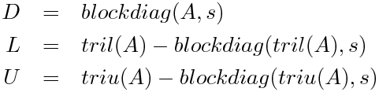
Smoothing
Smoothing makes things trickier… what smoother adequately damps the “higher order” modes?
One approach involves block methods, e.g. block Gauss-Seidel
Another approach involves exploiting the structure of the “higher order” problem to improve smoothing.
We’ll walk through 2 examples, CDFEM and HO-FEM.

Slide 17
Smoothing for CDFEM
CDFEM involves a local refinement (from tris/tets to tris/tets).
Since refinement is local, existing smoothers should be OK away from the refinement area.
Basic idea
  Smooth everywhere on the
  refined mesh.
  Smooth only near the cut on the
  locally de-refined mesh.

Slide 18
CDFEM Example
Test on regular 2D quad mesh.
One cut w/ jump discontinuity.
Solver
  GMRES w/ multigrid preconditioner.
  Smoothers: 1 SGS sweep (pre & post).
  Coarse solver: LU.
Compare coarsening discussed above with…
  Standard SA, no dropping.
  Standard SA, dropping by parameter (0.0001 to 0.1).
  “Distance Laplacian” SA, dropping by parameter (0.0001 to 0.1).

Slide 19
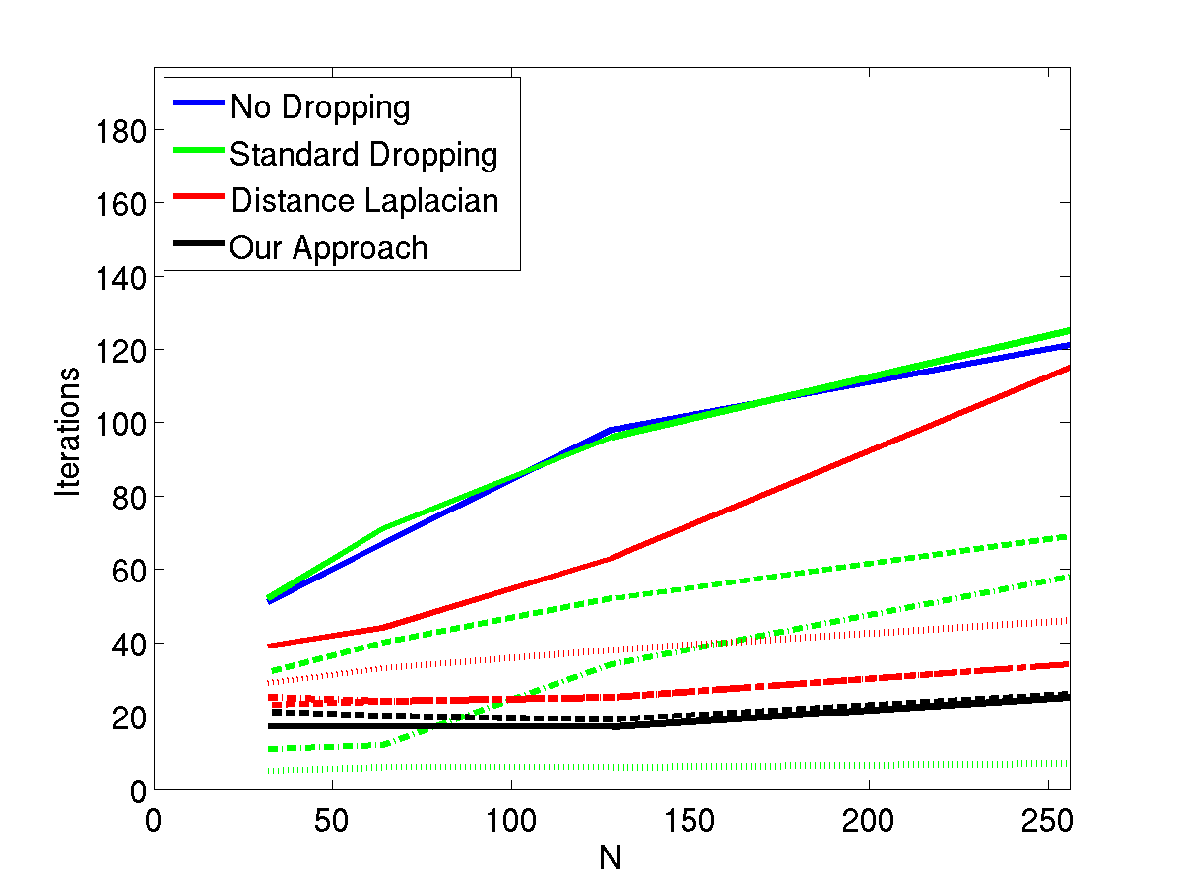
CDFEM Smoothing Results

Slide 20
Smoothing for HO-FEM
When coarsening, we lose access to the higher order information w/i an element (and along edges).
Smoother needs to take this into account, so we’ll block smooth.
But what blocks to use?
Ideas
  Block by topo-entity (GS).
  Element-wise blocks (Schwarz; e.g. Siefert et al.,2014).
  Vertex patches (Schwarz; e.g. Schöberl et al., 2007).
  “Spider” patches (Schwarz; inspired by Schöberl et al., 2007).

Slide 21
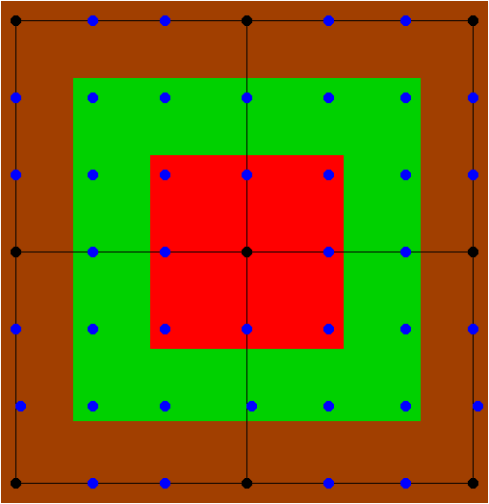
HO-FEM Smoother Details
Classical GS & ILU(0).
Element Patch: All unknowns attached to element.
Vertex Patch: All basis functions which overlap with a vertex.
  We ignore the “outer shell” of the exterior of the patch.
“Spider” Vertex Patches: Patches per vertex.
  Innermost: Vertex and closest points.
  Repeat outwards with concentric sells.
  Can include the “outer shell” or not.
Topo-GS: Block by topo-entity.
  Vertices stand alone.
  All entries interior to an edge are a block.
  All entries interior to an element are a block.

Slide 22
HO-FEM Example
Test on regular 2D quad mesh.
Consider p=2,3,4,5.
Solver
  CG w/ 2-level multigrid preconditioner.
  Fine smoother: Varies.
  Coarse solver: LU.
Goal: Consider p-sensitivity of method.

Slide 23
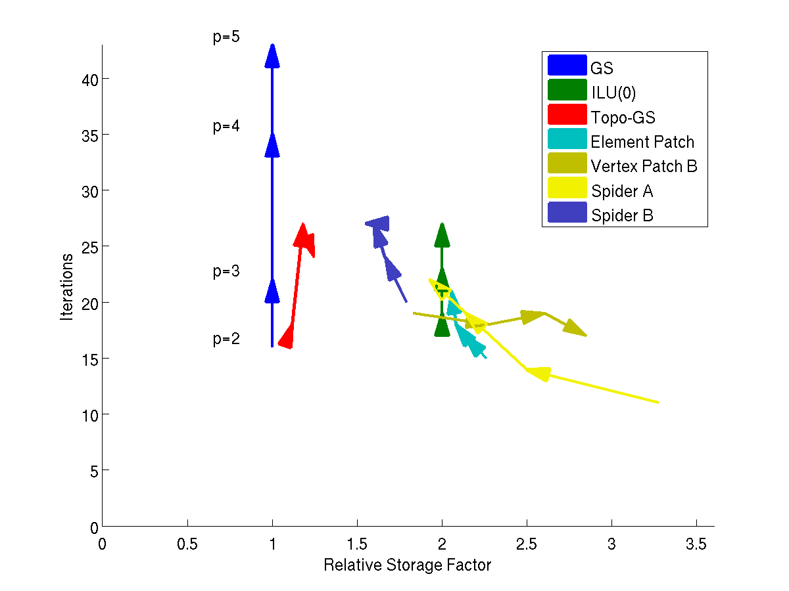
HO-FEM Smoothing Results
It is much easier to say what is bad than what is best.

Slide 24
HO-CDFEM Example
Test on regular 2D tri mesh.
Consider p=2,3.
Solver
  CG w/ 3-level multigrid preconditioner.
  Fine smoother: Smooth HO problem.
  Next finest smoother: Smooth CDFEM problem (locally).
  Coarse solver: LU.

Slide 25
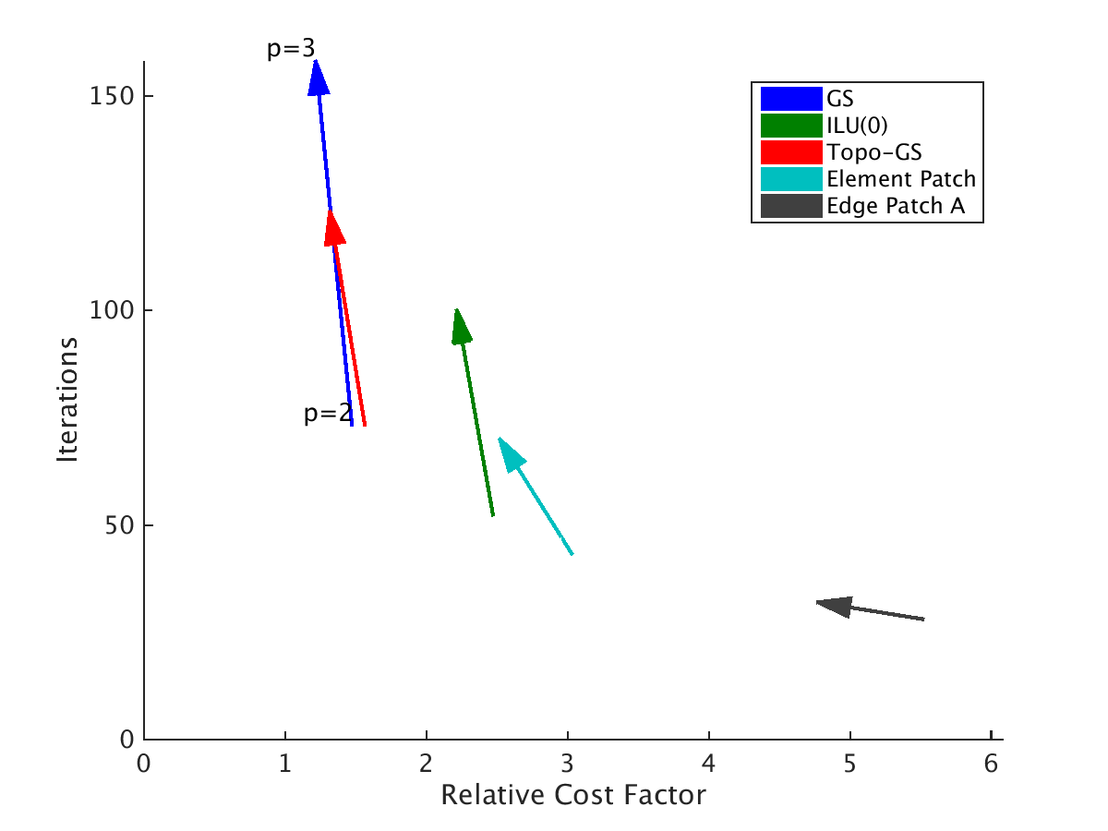
HO-CDFEM Example
Best choice isn’t obvious… more work needs to be done.

Slide 26
Outline
Introduction
Coarsening: Making basis functions work for you!
Smoothing
Results
Conclusions

Slide 27
Conclusions & Future Work
We have presented a general, basis-function informed, framework for coarsening higher-order and h-refined systems.
Framework can be applied to arbitrary elements and bases.
  Edge and faces bases will be extra tricky.
Choice of smoother still a bit of an art form!
Future work
  Larger problems; Tets/Hexes in 3D.
  Use of alternative bases for smoothing (Good idea, Tzanio!).
  “Grey Box” implementation in Trilinos/MueLu.

