Slide 1
Conservative, Multimaterial ReALE Hydro on a Staggered Grid
MultiMat 2015
7th International Conference on Numerical Methods for Multi-Material Fluid Flow
David Starinshak, LLNL
J. Michael Owen, LLNL
Douglas Miller, LLNL
2015 September 7--11

Slide 2
Acknowledgements
Collaborations
Original ReALE Authors (JCP, 2010)
Jeff Johnson (LBL, POLYTOPE)
Jeff Grandy (LLNL, OVERLINK)
Misha Shashkov (LANL)
Wurigen Bo (LANL)
Jerome Breil (Univ. of Bordequx)
Raphael Loubere (Toulouse)
Pierre-Henri Maire (Bordeaux)
Misha Shashkov (LANL)
Jerome Breil (Bordeaux)
Stephane Galera (Bordeaux)

Slide 3
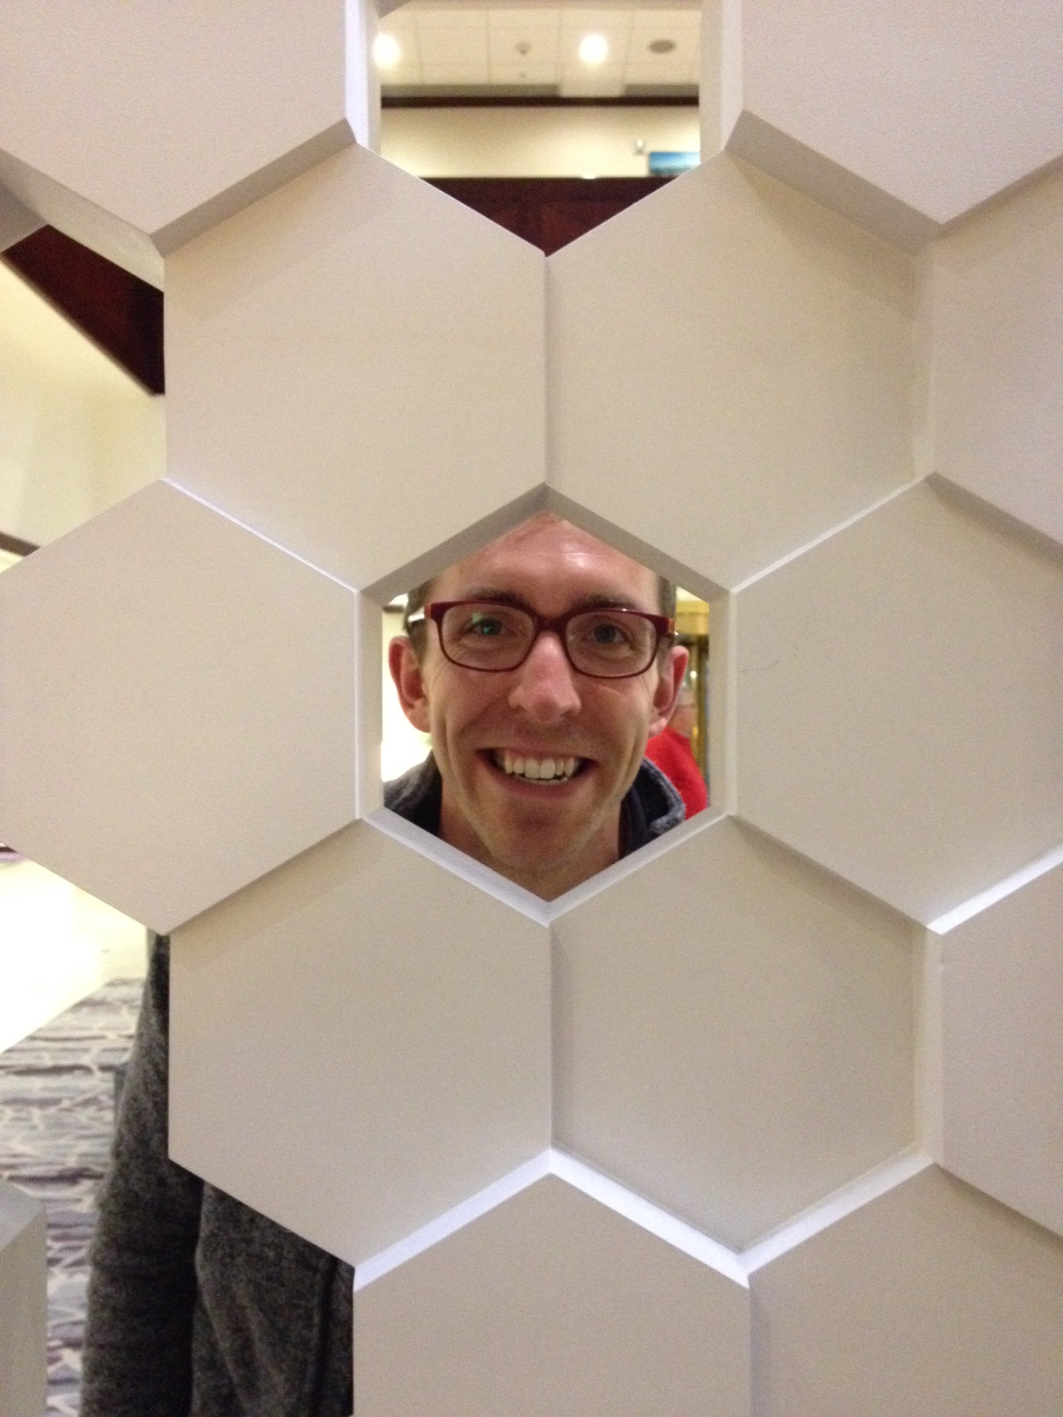
When you work on ReALE, you start seeing Voronoi diagrams everywhere

Slide 4
Our goal is to develop a hydro solver with on-the-fly mesh reconnection within a production multi-physics code base.
Support the host code
Conservative, multimaterial, and parallel
Support staggered discretization
Compatible with existing multi-physics algorithms
Innovate
Modularize algorithms for added flexibility
Improve accuracy with new algorithms and extensions
Improve efficiency, understand performance tradeoffs
The long-term goal is improved robustness for current and future ALE codes.
Notes:
Minimally invasive integration

Slide 5
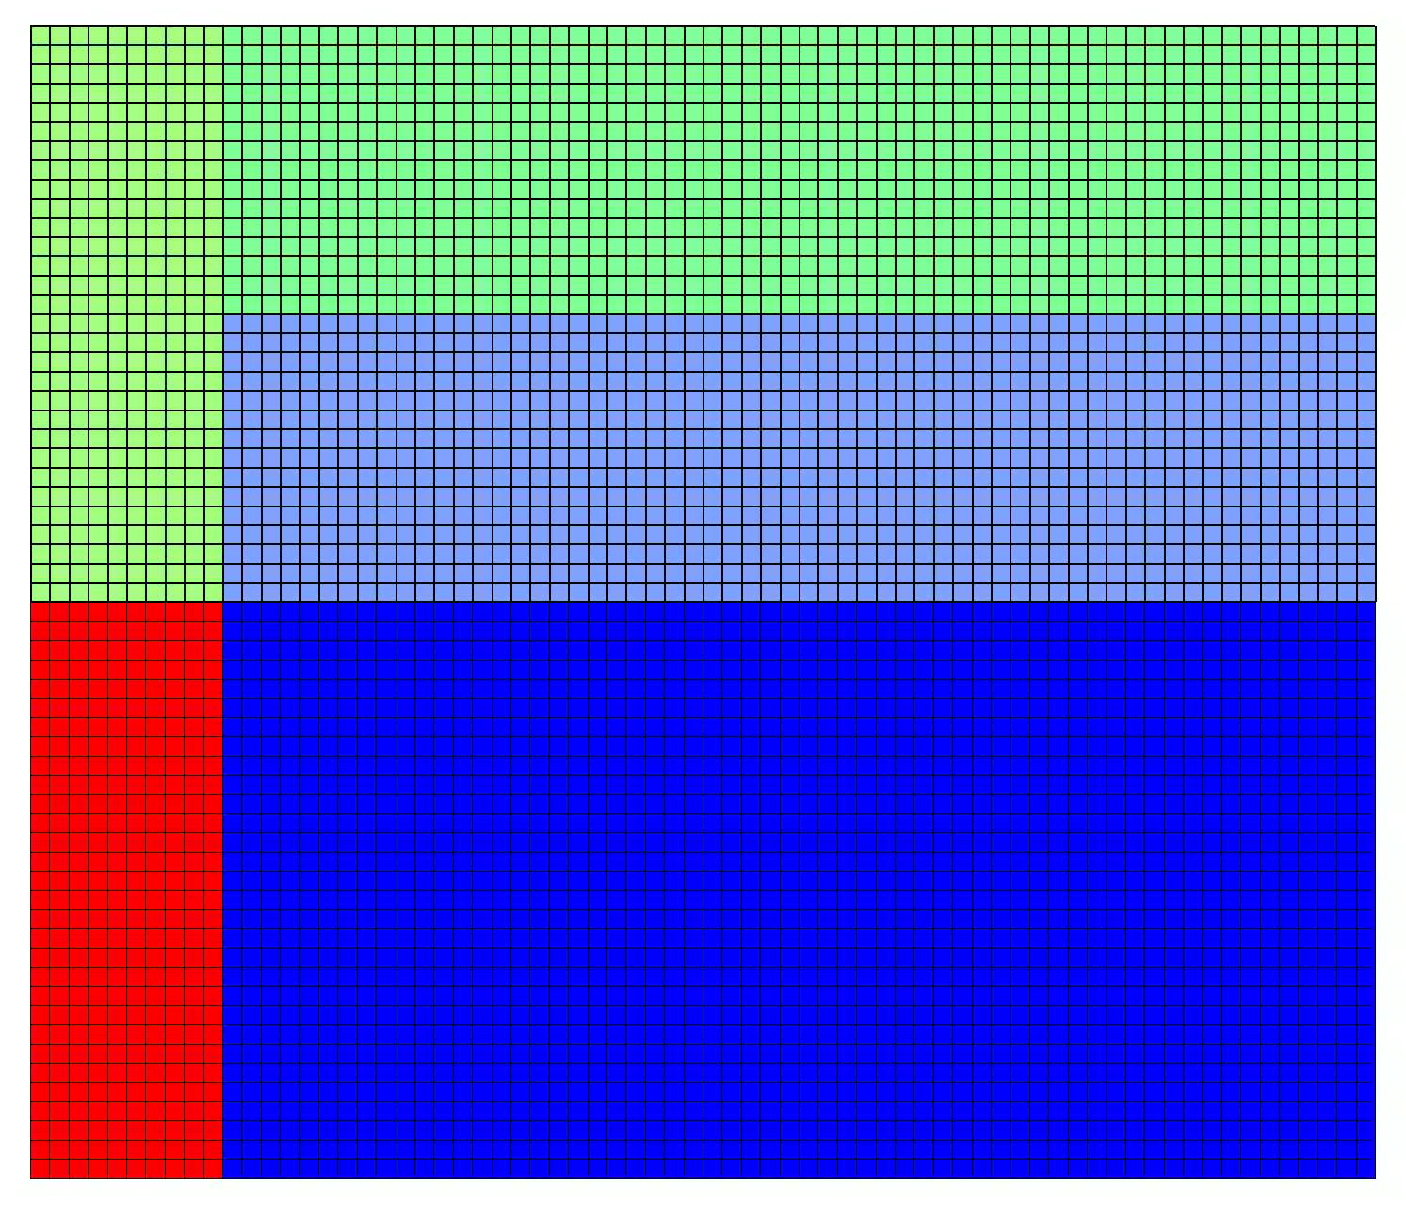
Under ReALE, the mesh can change connectivity on-the-fly, preventing tangling and locking in the face of extreme vorticity and shear.
Triple point test problem:
2D, multimaterial shock tube problem
Shear across horizontal interface leads to vortical roll-up
ALE
ReALE
Notes:
Interesting software design problem
This is the same code.
Mesh reconnection is added as an option

Slide 6
ReALE naturally extends the ALE cycle of Lagrange + Remap.
Voronoi generator
Lagrangian Stage
Lagrangian hydro code updates state
Mesh moves, generators move with mesh
Rezone Stage
Generators create new mesh elements
Mesh connectivity changes
Remap Stage
Map state from old mesh (red) to new mesh (black)
Compute polygon-polygon intersections

Slide 7
Staggered discretizations provide numerous benefits.
Artificial Viscosity
  Low dissipation shock capturing
  New tensor formulations under development
Flexibility
  Multiple control volumes available to discretize model equations
  Efficient gather-scatter operations for local physics
  Mimetic algorithms for discrete math operators
Multi-physics coupling
  Improved accuracy coupling radiation to materials
  Invariant-preserving magneto-hydrodynamics
We have decades of experience to draw on for staggered-grid modeling.
Notes:
EXPERIENCE!!!
Don’t need staggered variables to get many of these benefits

Slide 8
ReALE uses the OVERLINK library to handle its remap stage.
Successful remapping tool developed at LLNL [Grandy, JCP, 1999]
Multi-dimensional
Multi-material
Massively parallel (10⁶+ cores)
Handles unstructured meshes of arbitrary polygons/polyhedra
Formally second-order-accurate
Donor-target
intersections
Donor zone
contributions
OVERLINK meets nearly all requirements for a staggered ReALE remap.

Slide 9
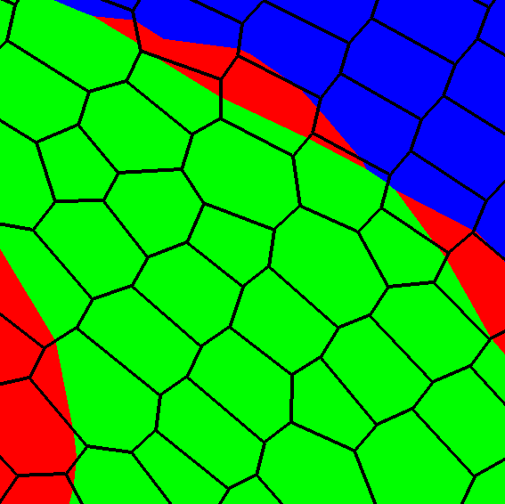
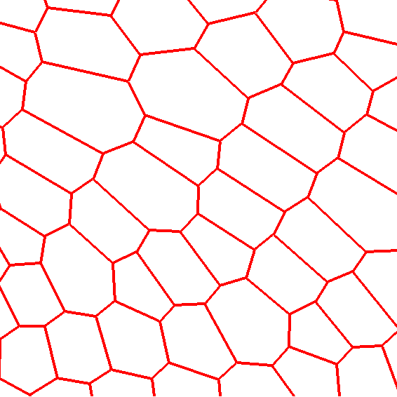
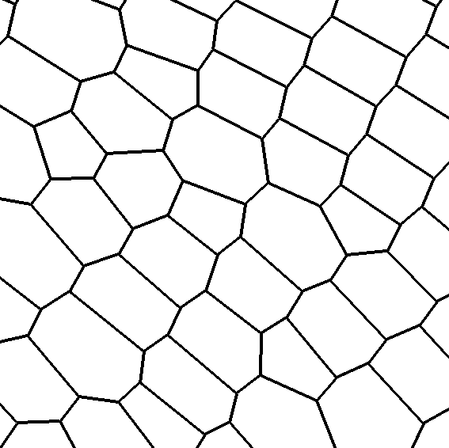
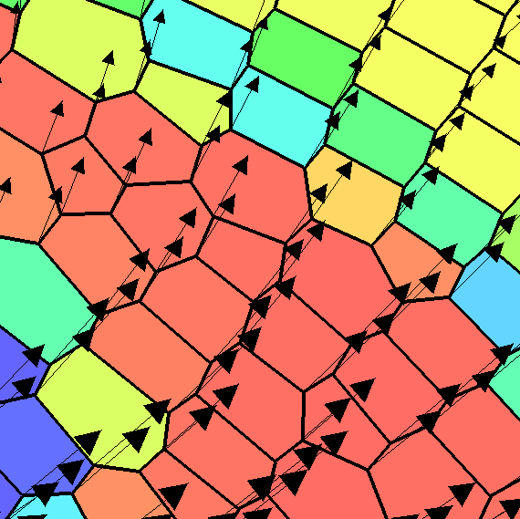
ReALE uses the OVERLINK library to handle its remap stage.
Material Data
volume concentrations
reconstructed interfaces
Donor
Mesh
Target
Mesh
Staggered Field Data
Mass, internal energy from zones
Momentum, kinetic energy from nodes
Notes:
ADVANTAGES OF STAGGERED
Extremely flexible model for discrete physics
Artificial viscosity formulations for low-dissipation shock capturing
Decades of experience for multi-physics coupling

Slide 10
Mass is discretized on subzonal elements to ensure compatible definitions of mass at zones and nodes.
Corner definition
Subzonal element
Zone + node + pair of half edges
Geometric intersection of zonal and nodal control volumes
Corners masses are an important component of the staggered compatible staggered discretization^{[1]}
Corners: mass
Zones: internal energy
Nodes: velocity, kinetic energy
[1] Caramana et al, JCP, 1998

Slide 11
Conserving momentum is challenging under this discretization.
Pre-remap state
Post-remap state
Nodal momentum
Post-remap velocity
Node-to-node overlay
Node sum
?
Zone sum
Zone-to-zone overlay
How do you recover subzonal masses after remapping?

Slide 12
Three options are available to recover subzonal masses.
Flatten: Set subzonal densities equal to to zone density
Simple, fast, local
Momentum not conserved
Subcell Remap: Directly overlay all quantities from subzones to subzones
Conservative
Prior experience available^{[1,2]}
Scales poorly (especially in 3D)
Multimaterial extension is not straightforward
Reconstruct: Constrained optimization computes best-fit densities
Conservative
Parallel, scales well
Must solve globally-coupled linear system
[1] R. Loubere et al, JCP, 2010
[2] R. Loubere & M. Shashkov, JCP, 2005

Slide 13
Subzonal masses solve an optimization problem with constraints.
Conservation constraint at each zone
Conservation constraint at each node
Minimize: L₂ variation relative to reference state
Global Lagrangian functional
[1] D.P. Starinshak, J.M. Owen (JCP 2015)
Fixed points of the Lagrangian satisfy an under-constrained system.

Slide 14
The linear system can be solved efficiently using existing tools.
Minimizing the Lagrangian amounts to solving a linear system
Remapped masses and reference density
Nonzero if z_{i} and z_{j} share nodes
Lagrange multiplier for z_{j}
Properties:
Size determined by number of zones (not subzones)
Sparse: matrix elements determined by mesh connectivity
Singular with codimension-1 null space
Matrix stencil
Solved in parallel using the HYPRE library
BoomerAMG preconditioner with GMRES linear solver
No expensive SVD required
Null space avoided using trivial initial guess

Slide 15
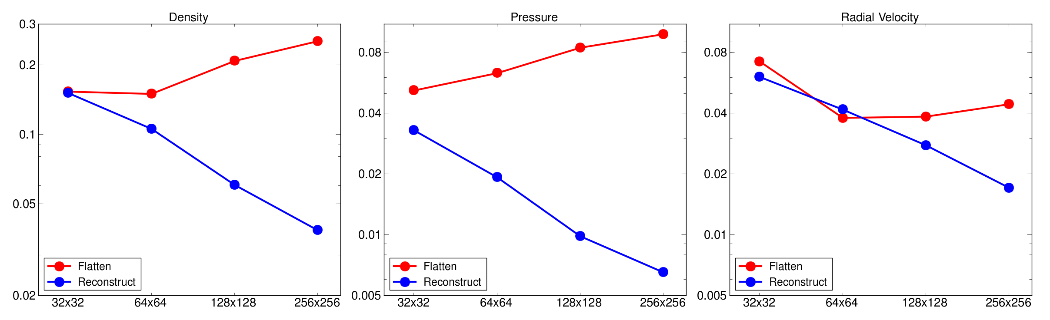
We establish L₁ convergence for the ReALE solution to Sedov’s blast wave when momentum is conserved
Flattened
Reconstructed
Pressure
Density
Pressure
Radial Velocity
L₁ Error
Notes:
Reconstruction adds ~15% onto the total overlay time
NxN quad mesh -> N^2 zones, N^2 nodes
Staggered remap + reconstruction ~ 2.3 * N^2
Subcell remap ~ 4 * N^2
Convergence rates:
Density: 0.72
Pressure: 0.68
Velocity: 0.58

Slide 16
Corner reconstruction extends naturally to multiple materials.
Reconstruction is independent of materials
Total zone mass:
Total corner mass:
Total node mass:
Material-dependent variables exist only on zone elements
Per-material zone mass:
Per-material volume fraction:
Material concentrations inside a corner matches the concentrations of its zone
Zone view
Corner view
Notes:
Additional physics does not couple to materials at a scale below zones
Subgrid material model is unnecessary and wasteful in memory and resources

Slide 17
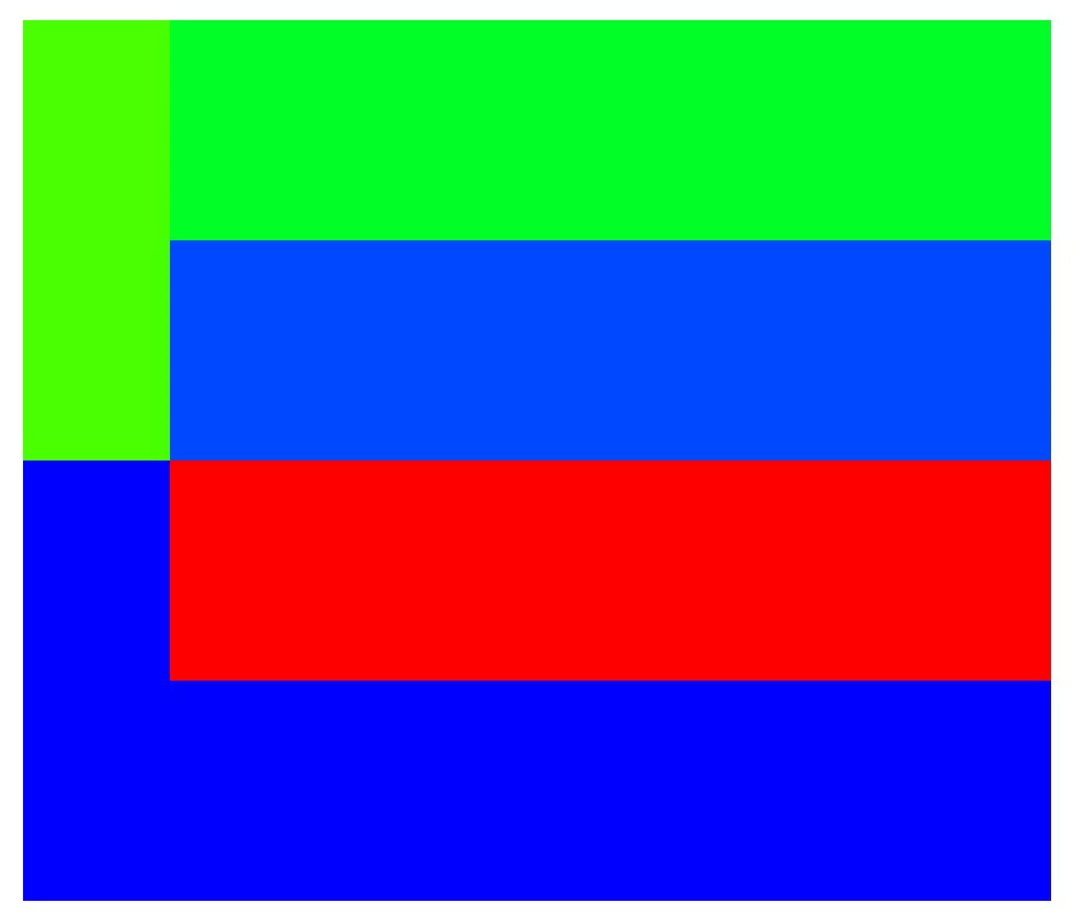
We robustly simulate problems with multiple interacting materials having extreme shear and vorticity.
Total Energy
Volume Fraction
560 x 240
80 procs

Slide 18
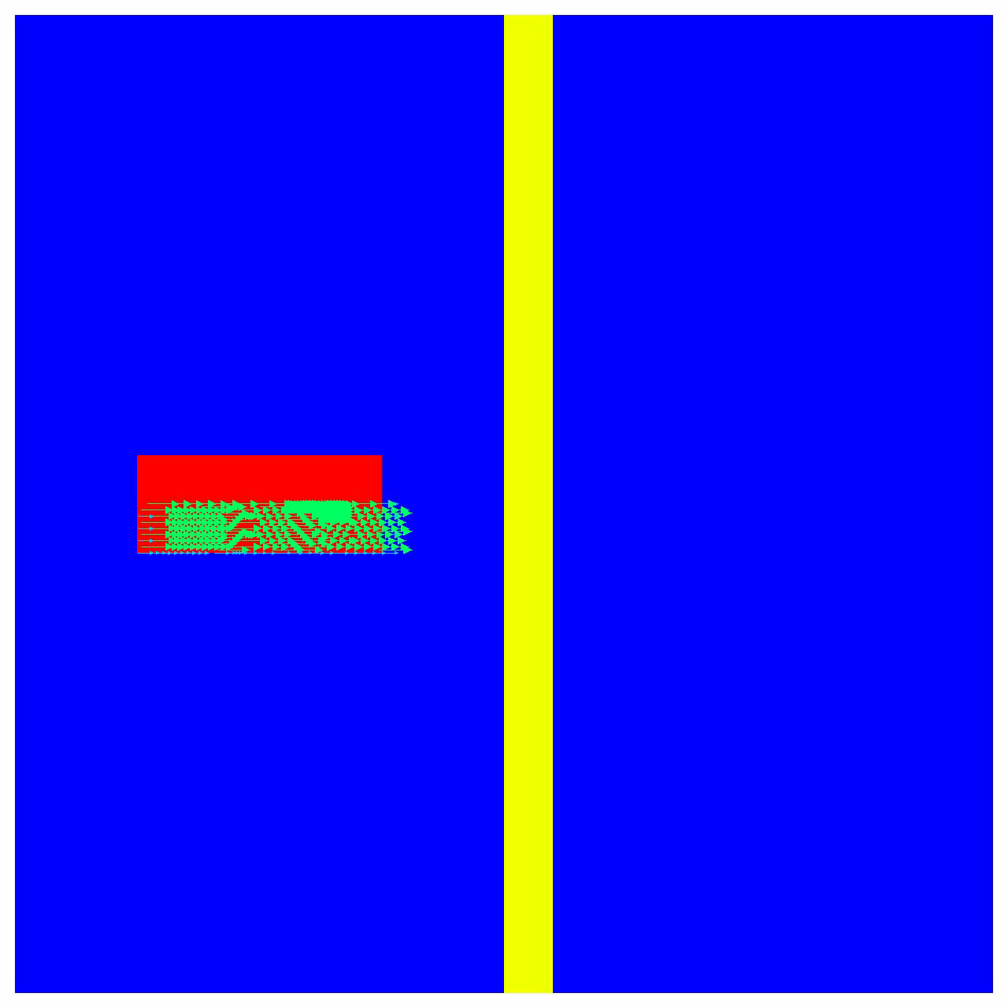
We robustly simulate problems with multiple interacting materials having extreme shear and vorticity.
Impactor
320² zones
64 processors
Air
Slab

Slide 19
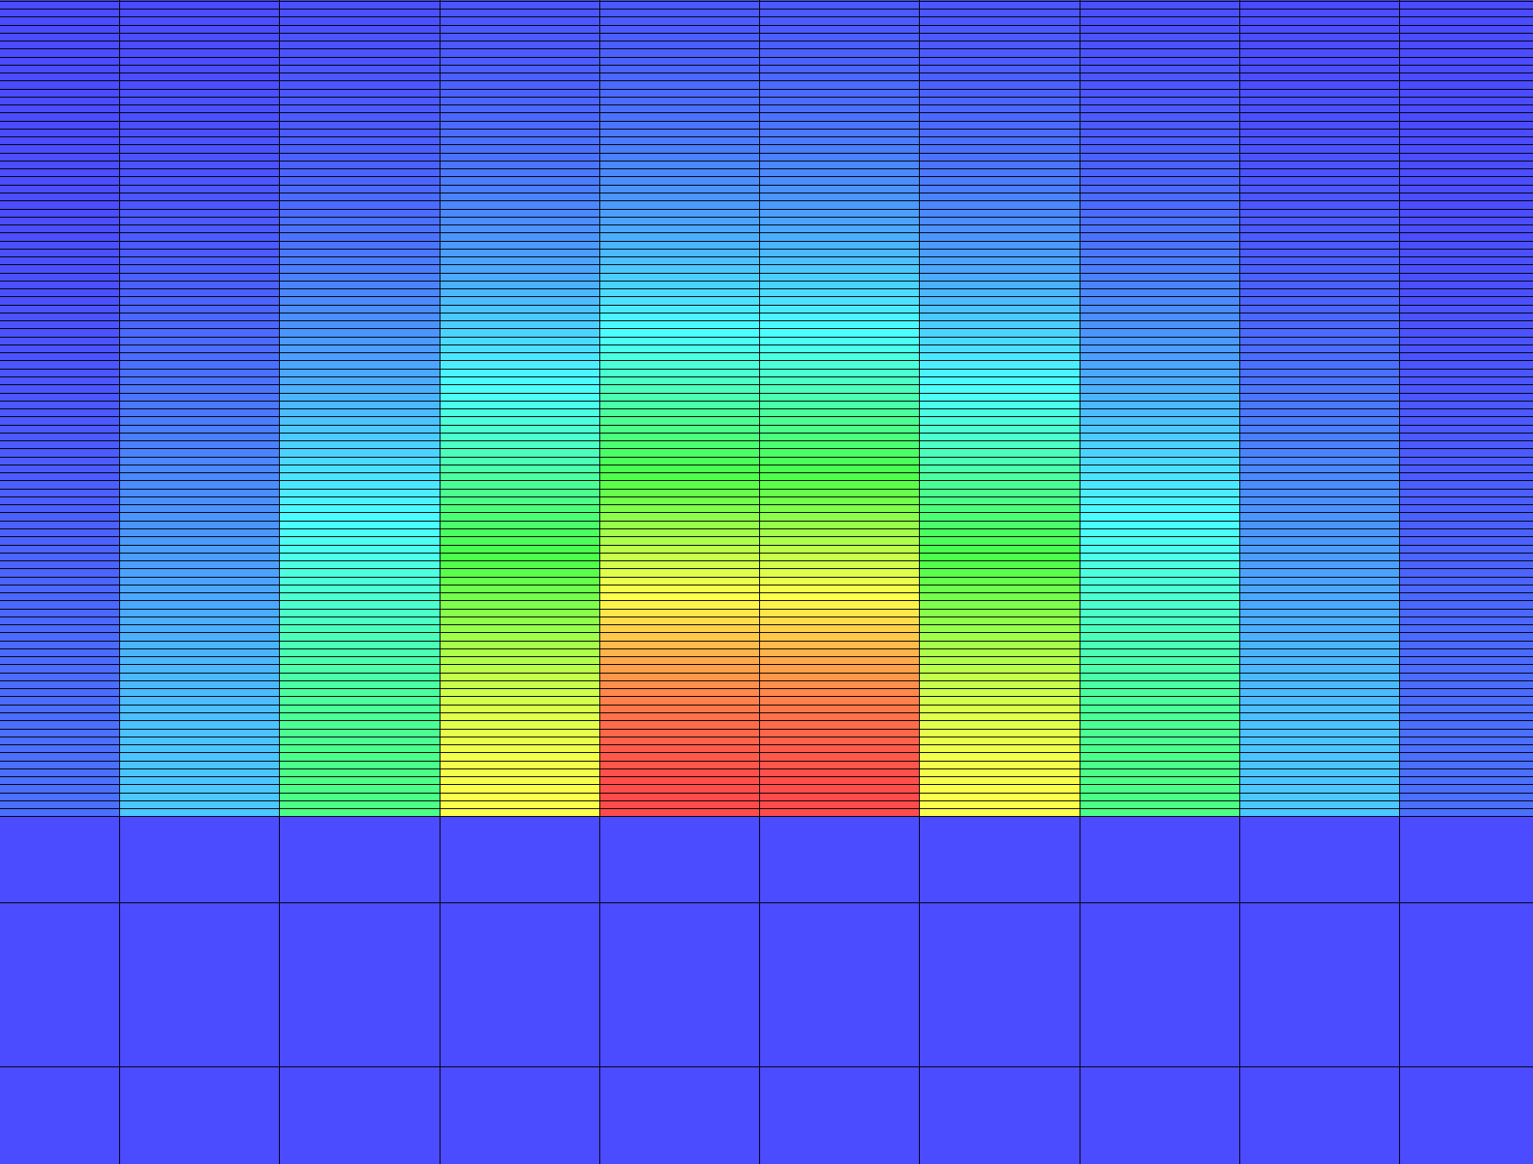
We’ve defined a pure-hydro test problem to approximate the laser-driven ablation of a surface.
Pseudo holhraum wall
20:1 aspect ratio zones
Density = 10
Gamma law gas
Pseudo holhraum interior
Density = 0.01
Gamma law gas
Pseudo laser spot
Exponentially-decaying energy deposition
The test approximates an ICF holhraum in planar geometry.

Slide 20
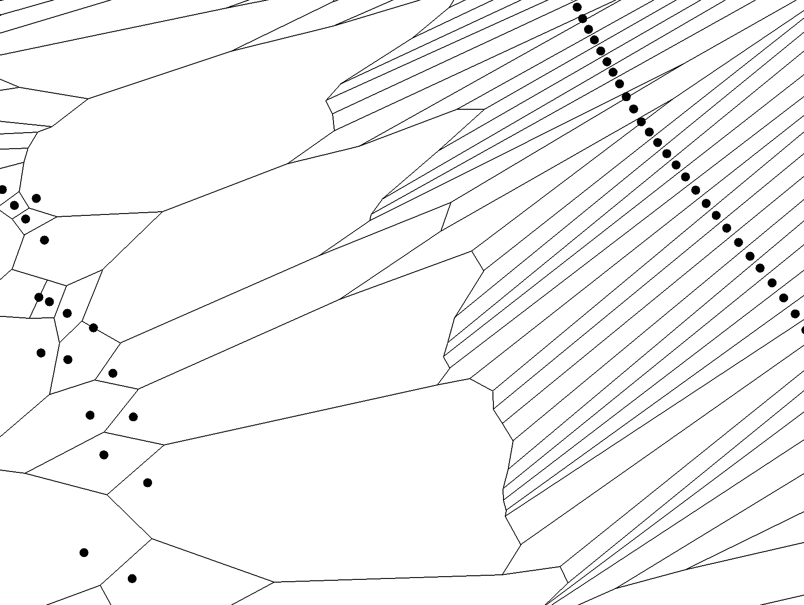
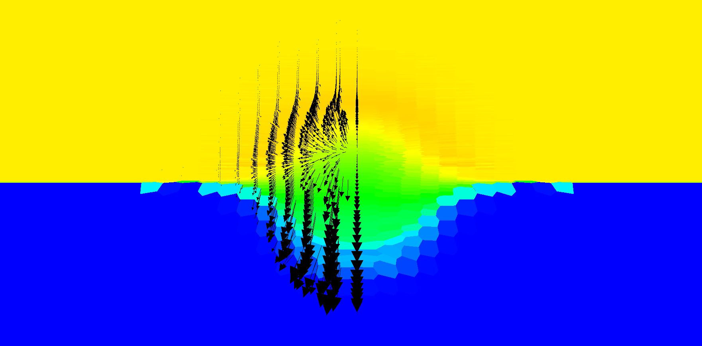
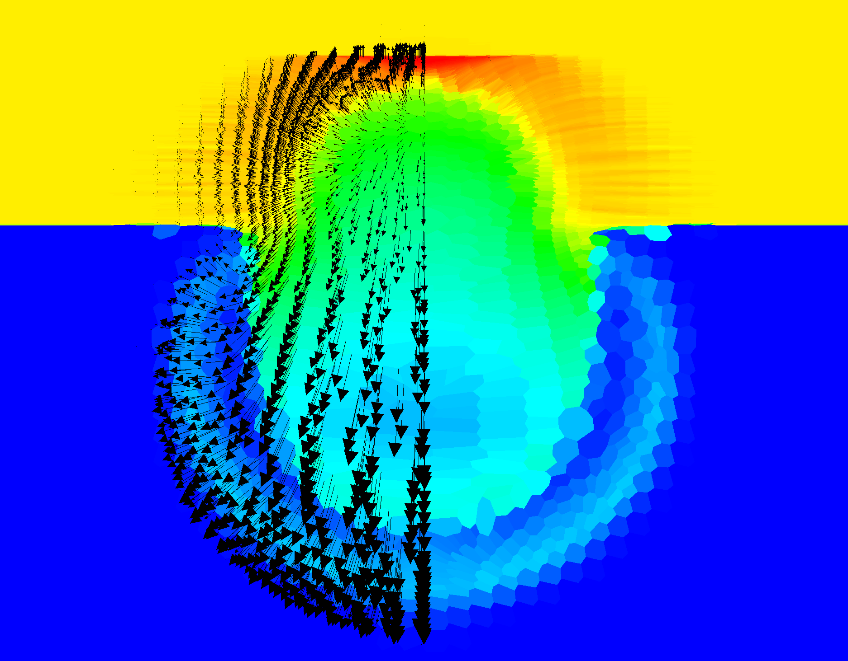
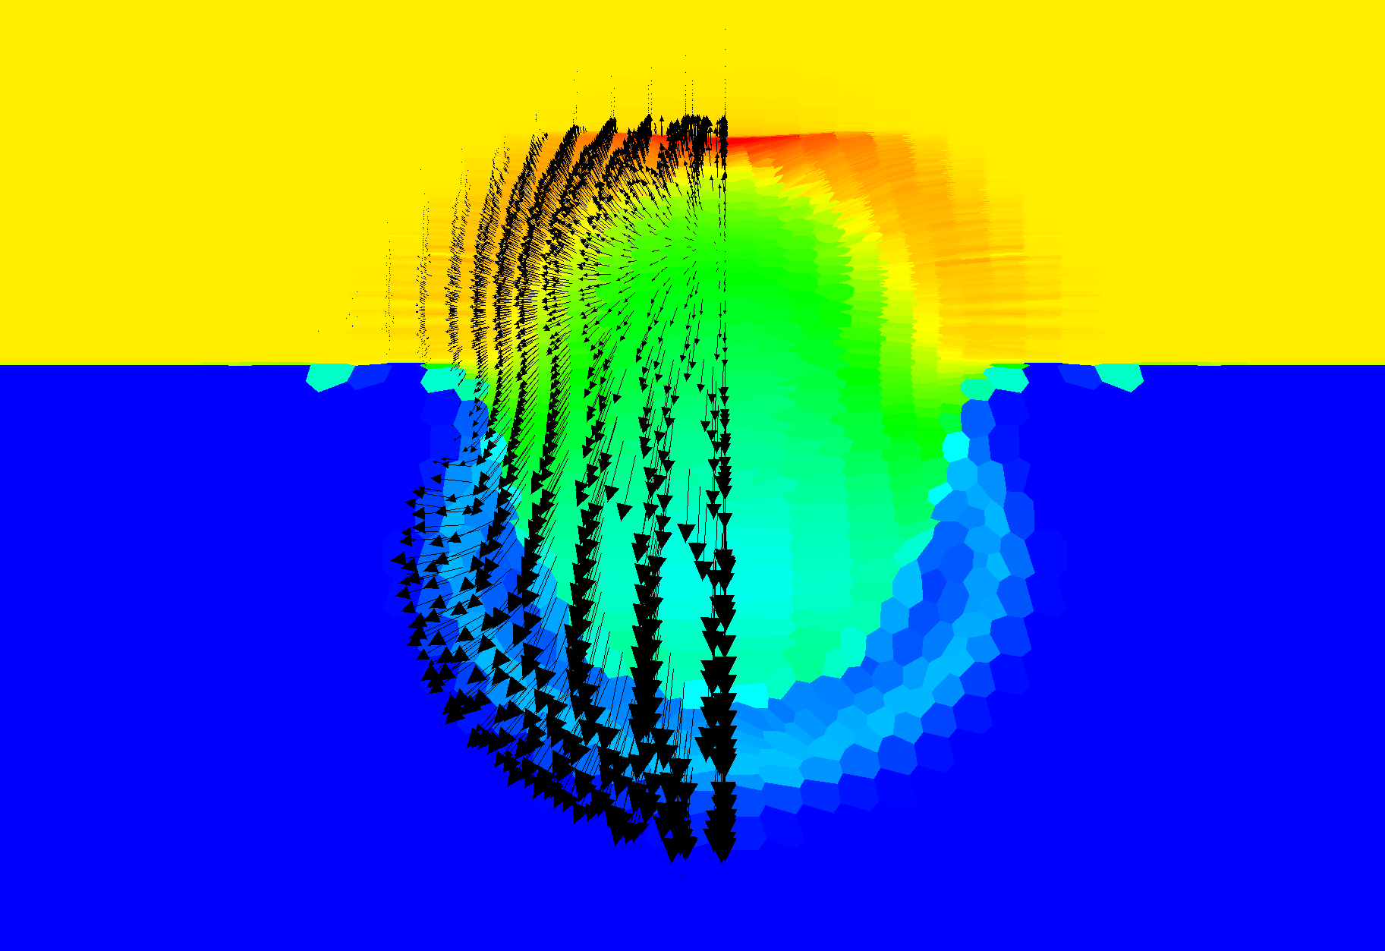
ReALE robustly models the blow-off of high-density material without tangling the mesh or resorting to excessive ALE dissipation.
The mesh doesn’t tangle, but more work is needed to improve the wall-ablation transition region.
log(density)

Slide 21
Summary
Efficient algorithm for staggered remapping
Conservative post-processing stage for reconstructing subzonal data
Parallel, multimaterial, and scalable in complexity
Future Work
Multi-physics ReALE
Coupled radiation-hydrodynamics on a reconnecting mesh
Repeat ablation calculation with full physics
Regional ReALE
Reconnect only a subset of the mesh
Develop strategies for when/where to reconnect
Lagrange, ALE, and ReALE in a single simulation

