Slide 1
Comparison of Material Point Method (MPM) and Volume of Fluid (VOF) Method in simulation of HE material fragment impact
Xia Ma†, Christopher C. Long, Erik A. Moro, Bradford E. Clements and Duan Z. Zhang
September 7th, 2015
LA-UR-15-26630
Notes:
Recently I shifted my working load from MPM method to VOF method to simulate the high explosive detonation shock waves, which involve a quick transition from solid state to gas state, in addition to the high speed impact between metal fragment and the explosives, and often further involve a covering shell of different materials. so what I am doing is a great challenge for multi-material interaction simulations. Also my recent work area shift put me in a unique position that I can compare the MPM method with VOF method for predicting and simulation these challenging multi-material interaction problems

Slide 2
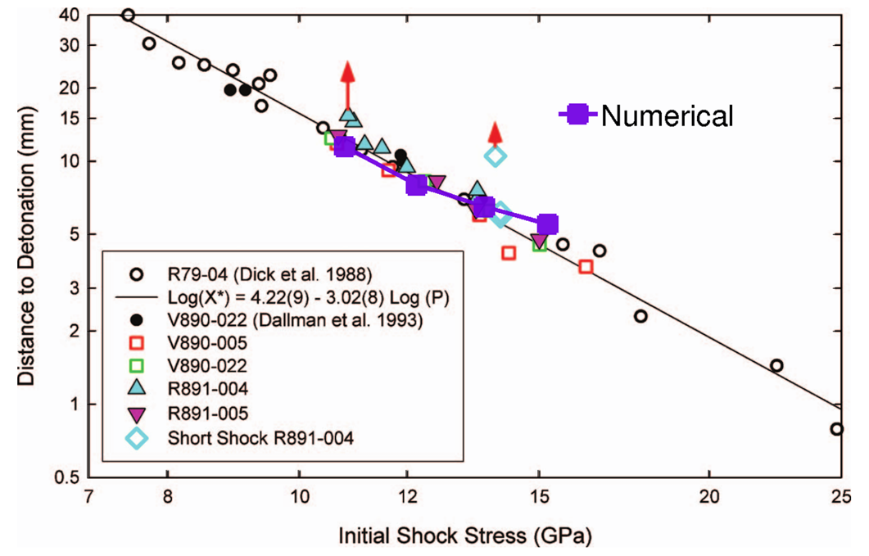
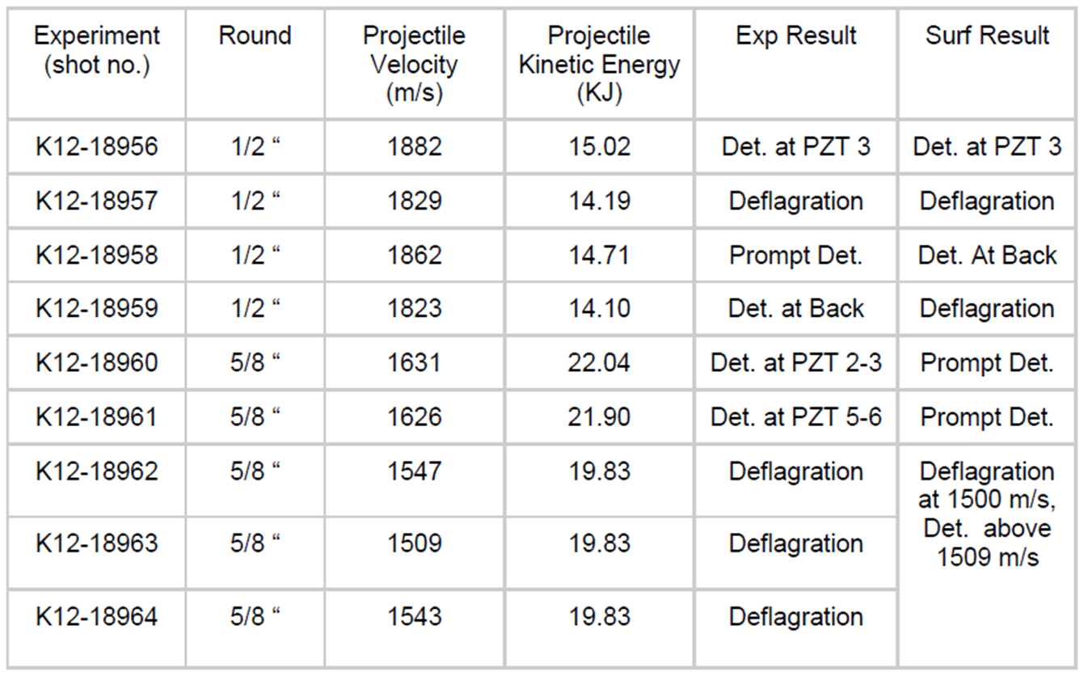
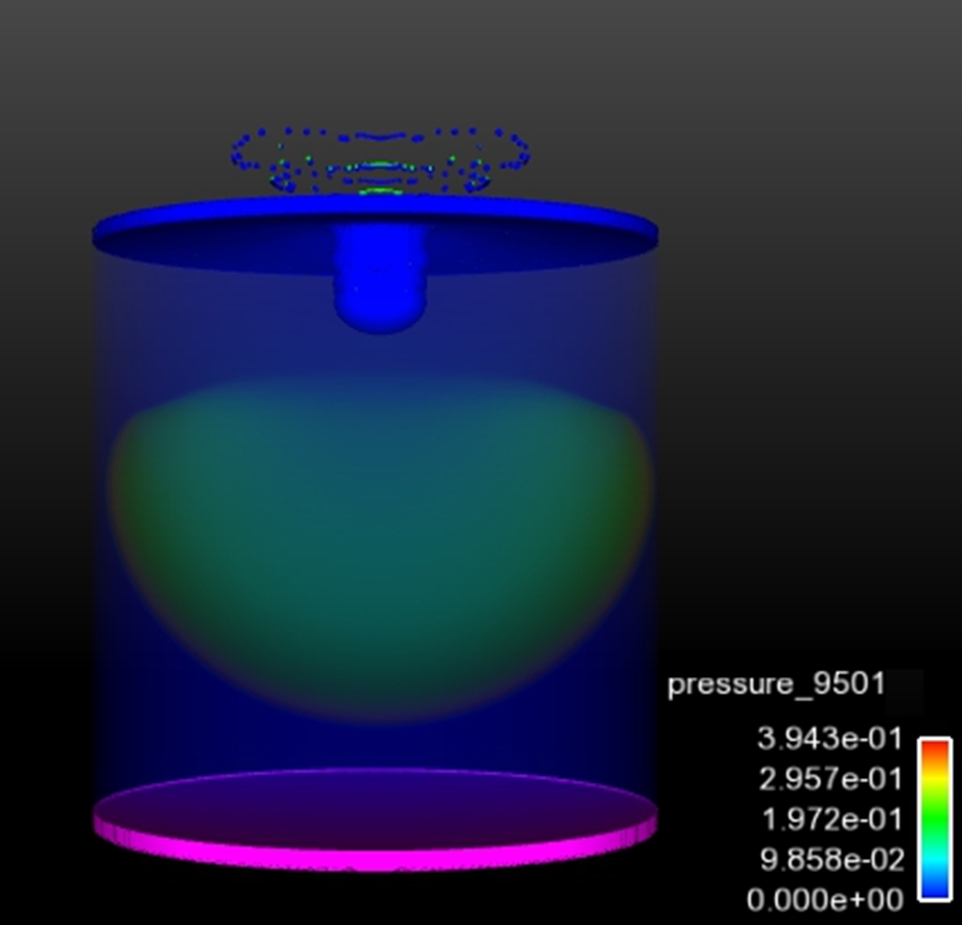
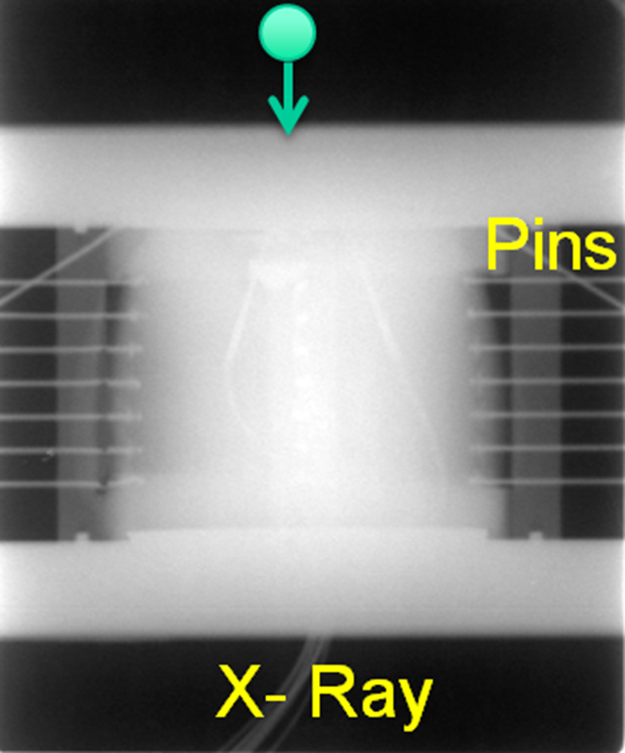
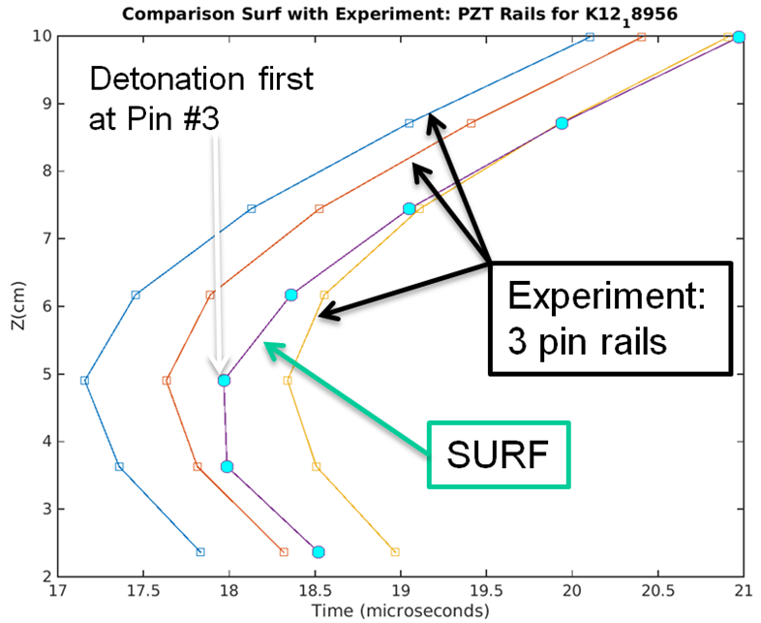
A spherical projectile penetrates the cover plate and detonates the solid explosive underneath. This is a Pagosa simulation based on VOF and SURF.
1
2
3
4
5
6
7
1234567
Fig. Full 3D simulation
Fig. Experimental set-up
Notes:
One of the several issues we are working on for this simulation are the quenching phenomena, which is called corner turning effect

Slide 3
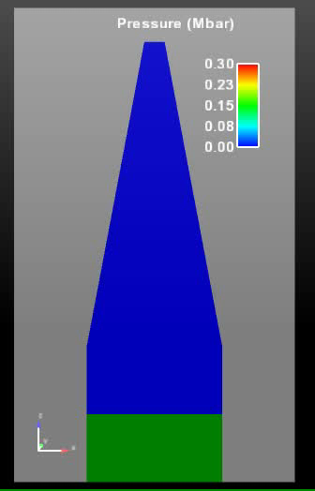
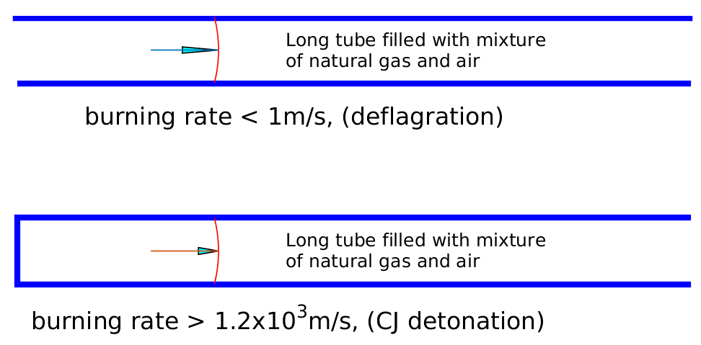
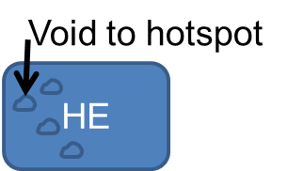
Corner turning (quench problem)
Solid HE has additional mechanism often dominate detonation
Void to hotspot
shock
Analogy HE as a mixture of paper and coal
HE
Paper on fire | Coal on fire
Deflagration Violent burn | Detonation 10⁶ faster
shock
Notes:
Sometimes tt looks like a full blown explosion, but suddenly it quenches. which is perplexing and baffling, anti-intuitive.
Close void and desensitize it

Slide 4
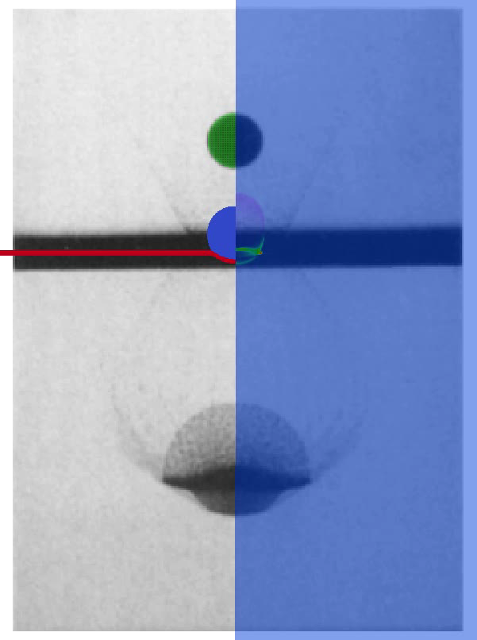
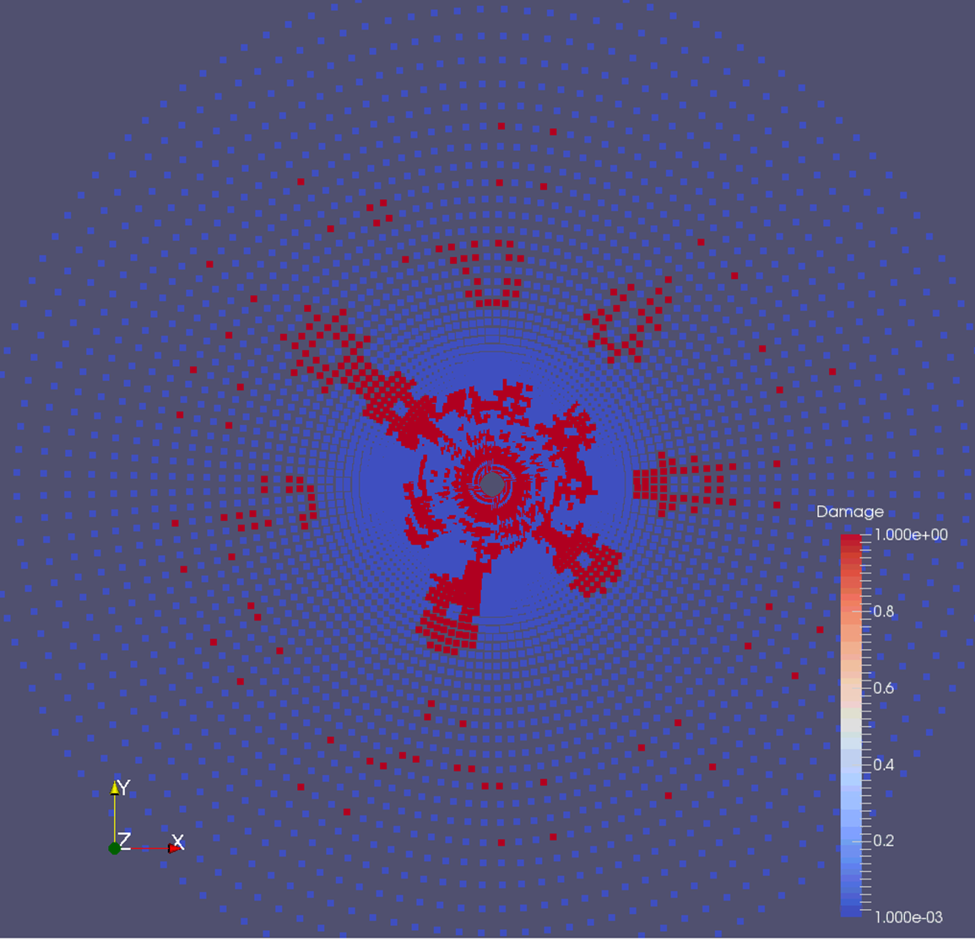
Things that only CartaBlanca can do
Center circle (oil well) is heated.
The heat transfer by conduction vaporizes the water permeated in the rock and this creates a high pressure which in turn cracks the rock.
The red color represents the damaged (or cracked) rock.
There are four phases in the simulation: Rock, bitumen, water and vapor generated by phase transition from water.
The high pressure also drives the melted oil toward the center which has a lower pressure.
Non uniform instability is observed.
Fig. Pulverized to dust cloud by striking the aluminum plate with a sphere.
Fig. MPM Simulation of Rock cracking by vaporization
Notes:
The transition from Solid HE to Gas usually needs an explicit model, for example the JWL and Surf model. But we sometime encounter situation that there is a lack of experimental data to calibrate an accurate transition model. In this case Cartablanca can simulate decently without such a model, for example this sphere impact the aluminum plate and powerivized it

Slide 5
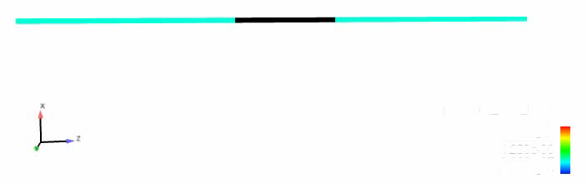
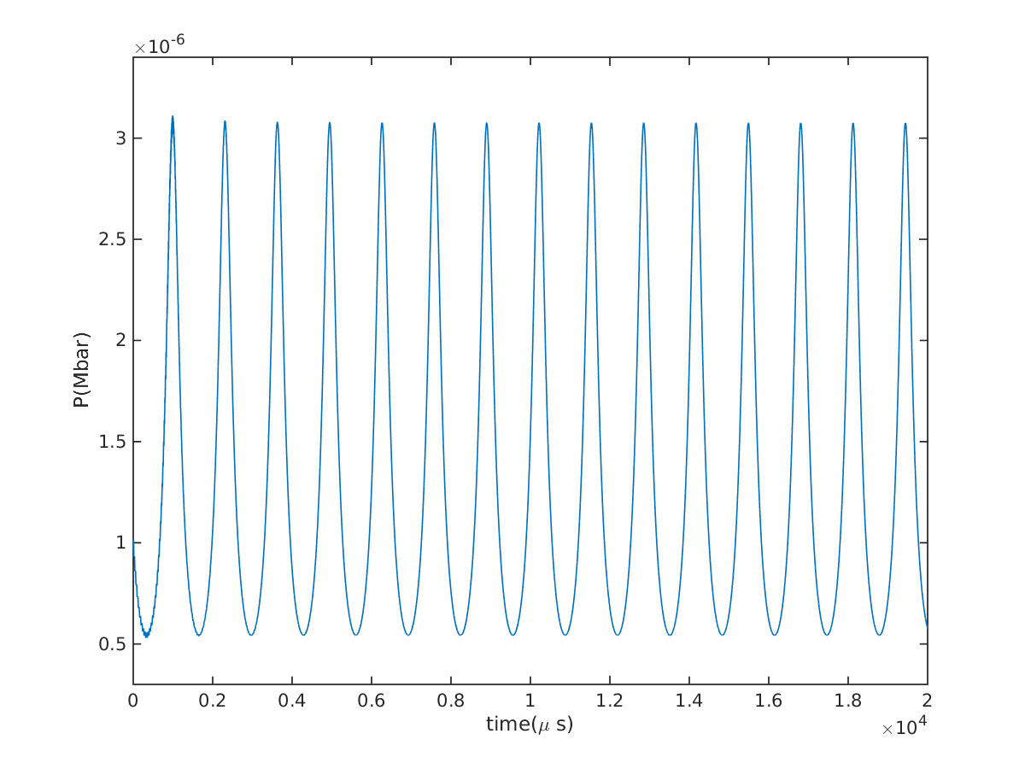
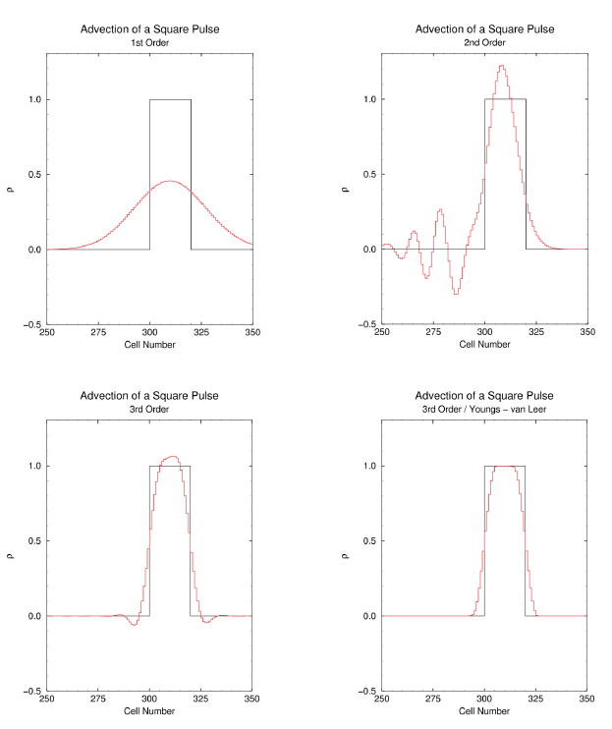
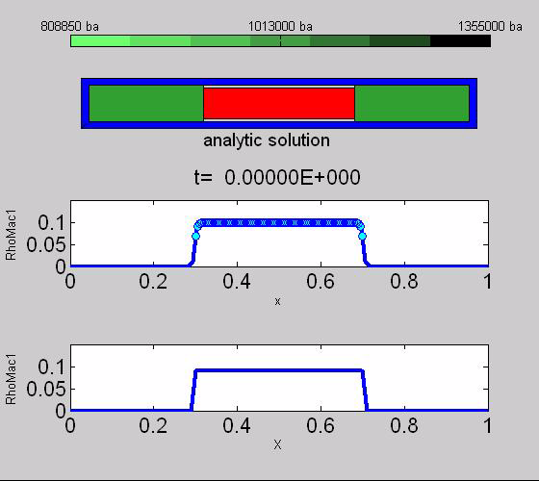
Advection
Diffusion
New VOF (PAGOSA)oscillating piston simulation
Pressure
Notes:
Advection diffusion error is actually the major drawback of Eulerian method, which provide reasons for advancing other method, but at same time it also improve itself.
These are very low frequency vibration, what about a high frequency vibration

Slide 6
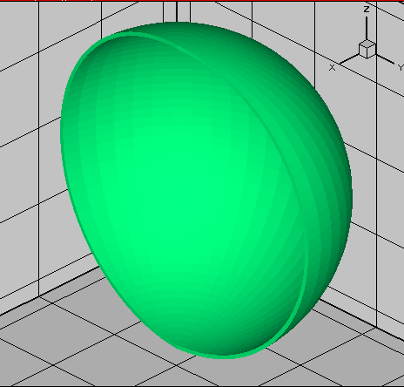

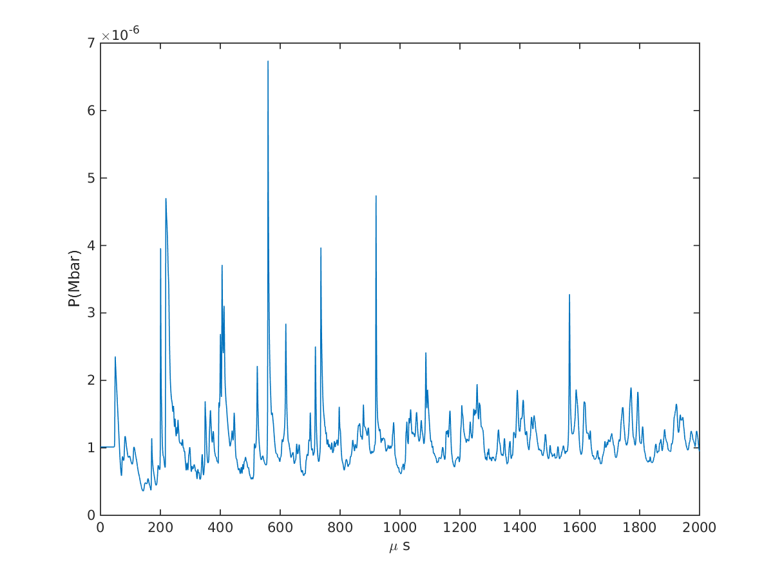
Problem having analytic solution for V&V code
Analytic period is 29.27µs
DCA with Δt=0.01µs, 29.28µs
vibration of a thin elastic shell (copper)
Notes:
This is a high frequency vibration which also has analytic solution. We did it many years ago to V&V our MPM cartablanca code. Recently I revisit the problem with pagosa, this is the results of pagaso simulation.
It is a spherical copper shell vibration. The pressure at the center is displaced here. I thought if I turn this signal to sound, I may get a music of copper bell, however, to my surprise it is an unpleasant noise.
Of course we also use experimental data for V&V our code.
High speed copper ball squeeze through a convergent channel, forming droplet after pass it,

Slide 7
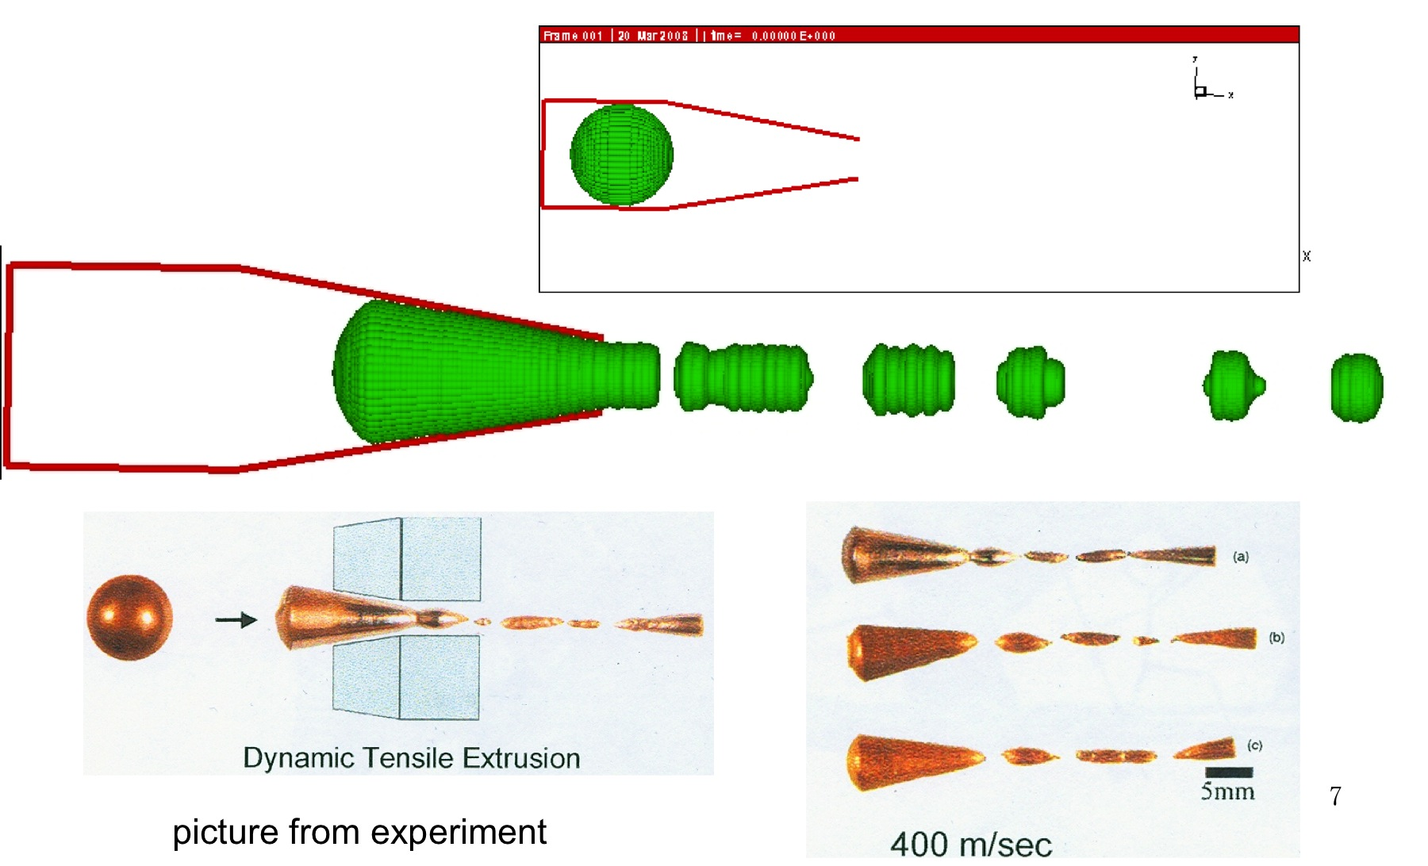
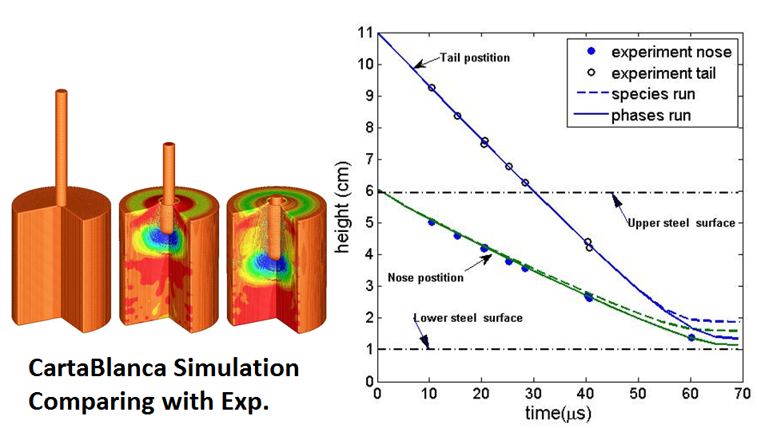
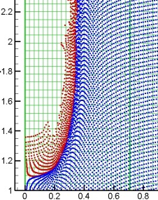
Problem with experimental data for V&V code
Analytic period is 29.27µs
simulation Δt=0.01µs, 29.28µs
Notes:
This is a high frequency vibration which also has analytic solution. We did it many years ago to V&V our MPM cartablanca code. Recently I revisit the problem with pagosa, this is the results of pagaso simulation.
It is a spherical copper shell vibration. The pressure at the center is displaced here. I thought if I turn this signal to sound, I may get a music of copper bell, however, to my surprise it is an unpleasant noise.
Of course we also use experimental data for V&V our code.
High speed copper ball squeeze through a convergent channel, forming droplet after pass it,

Slide 8
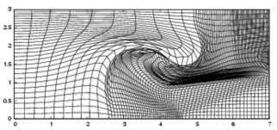
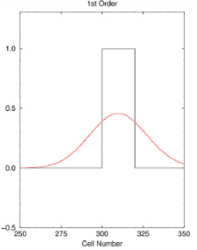
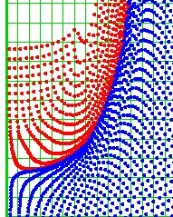
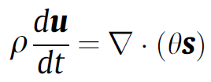
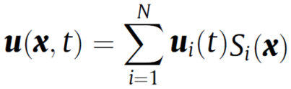
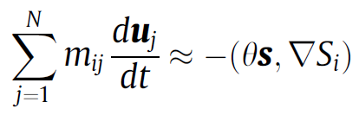
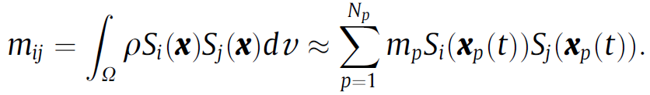
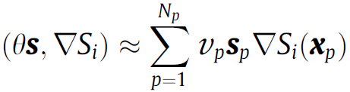
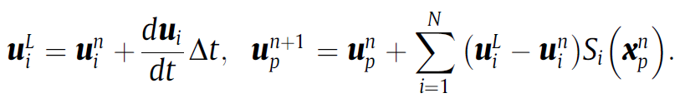
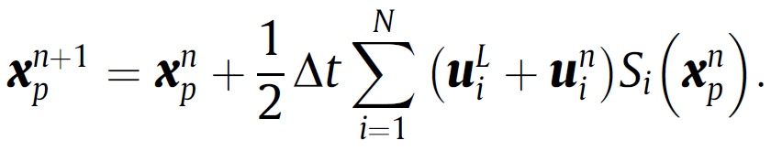
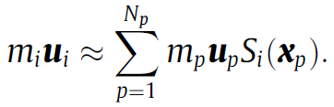
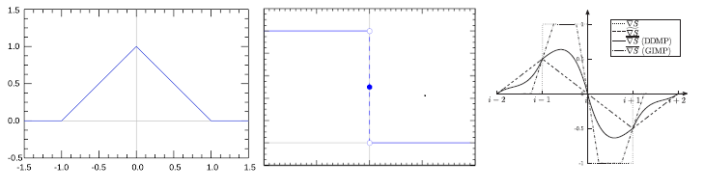
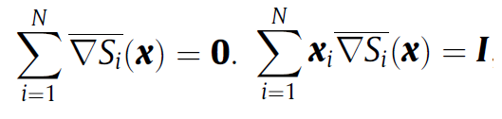



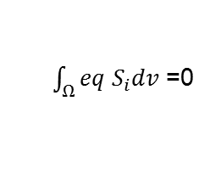
MPM in a nutshell
$\int_{Ω}^{ }{eq S_{i}dv }$=0
Discretizing as FEM
1.
2.
3.
DDMP new development by Zhang etc.
$$S$$
$$∇S$$
$$\overline{∇S }$$
Notes:
I think most of you are familiar with the Eulerian VOF, but not for MPM, so here is most brief introduction of MPM. Though MPM is not a strict ALE (Arbitrary Lagrangian Eulerian) method, but with its philosophy, since the moving particle is pretty much like the free moving mesh of ALE. Except it is particle, so no need to keep the connectivity or topology of a mesh, and also except the particle moves strictly Lagrangian. The philosophy, like ALE, is also to avoid the error of diffusivity in advection of Eulerian method, and to avoid the mesh tangling of Lagrangian method, and in addition to that, to track material interface and other discontinuity naturally and can trace material history effect. The method consist of a pure Eulerian fix mesh superimposed with a pure Lagrangian moving particle. The particle carries material property and its stress history. The governing equation is discretized like the Finite Element method.
The Gaussian points are replace with the particle in the integral of projection in seeking a weak solution, so that the discretization error is perpendicular to the trail space of the shape function.
First step is physical step or Lagrangian step, forces on the grid is computed from the stress carried by the particles, second step interpolating the grid quantities to particle and moving the particle, like the rezoning step in ALE, Third step, interpolating from particle to grid, like the remapping step in ALE. DDMP: two sets of shape function are used, they are equivalent in the integral sense, or in the weak solution, one is the old liner one which has a discontinuity in its derivative which results a jump force when particle crossing the grid line. But has a local support. The other one which is equivalent in the weak solution is has a continues derivative.
Both are used in different places depending on S or Del S is used. The error introduced by using a different shape function for S and Del S are within the weak solution descretization error, since they are equivalent in the weak solution sense and the advantage of DDMP mitigate the force jump when particle passing the grid line and also preserved the local support of the shape function.

Slide 9
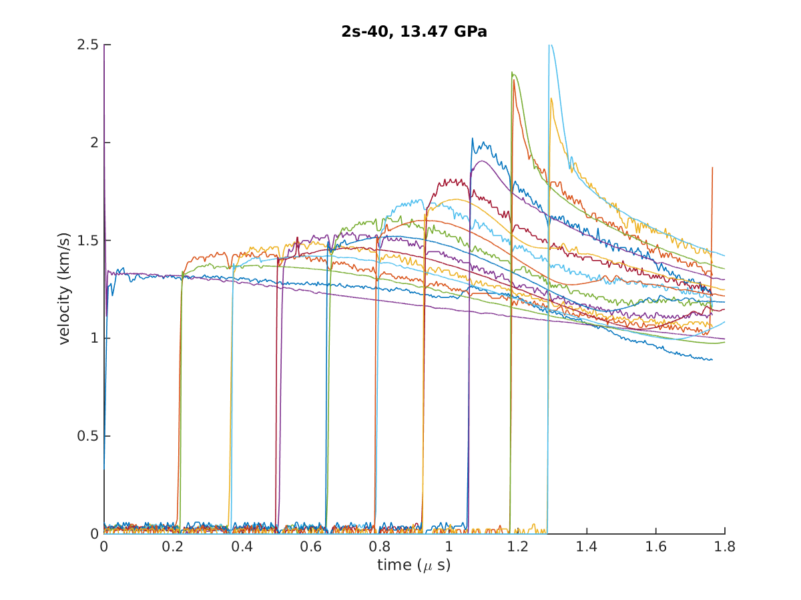
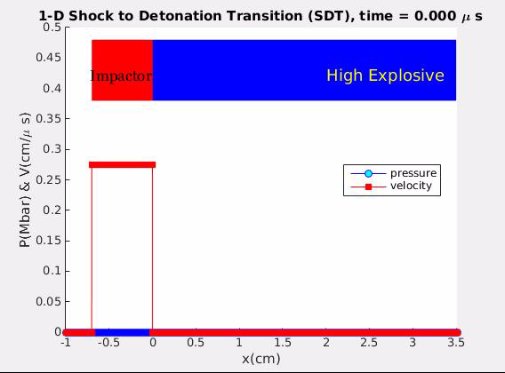
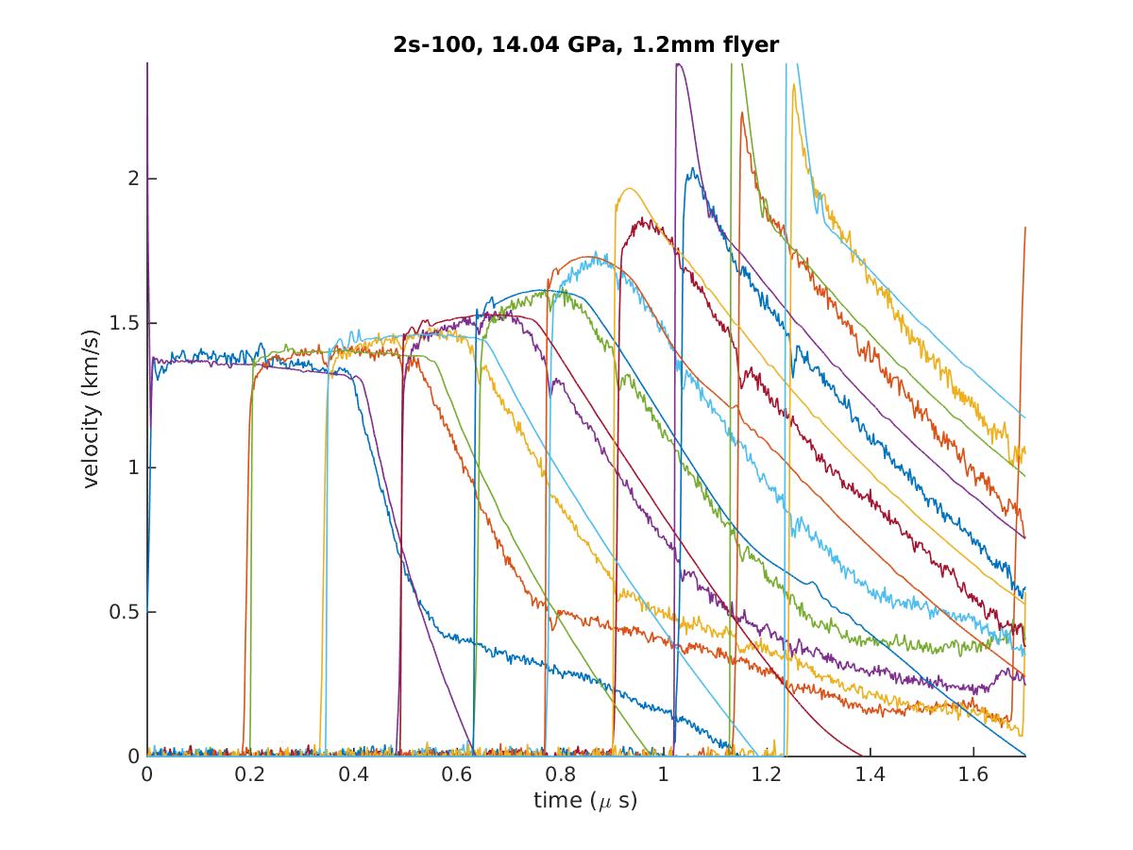
Empirical Modeling versus first principle simulation
Notes:
Right now I’m implementing the surf and JWL model to the MPM code cartablanca so that a very detailed comparison can be made for a canned explosive problem.
1D is done, Surf only has two free parameters (the others are usually with 10) tune and calibrate with the experiment and it can agree with a much border range of experimental data.
This is not the calibrated one, it agrees quite well.
There world is complicated, there are always special conditions that the first principle did not take into account.

Slide 10
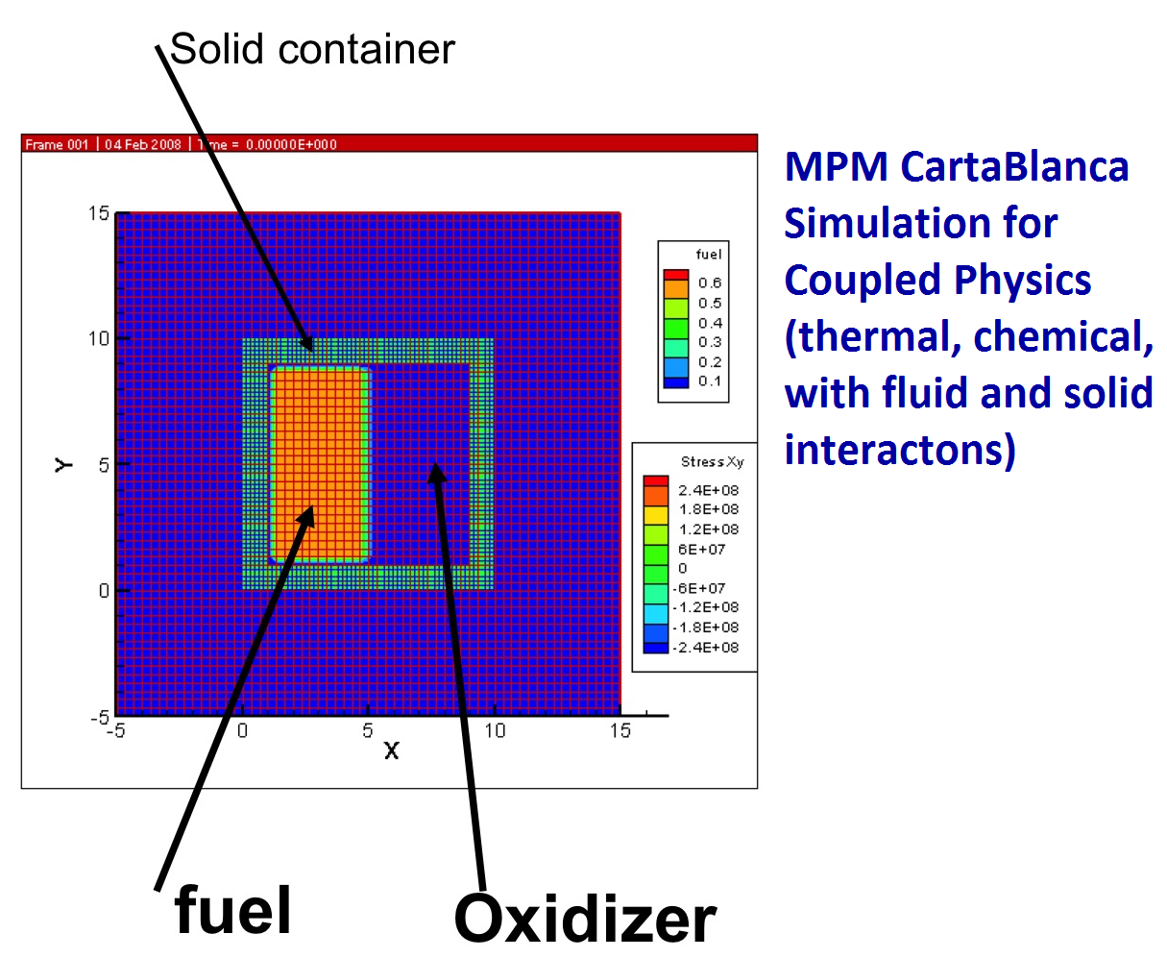
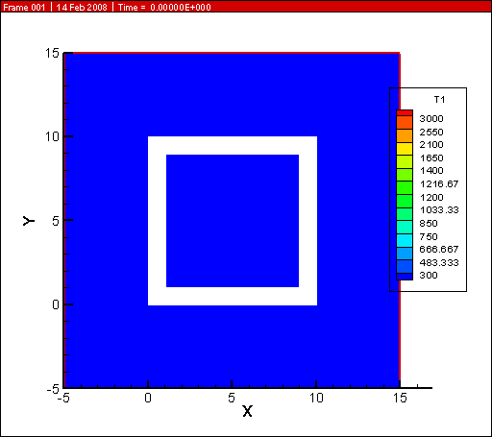
Empirical Modeling versus first principle simulation
Notes:
Right now I’m implementing the surf and JWL model to the MPM code cartablanca so that a very detailed comparison can be made for a canned explosive problem.
1D is done, Surf only has two free parameters (the others are usually with 10) tune and calibrate with the experiment and it can agree with a much border range of experimental data.
This is not the calibrated one, it agrees quite well.
There world is complicated, there are always special conditions that the first principle did not take into account.

Slide 11
Conclusions
The capabilities and limitations of predicting responses of multi-materials under extreme environment are reviewed.
Both CartaBlanca and Pagosa, developed by LANL using MPM and VOF respectively, have very powerful capabilities in modeling and simulation of multi-material impact.
Pagosa is very efficient in large 3-D parallel simulation of explosives.

